Slide 1
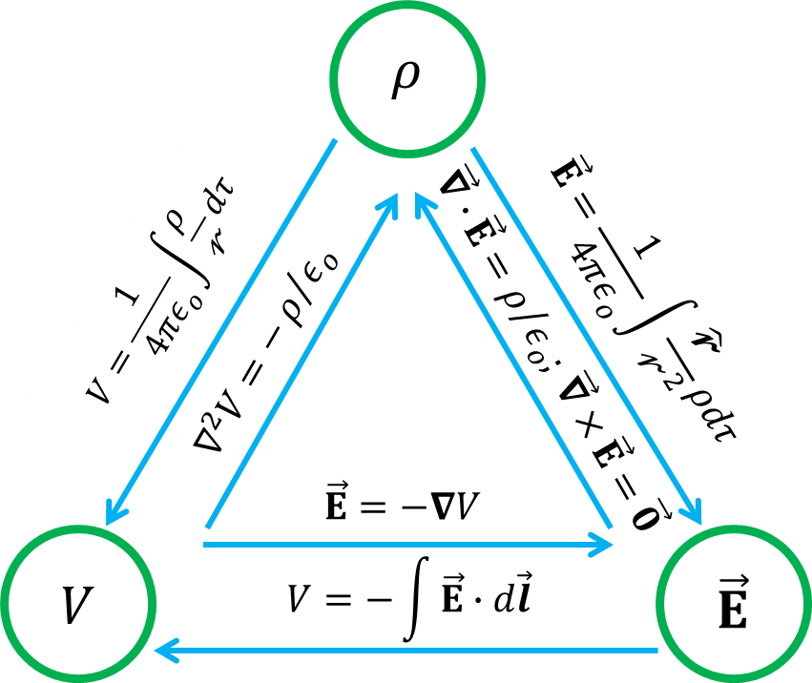
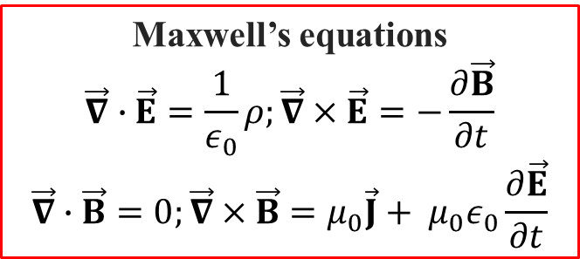
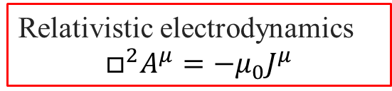
Electricity and Magnetism: Postscriptum
1
Electrostatics
Magnetostatics
Maxwell’s equations
$$\vec{∇}∙\vec{E}=\frac{1}{ε_{0}}ρ;\vec{∇}×\vec{E}=−\frac{∂\vec{B}}{∂t}$$
$$\vec{∇}∙\vec{B}=0;\vec{∇}×\vec{B}=μ_{0}\vec{J}+{{ μ}_{0}ε}_{0}\frac{∂\vec{E}}{∂t}$$
Conservation laws
Potentials and fields
Electromagnetic waves
Radiation
Relativistic electrodynamics
$$□^{2}A^{μ}=−μ_{0}J^{μ}$$
Notes:
1
350 slides of lecture notes

Slide 2
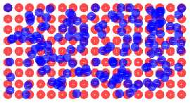
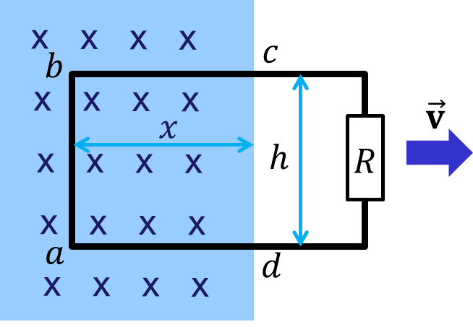
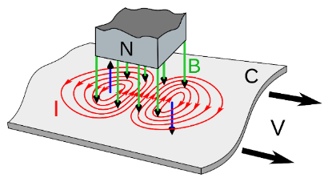
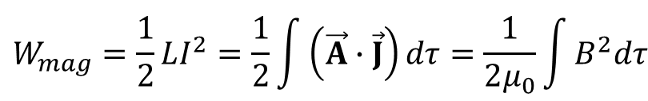

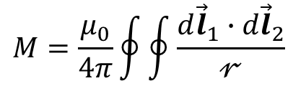
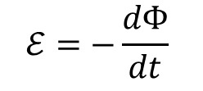
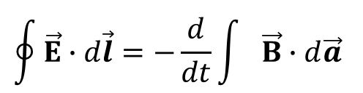
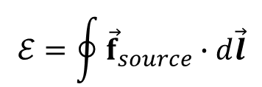
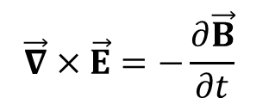

Recap Chapter 7: Electrodynamics
2
Ohm’s law
Electromotive force
Faraday’s flux rule and Lenz’s rule
Eddy currents
Faraday’s law
Inductance and mutual inductance
Energy of magnetic field
$$\vec{J}=σ\vec{E}$$
$$ℰ=\oint{{\vec{f}}_{source}∙d\vec{l}}$$
$$ℰ=−\frac{dΦ}{dt}$$
$$\vec{∇}×\vec{E}=−\frac{∂\vec{B}}{∂t}$$
$$\oint{\vec{E}∙d\vec{l}}=−\frac{d}{dt}\int{\vec{B}∙d\vec{a}}$$
$$M=\frac{μ_{0}}{4π}\oint{\oint{\frac{d{\vec{l}}_{1}∙d{\vec{l}}_{2}}{𝓇}}}$$
$$Φ_{2}=MI_{1}$$
$$W_{mag}=\frac{1}{2}LI^{2}=\frac{1}{2}\int{\left(\vec{A}∙\vec{J}\right)dτ}=\frac{1}{2μ_{0}}\int{B^{2}dτ}$$
Notes:
2
Electromotive force: work done per unit charge

Slide 3
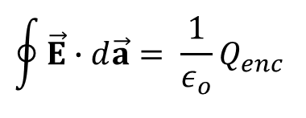
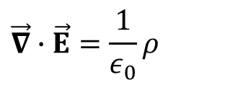
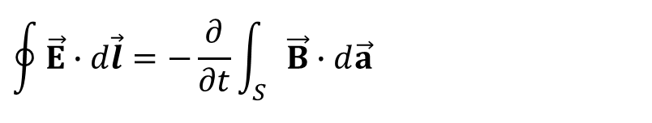
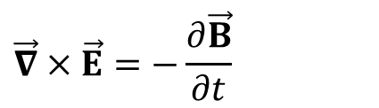
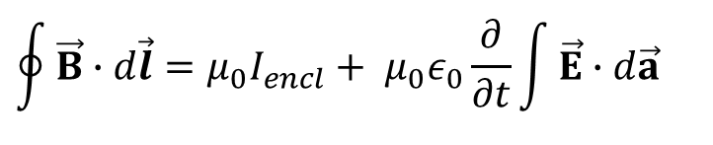
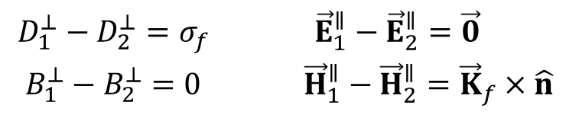
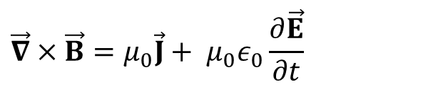
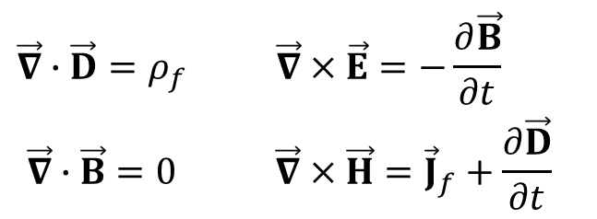

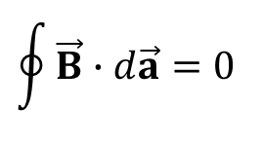
Recap Chapter 7: Electrodynamics
3
Maxwell’s equation in vacuum
$$\oint{\vec{E}∙d\vec{a}}= \frac{1}{ε_{o}}Q_{enc}^{}$$
$$\vec{∇}∙\vec{E}=\frac{1}{ε_{0}}ρ$$
Gauss’s law
No name
$$\oint{\vec{B}∙d\vec{a}}=0$$
$$\vec{∇}∙\vec{B}=0$$
$$\vec{∇}×\vec{E}=−\frac{∂\vec{B}}{∂t}$$
Faraday’s law
$$\oint{\vec{E}∙d\vec{l}}=−\frac{∂}{∂t}\int_{S}{\vec{B}∙d\vec{a}}$$
$$\vec{∇}×\vec{B}=μ_{0}\vec{J}+{{ μ}_{0}ε}_{0}\frac{∂\vec{E}}{∂t}$$
$$\oint{\vec{B}∙d\vec{l}}=μ_{0}I_{encl}+{{ μ}_{0}ε}_{0}\frac{∂}{∂t}\int{\vec{E}∙d\vec{a}}$$
Ampère-Maxwell’s law
Maxwell’s equations in matter
Boundary conditions
$$\begin{matrix}\vec{∇}∙\vec{D}=ρ_{f} & \vec{∇}×\vec{E}=−\frac{∂\vec{B}}{∂t} \\ \vec{∇}∙\vec{B}=0 & \vec{∇}×\vec{H}={\vec{J}}_{f}+\frac{∂\vec{D}}{∂t} \end{matrix}$$
$$\begin{matrix}D_{1}^{⊥}−D_{2}^{⊥}=σ_{f} & {\vec{E}}_{1}^{∥}−{\vec{E}}_{2}^{∥}=\vec{0} \\ B_{1}^{⊥}−B_{2}^{⊥}=0 & {\vec{H}}_{1}^{∥}−{\vec{H}}_{2}^{∥}={\vec{K}}_{f}×\hat{n}\end{matrix}$$

Slide 4
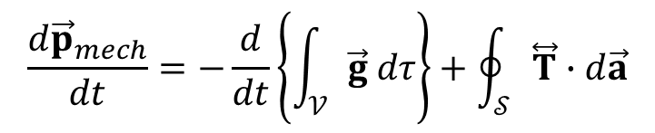
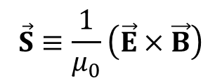

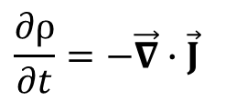
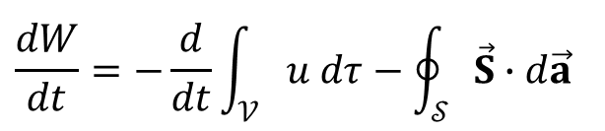
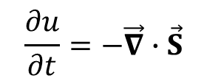
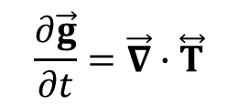
Chapter 8. Conservation Laws: Charge, Energy & Momentum
4
The continuity equation for charge
The Poynting theorem and Poynting’s vector
The continuity equation for energy
Conservation of momentum
Electromagnetic momentum density
The continuity equation for momentum
$$\frac{∂ρ}{∂t}=−\vec{∇}∙\vec{J}$$
$$\frac{dW}{dt}=−\frac{d}{dt}\int_{𝒱}{u dτ−\oint_{𝒮}{\vec{S}∙d\vec{a}}}$$
$$\vec{S}≡\frac{1}{μ_{0}}\left(\vec{E}×\vec{B}\right)$$
$$\frac{∂u}{∂t}=−\vec{∇}∙\vec{S}$$
$$\frac{d{\vec{p}}_{mech}}{dt}=−\frac{d}{dt}\left\{\int_{𝒱}{\vec{g} dτ}\right\}+\oint_{𝒮}{\overset{⃡}{T}∙d\vec{a}}$$
$$\vec{g}=ε_{0}μ_{0}\vec{S}=ε_{0}\left(\vec{E}×\vec{B}\right)$$
$$\frac{∂\vec{g}}{∂t}=\vec{∇}∙\overset{⃡}{T}$$
Notes:
4

Slide 5
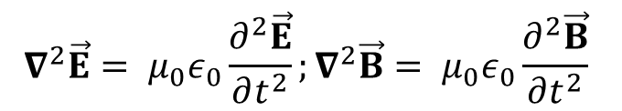
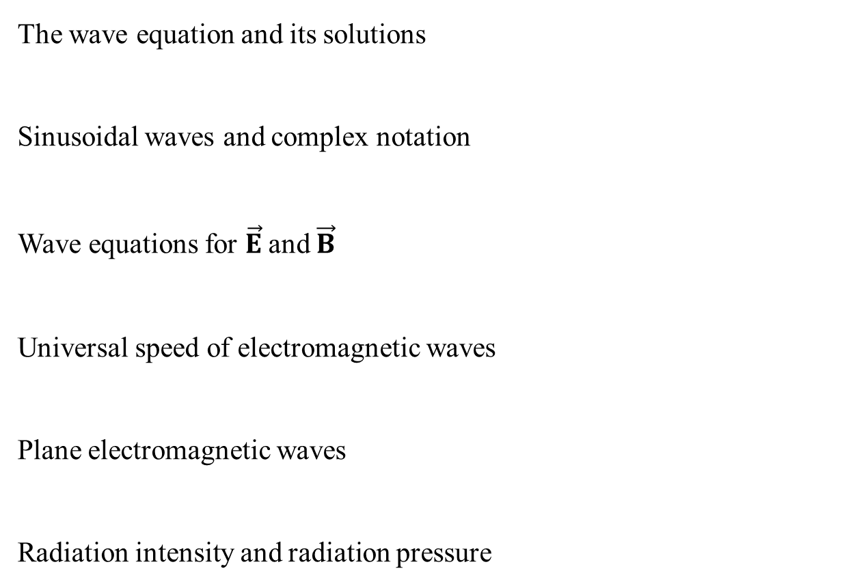
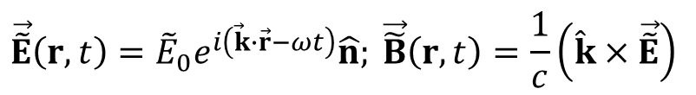

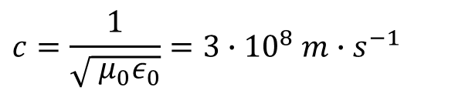

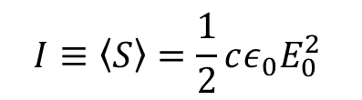

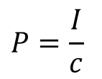
Chapter 9. Electromagnetic waves in vacuum
5
$$\frac{∂^{2}f}{∂z^{2}}=\frac{1}{v^{2}}\frac{∂^{2}f}{∂t^{2}}$$
The wave equation and its solutions
Sinusoidal waves and complex notation
Wave equations for $\vec{E}$and $\vec{B}$
Universal speed of electromagnetic waves
Plane electromagnetic waves
Radiation intensity and radiation pressure
$$f\left(z,t\right)=g\left(z−vt\right)+h\left(z+vt\right)$$
$⟹ ⟸$
$$\tilde{f}\left(z,t\right)=\tilde{A}e^{i\left(kz −ωt\right)}$$
$$∇^{2}\vec{E}={{ μ}_{0}ε}_{0}\frac{∂^{2}\vec{E}}{∂t^{2}};∇^{2}\vec{B}={{ μ}_{0}ε}_{0}\frac{∂^{2}\vec{B}}{∂t^{2}}$$
$$c=\frac{1}{\sqrt{{{ μ}_{0}ε}_{0}}}=3∙{10}^{8} m∙s^{−1}$$
$$\vec{\tilde{E}}\left(r,t\right)={\tilde{E}}_{0}e^{i\left(\vec{k}∙\vec{r}−ωt\right)}\hat{n}; \vec{\tilde{B}}\left(r,t\right)=\frac{1}{c}\left(\hat{k}×\vec{\tilde{E}}\right)$$
$$I≡\left\langle S\right\rangle =\frac{1}{2}cε_{0}E_{0}^{2}$$
$$P=\frac{I}{c}$$
Notes:
5

Slide 6


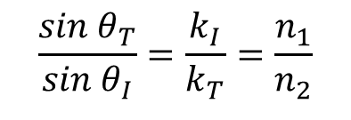
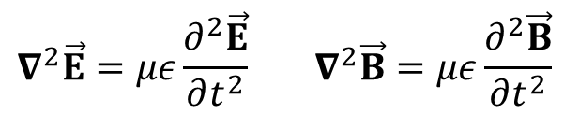
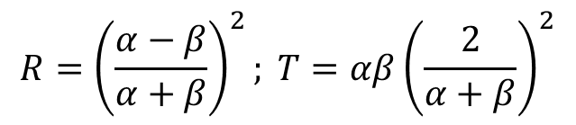
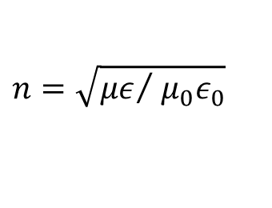
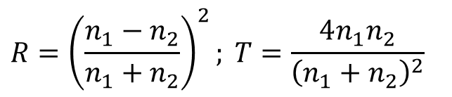
Chapter 9. Electromagnetic waves in matter
6
Wave equations in matter
The index of refraction
Reflection and transmission at normal incidence
Reflection and transmission at oblique incidence
Fresnel’s equations for parallel polarizations
Brewster's angle
Metamaterials. Optical tweezers
$$∇^{2}\vec{E}=με\frac{∂^{2}\vec{E}}{∂t^{2}} ∇^{2}\vec{B}=με\frac{∂^{2}\vec{B}}{∂t^{2}}$$
$$n=\sqrt{{με}/{{{ μ}_{0}ε}_{0}}}$$
$$R={\left(\frac{n_{1}−n_{2}}{n_{1}+n_{2}}\right)}^{2}; T=\frac{4n_{1}n_{2}}{{\left(n_{1}+n_{2}\right)}^{2}}$$
$$\frac{sin{ θ}_{T}}{sin{ θ}_{I}}=\frac{k_{I}}{k_{T}}=\frac{n_{1}}{n_{2}}$$
$$θ_{I}=θ_{R}$$
$$R={\left(\frac{α−β}{α+β}\right)}^{2}; T=αβ{\left(\frac{2}{α+β}\right)}^{2}$$
$$θ_{B}=atan\left({n_{2}}/{n_{1}}\right)$$
Notes:
6

Slide 7


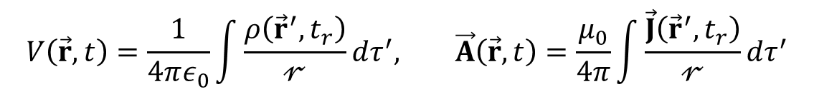
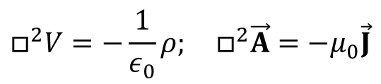
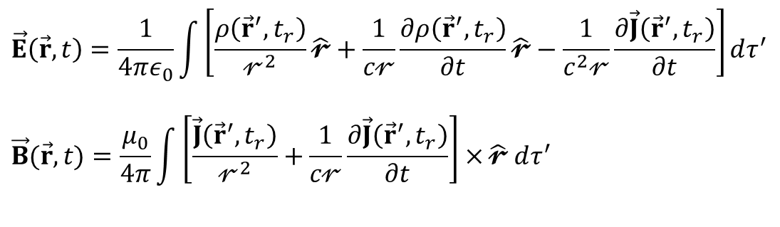
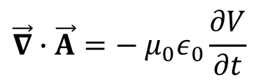



Chapter 10. Potentials and fields
7
Scalar and vector potentials
The Coulomb gauge and the Lorenz gauge
Inhomogeneous wave equations for V and $\vec{A}$
Retarded time
Retarded potentials
Jefimenko’s equation for $\vec{E}(\vec{r}$,t) and $\vec{B}(\vec{r},t)$
How slow is “slowly enough” in E&M?
$$\vec{B}=\vec{∇}×\vec{A}$$
$$\vec{E}=−∇V−\frac{∂\vec{A}}{∂t}$$
$$\vec{∇}∙\vec{A}=−{{ μ}_{0}ε}_{0}\frac{∂V}{∂t}$$
$$\vec{∇}∙\vec{A}=0$$
$$□^{2}V=−\frac{1}{ε_{0}}ρ; □^{2}\vec{A}=−μ_{0}\vec{J}$$
$$t_{r}≡t−\frac{𝓇}{c}$$
$$V\left(\vec{r},t\right)=\frac{1}{4πε_{0}}\int{\frac{ρ\left({\vec{r}}^{′},t_{r}\right)}{𝓇}}dτ^{′},{}^{}\vec{A}\left(\vec{r},t\right)=\frac{μ_{0}}{4π}\int{\frac{\vec{J}\left({\vec{r}}^{′},t_{r}\right)}{𝓇}}dτ^{′}$$
$$\vec{E}\left(\vec{r},t\right)=\frac{1}{4πε_{0}}\int{\left[\frac{ρ\left({\vec{r}}^{′},t_{r}\right)}{𝓇^{2}}\hat{𝓻}+\frac{1}{c𝓇}\frac{∂ρ\left({\vec{r}}^{′},t_{r}\right)}{∂t}\hat{𝓻}−\frac{1}{c^{2}𝓇}\frac{∂\vec{J}\left({\vec{r}}^{′},t_{r}\right)}{∂t}\right]}dτ^{′}$$
$$\vec{B}(\vec{r},t)=\frac{μ_{0}}{4π}\int{\left[\frac{\vec{J}\left({\vec{r}}^{′},t_{r}\right)}{𝓇^{2}}+\frac{1}{c𝓇}\frac{∂\vec{J}\left({\vec{r}}^{′},t_{r}\right)}{∂t}\right]×}\hat{𝓻} dτ^{′}$$
Notes:
7

Slide 8
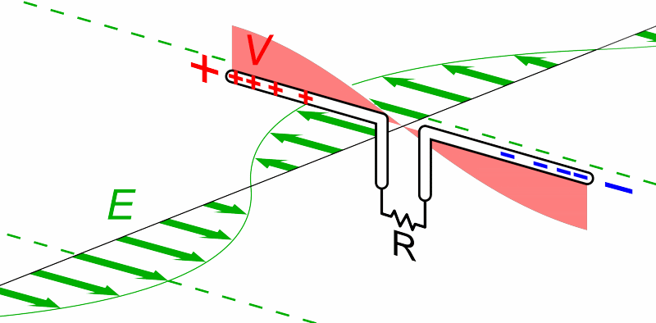
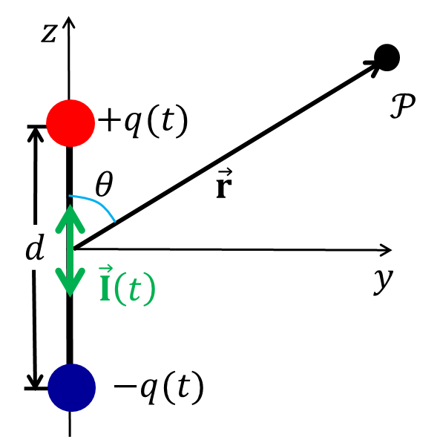
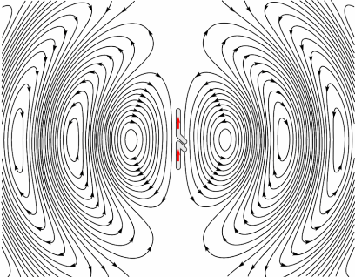
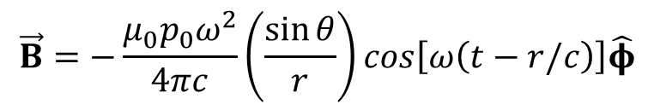

Chapter 11. Radiation
8
What is radiation?
Electric dipole radiation
EM field of the oscillating dipole
Properties of spherical waves
$$\vec{E}=−\frac{μ_{0}p_{0}ω^{2}}{4π}\left(\frac{\sin{θ}}{r}\right)cos\left[ω\left(t−r/c\right)\right] \hat{θ}$$
$$\vec{B}=−\frac{μ_{0}p_{0}ω^{2}}{4πc}\left(\frac{\sin{θ}}{r}\right)cos\left[ω\left(t−r/c\right)\right]\hat{φ}$$
Notes:
8

Slide 9






Chapter 11. Radiation
9
The radiated intensity
The radiated power
Why the sky is blue and polarized, and the sunset is red
Larmor formula and synchrotron radiation
Synchrotron radiation
$$\left\langle \vec{S}\right\rangle =\frac{μ_{0}p_{0}^{2}ω^{4}}{32π^{2}c}\left(\frac{\sin^{2}θ}{r^{2}}\right)\hat{r}$$
$$\left\langle P\right\rangle =\frac{μ_{0}p_{0}^{2}ω^{4}}{12πc}$$
$$P=\frac{μ_{0}q^{2}a^{2}}{6πc}$$
Notes:
9

Slide 10






Chapter 12. Electrodynamics and Relativity
10
Einstein’s postulates
How the EM fields transform
Special case I. $\vec{B}=\vec{0}$ in 𝒮
Special case II. $\vec{E}=\vec{0}$ in $𝒮$
EM field of a moving charge
$${{\overline{E}}_{x}=E}_{x}; {\overline{E}}_{y}=γ\left(E_{y}−vB_{z}\right); {\overline{E}}_{z}=γ\left(E_{z}+vB_{y}\right)$$
$${{\overline{B}}_{x}=B}_{x}; {\overline{B}}_{y}=γ\left(B_{y}+\frac{v}{c^{2}}E_{z}\right); {\overline{B}}_{z}=γ\left(B_{z}−\frac{v}{c^{2}}E_{y}\right)$$
$$\vec{\overline{B}}=−\frac{1}{c^{2}}\left(\vec{v}×\vec{\overline{E}}\right)$$
$$\vec{\overline{E}}=\vec{v}×\vec{\overline{B}}$$
$$\vec{E}=\frac{q}{4πε_{0}}\frac{1−{v^{2}}/{c^{2}}}{{\left[1−\left({v^{2}}/{c^{2}}\right)\sin^{2}θ\right]}^{3/2}}\frac{\hat{R}}{R^{2}};\vec{B}=\frac{1}{c^{2}}\left(\vec{v}×\vec{E}\right)$$
Notes:
10

Slide 11








Chapter 12. Electrodynamics and Relativity
11
The Lorentz transformation matrix $Λ_{ν}^{μ}$ and 4-vectors
The field tensor $F^{μν}$ and dual field tensor $G^{μν}$
Current density 4-vector
Maxwell's equations
Relativistic 4-vector potential
The field tensor and 4-vector potential
Relativistic formulation of Maxwell’s equations
$${\overline{x}}^{μ}=Λ_{ν}^{μ}x^{ν}$$
$$F^{μν}=\left\{\begin{matrix}\begin{matrix}0 & E_{x}/c \\ −E_{x}/c & 0\end{matrix} & \begin{matrix}E_{y}/c & E_{z}/c \\ B_{z} & −B_{y}\end{matrix} \\ \begin{matrix}−E_{y}/c & {−B}_{z} \\ −E_{z}/c & B_{y}\end{matrix} & \begin{matrix}0 & B_{x} \\ −B_{x} & 0\end{matrix}\end{matrix}\right\};G^{μν}=\left\{\begin{matrix}\begin{matrix}0 & B_{x} \\ −B_{x} & 0\end{matrix} & \begin{matrix}B_{y} & B_{z} \\ −E_{z}/c & E_{y}/c\end{matrix} \\ \begin{matrix}−B_{y} & E_{z}/c \\ −B_{z} & {−E}_{y}/c\end{matrix} & \begin{matrix}0 & −E_{x}/c \\ E_{x}/c & 0\end{matrix}\end{matrix}\right\}$$
$$J^{μ}=\left(cρ,{ J}_{x},{ J}_{y}, { J}_{z}\right)$$
$$\frac{∂F^{μν}}{∂x^{ν}}=μ_{0}J^{μ}; \frac{∂G^{μν}}{∂x^{ν}}=0$$
$$A^{μ}=\left(V/c, A_{x},A_{y},A_{z}\right)$$
$$F^{μν}=\frac{∂A^{ν}}{∂x_{μ}}−\frac{∂A^{μ}}{∂x_{ν}}$$
$$□^{2}A^{μ}=−μ_{0}J^{μ}$$
Notes:
11

Slide 12

Limitations of classical electrodynamics
12
Classical electrodynamics represents a classical field theory approximation of the fundamental theory of quantum electrodynamics
Some predictions of classical electrodynamics (e.g. lifetime of an atom) are simply not correct. Quantum mechanics is needed to account for materials properties
Quantum features, such as photon–photon scattering, quantum optics, quantum entanglement, quantum computing and quantum cryptography, are completely missed
All charges considered by classical electrodynamics are point charges which leads to the infinite field energy of a point charge. Classical electrodynamics does not account for “internal” structure of charges; it fails at the spatial scale shorter than ~1 fm (size of proton)
Nevertheless, in many situations deviations from classical electrodynamics are immeasurably small so it still remains – after 150 years of discovery – a very useful theory!
Notes:
12

