Slide 1
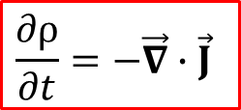
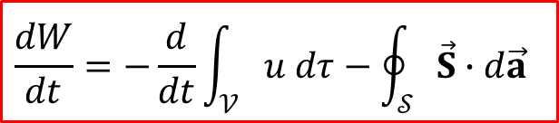
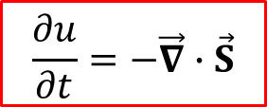
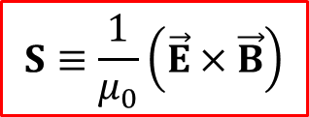
½ Lecture 22. Conservation Laws: Charge and Energy
1
Chapters 8.1, 8.2 except 8.2.4
What you should learn:
1. The continuity equation for charge
2. The Poynting theorem and Poynting’s vector
3. The continuity equation for energy
$$\frac{∂ρ}{∂t}=−\vec{∇}∙\vec{J}$$
$$\frac{dW}{dt}=−\frac{d}{dt}\int_{𝒱}{u dτ−\oint_{𝒮}{\vec{S}∙d\vec{a}}}$$
$$S≡\frac{1}{μ_{0}}\left(\vec{E}×\vec{B}\right)$$
$$\frac{∂u}{∂t}=−\vec{∇}∙\vec{S}$$
This lecture could be given in a shorter (~5-10 mins) time
Notes:
1

Slide 2
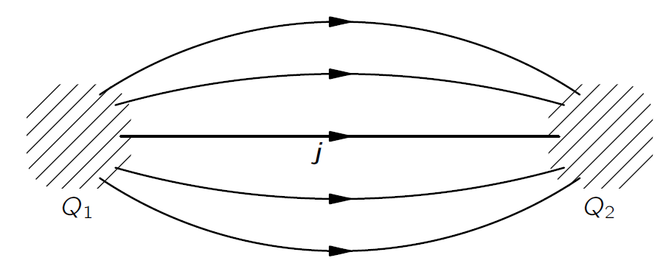
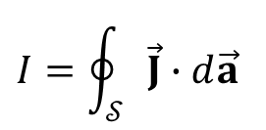

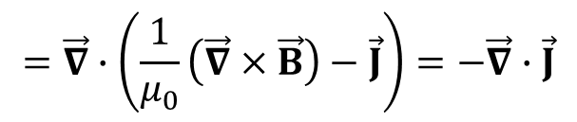
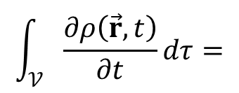
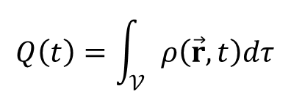

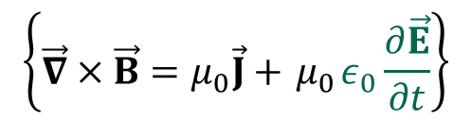
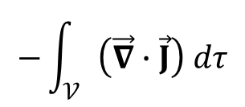


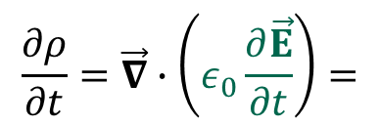

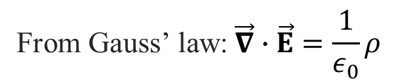

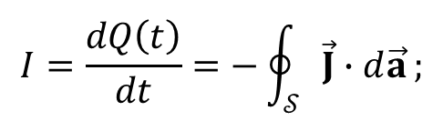

Conservation of charge: the continuity equation
2
Global conservation of charge: the total charge in the universe is constant
Local conservation of charge: if the charge in some region changes, then exactly that amount of charge must have passed in or out through the surface
$$𝒮$$
$$Q\left(t\right)=\int_{𝒱}{ρ\left(\vec{r},t\right)dτ}$$
$$\vec{J}$$
The charge in a volume $𝒱$is
$$I=\oint_{𝒮}{\vec{J}∙d\vec{a}}$$
$$ρ$$
The current flowing out through the boundary $𝒮$ is:
$$d\vec{a}$$
div theorem
$$I=\frac{dQ\left(t\right)}{dt}=−\oint_{𝒮}{\vec{J}∙d\vec{a}};$$
$$\int_{𝒱}{\frac{∂ρ\left(\vec{r},t\right)}{∂t}dτ}=$$
$$−\int_{𝒱}{\left(\vec{∇}∙\vec{J}\right) dτ}$$
$$𝒱$$
$$\frac{∂ρ}{∂t}=−\vec{∇}∙\vec{J}$$
the continuity equation
$$\text{From} \text{Gauss}\text{’ }\text{law}\text{:} \vec{∇}∙\vec{E}=\frac{1}{ε_{0}}ρ$$
Conservation of charge is not an independent assumption!
$$\frac{∂ρ}{∂t}=\vec{∇}∙\left(ε_{0}\frac{∂\vec{E}}{∂t}\right)=$$
$$\left\{\vec{∇}×\vec{B}=μ_{0}\vec{J}+{ μ}_{0}ε_{0}\frac{∂\vec{E}}{∂t}\right\}$$
$$=\vec{∇}∙\left(\frac{1}{μ_{0}}\left(\vec{∇}×\vec{B}\right)−\vec{J}\right)=−\vec{∇}∙\vec{J}$$
Note the importance of Maxwell’s term!
This also tells us that $ρ$ and $\vec{J}$ cannot be any functions!
The purpose of the next two lectures is to develop the corresponding equations for local conservation of energy and momentum
Notes:
2
NOTE: the derivation was done in Part I

Slide 3


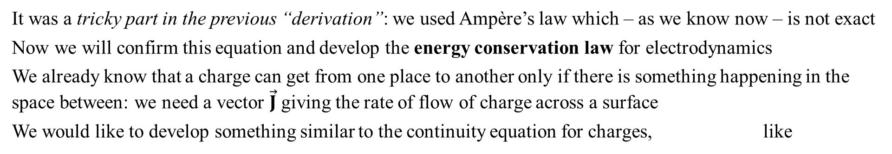
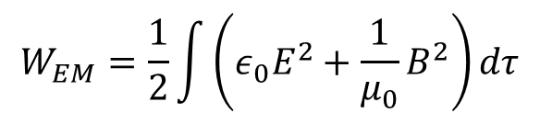
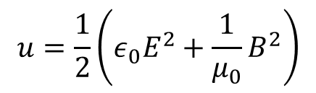

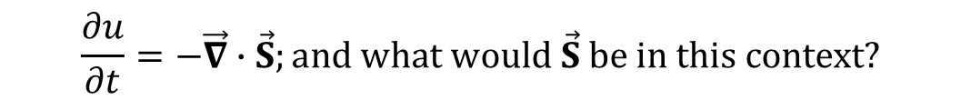
Electric and magnetic energy
3
$$W_{elec}=\frac{ε_{0}}{2}\int{E^{2}dτ}$$
The total energy stored in electric field:
$$W_{mag}=\frac{1}{2μ_{0}}\int{B^{2}dτ}$$
The total energy stored in magnetic field:
$$W_{EM}=\frac{1}{2}\int{\left({ε_{0}E}^{2}+{\frac{1}{μ_{0}}B}^{2}\right)dτ}$$
The total energy stored in electromagnetic fields:
Units = [J]
The total energy stored in electromagnetic fields, per unit volume (aka energy density):
$$u=\frac{1}{2}\left({ε_{0}E}^{2}+{\frac{1}{μ_{0}}B}^{2}\right)$$
Units = [J/m³]
It was a tricky part in the previous “derivation”: we used Ampère’s law which – as we know now – is not exact
Now we will confirm this equation and develop the energy conservation law for electrodynamics
We already know that a charge can get from one place to another only if there is something happening in the space between: we need a vector $\vec{J}$ giving the rate of flow of charge across a surface
We would like to develop something similar to the continuity equation for charges, like
$$\frac{∂ρ}{∂t}=−\vec{∇}∙\vec{J}$$
$$\frac{∂u}{∂t}=−\vec{∇}∙\vec{S};and what would \vec{S} be in this context?$$
Notes:
3

Slide 4
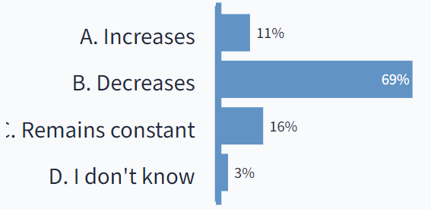


Question 2: PollEv.com/2023mp
4
Two charges (1 positive, 1 negative) are placed at a mutual distance R from each other. At time t₀ one releases these charges. The two charges accelerate toward each other as a result of the Coulomb attraction. As the charges approach each other, the energy contained in the electric field surrounding the two charges:
Answer
A. increases
B. decreases
C. remains constant
D. ??
+Q
$$\vec{v}$$
$$\vec{v}$$
-Q
Answer B
Use energy conservation: kinetic energy increases, therefore, the energy contained in the electric field must decrease
PollEv.com/2023mp, Lecture 22
Notes:
4

Slide 5
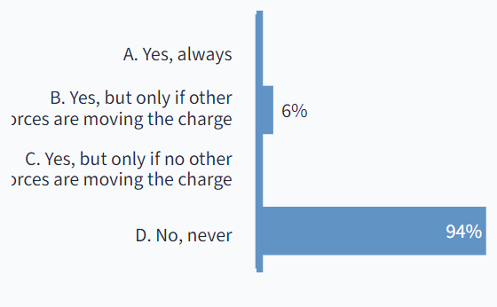








Question 3: PollEv.com/2023mp
5
Can the force from a magnetic field do work on a charge?
Answer
A Yes, always
B Yes, but only if other forces are moving the charge
C Yes, but only if no other forces are moving the charge
D No, never
+Q
v
$$\vec{v}$$
$$\vec{B}$$
Answer D
$$d\vec{l}$$
$$dW=\vec{F}∙d\vec{l}$$
$$=q\left(\vec{v}×\vec{B}\right)∙\vec{v} dt$$
$$\left(\vec{v}×\vec{B}\right)∙\vec{v}=\vec{v}∙\left(\vec{v}×\vec{B}\right)=$$
$$\vec{B}∙\left(\vec{v}×\vec{v}\right)≡0$$
$$Rule 1:\vec{A}∙\left(\vec{B}×\vec{C}\right)=\vec{C}∙\left(\vec{A}×\vec{B}\right)$$
Magnetic forces do not work !
PollEv.com/2023mp, Lecture 22
Notes:
5

Slide 6



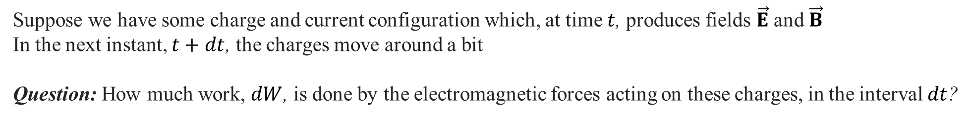
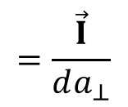
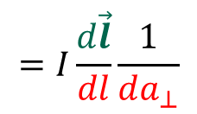
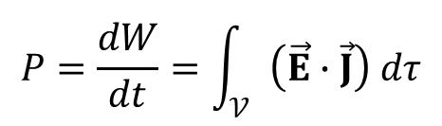

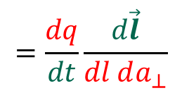
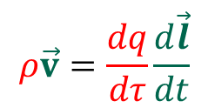
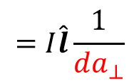


Moving charges requires energy
6
Suppose we have some charge and current configuration which, at time $t$, produces fields $\vec{E}$ and $\vec{B}$
In the next instant, $t+dt$, the charges move around a bit
Question: How much work, $dW$, is done by the electromagnetic forces acting on these charges, in the interval $dt$?
$$d\vec{l}$$
Work done on a charge $q$ in time $dt$ is:
$$dW=\vec{F}∙d\vec{l}=q\left(\vec{E}+\vec{v}×\vec{B}\right)∙\vec{v} dt$$
Magnetic forces do not work:
$$\left(\vec{v}×\vec{B}\right)∙\vec{v}=\vec{v}∙\left(\vec{v}×\vec{B}\right)=\vec{B}∙\left(\vec{v}×\vec{v}\right)≡0$$
$$Rule 1:\vec{A}∙\left(\vec{B}×\vec{C}\right)=\vec{C}∙\left(\vec{A}×\vec{B}\right)$$
$$dW=q\vec{E}∙\vec{v} dt=\left\{q=ρ dτ\right\}=\vec{E}∙ρ\vec{v} dt dτ$$
$$ρ\vec{v}=\frac{dq}{dτ}\frac{d\vec{l}}{dt}$$
$$=\frac{dq}{dt}\frac{d\vec{l}}{dl da_{⊥}}$$
$$=I\frac{d\vec{l}}{dl}\frac{1}{da_{⊥}}$$
$$=I\hat{l}\frac{1}{da_{⊥}}$$
$$=\frac{\vec{I}}{da_{⊥}}$$
$$=\vec{J}$$
$$dW=\vec{E}∙\vec{J} dt dτ$$
$$P=\frac{dW}{dt}=\int_{𝒱}{\left(\vec{E}∙\vec{J}\right) dτ}$$
The rate at which work is done (i.e. power) on all charges in $𝒱$:
$\left(\vec{E}∙\vec{J}\right)$ is the work done per unit time, per unit volume - which is the power delivered per unit volume
Notes:
6
Note $P=\frac{dW}{dt}=\int_{𝒱}{\left(E∙J\right) dτ}$ at the side of blackboard!

Slide 7
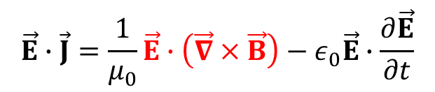

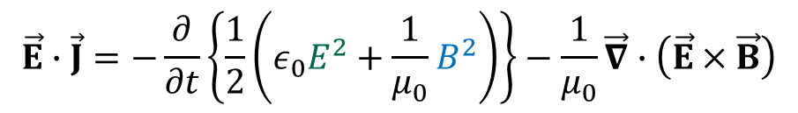
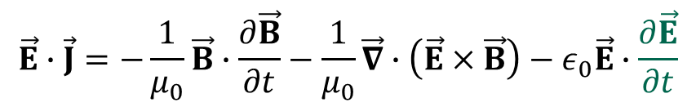
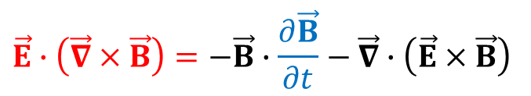
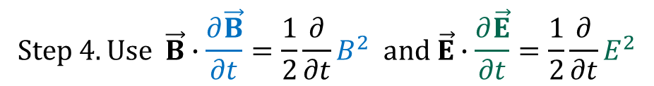

Four steps
7
Route: express $\left(\vec{E}∙\vec{J}\right)$ in terms of the fields alone (Homework: Griffiths, p.358)
$$\text{Step} \text{1. }\text{Use} \text{Amp}\text{è}\text{re}\text{−}\text{Maxwell}\text{’}\text{s} \text{law} \vec{∇}×\vec{B}=μ_{0}\vec{J}+{ μ}_{0}ε_{0}\frac{∂\vec{E}}{∂t}\text{to} \text{eliminate} \vec{J}=\frac{1}{μ_{0}}\vec{∇}×\vec{B}−ε_{0}\frac{∂\vec{E}}{∂t}$$
$$\vec{E}∙\vec{J}=\frac{1}{μ_{0}}\vec{E}∙\left(\vec{∇}×\vec{B}\right)−ε_{0}\vec{E}∙\frac{∂\vec{E}}{∂t}$$
Step 2. Use product Rule #6 to express $\vec{E}∙\left(\vec{∇}×\vec{B}\right) (in Rule \#6, \vec{A}≡\vec{E})$:
$$\vec{∇}∙\left(\vec{E}×\vec{B}\right)=\vec{B}∙\left(\vec{∇}×\vec{E}\right)−\vec{E}∙\left(\vec{∇}×\vec{B}\right)$$
$$⇒\vec{E}∙\left(\vec{∇}×\vec{B}\right)=\vec{B}∙\left(\vec{∇}×\vec{E}\right)−\vec{∇}∙\left(\vec{E}×\vec{B}\right)$$
$$\vec{∇}×\vec{E}=−\frac{∂\vec{B}}{∂t}$$
Step 3. Use Faraday's law to express $\vec{∇}×\vec{E}$:
$$\vec{E}∙\left(\vec{∇}×\vec{B}\right)=−\vec{B}∙\frac{∂\vec{B}}{∂t}−\vec{∇}∙\left(\vec{E}×\vec{B}\right)$$
$$\vec{E}∙\vec{J}=−\frac{1}{μ_{0}}\vec{B}∙\frac{∂\vec{B}}{∂t}−\frac{1}{μ_{0}}\vec{∇}∙\left(\vec{E}×\vec{B}\right)−ε_{0}\vec{E}∙\frac{∂\vec{E}}{∂t}$$
$$Step 4. Use \vec{B}∙\frac{∂\vec{B}}{∂t}=\frac{1}{2}\frac{∂}{∂t}B^{2} and \vec{E}∙\frac{∂\vec{E}}{∂t}=\frac{1}{2}\frac{∂}{∂t}E^{2}$$
(VERY useful trick! Memorize!)
$$\vec{E}∙\vec{J}=−\frac{∂}{∂t}\left\{\frac{1}{2}\left(ε_{0}E^{2}+\frac{1}{μ_{0}}B^{2}\right)\right\}−\frac{1}{μ_{0}}\vec{∇}∙\left(\vec{E}×\vec{B}\right)$$
Notes:
7
$\frac{dW}{dt}=\int_{𝒱}{\left(E∙J\right) dτ}$ stands at the side of the blackboard

Slide 8
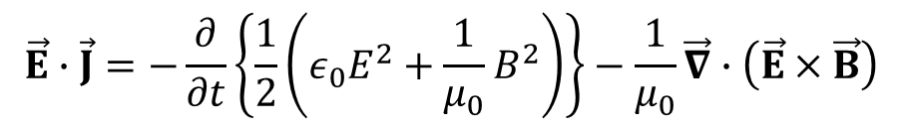

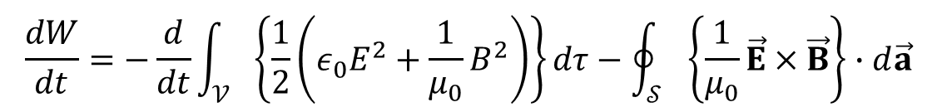
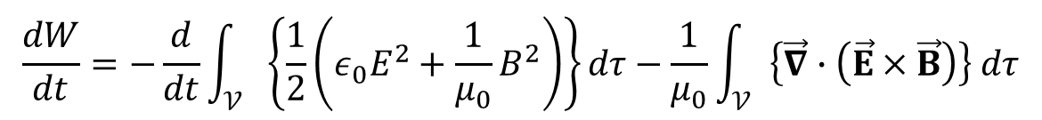
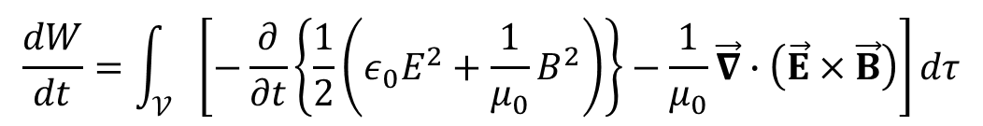
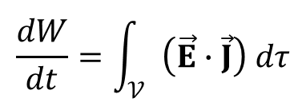
The fifth step
8
$$\vec{E}∙\vec{J}=−\frac{∂}{∂t}\left\{\frac{1}{2}\left({ε_{0}E}^{2}+{\frac{1}{μ_{0}}B}^{2}\right)\right\}−\frac{1}{μ_{0}}\vec{∇}∙\left(\vec{E}×\vec{B}\right)$$
From the previous slide:
- the power delivered per unit volume
$$\frac{dW}{dt}=\int_{𝒱}{\left(\vec{E}∙\vec{J}\right) dτ}$$
Work $W$done on all the charges in a volume $𝒱$:
$$\frac{dW}{dt}=\int_{𝒱}{\left[−\frac{∂}{∂t}\left\{\frac{1}{2}\left({ε_{0}E}^{2}+{\frac{1}{μ_{0}}B}^{2}\right)\right\}−\frac{1}{μ_{0}}\vec{∇}∙\left(\vec{E}×\vec{B}\right)\right]dτ}$$
$$\frac{dW}{dt}=−\frac{d}{dt}\int_{𝒱}{\left\{\frac{1}{2}\left({ε_{0}E}^{2}+{\frac{1}{μ_{0}}B}^{2}\right)\right\}dτ−\frac{1}{μ_{0}}\int_{𝒱}{\left\{\vec{∇}∙\left(\vec{E}×\vec{B}\right)\right\} dτ}}$$
Divergence theorem
$$\frac{dW}{dt}=−\frac{d}{dt}\int_{𝒱}{\left\{\frac{1}{2}\left({ε_{0}E}^{2}+{\frac{1}{μ_{0}}B}^{2}\right)\right\}dτ−\oint_{𝒮}{\left\{\frac{1}{μ_{0}}\vec{E}×\vec{B}\right\}∙d\vec{a}}}$$
Notes:
8
$\left(\vec{E}∙\vec{J}\right)$ is the power delivered per unit volume
$\frac{dW}{dt}=\int_{𝒱}{\left(E∙J\right) dτ}$ stands at the side of the balckboard

Slide 9
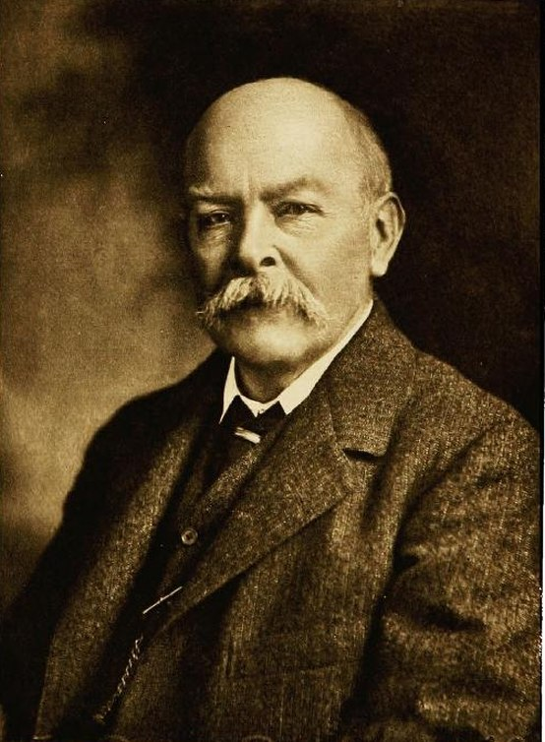
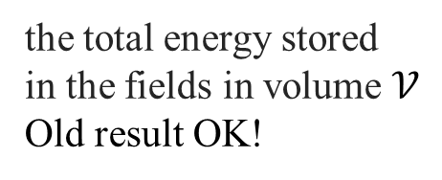

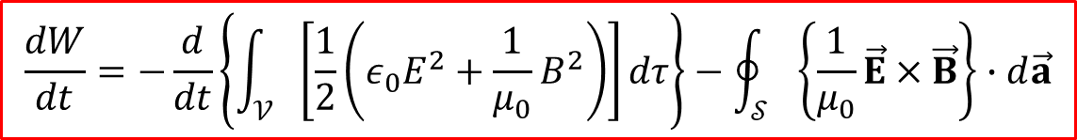
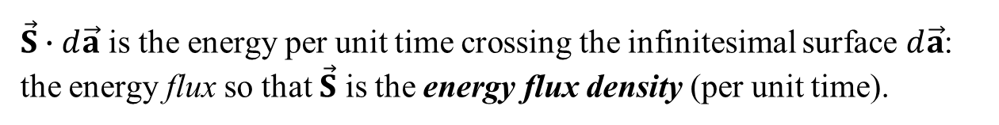
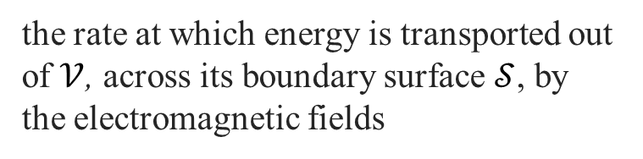
Poynting’s theorem
9
$$\frac{dW}{dt}=−\frac{d}{dt}\left\{\int_{𝒱}{\left[\frac{1}{2}\left({ε_{0}E}^{2}+{\frac{1}{μ_{0}}B}^{2}\right)\right]dτ}\right\}−\oint_{𝒮}{\left\{\frac{1}{μ_{0}}\vec{E}×\vec{B}\right\}∙d\vec{a}}$$
The rate at which the work done on the charges by the electromagnetic force
the total energy stored
in the fields in volume $𝒱$
Old result OK!
the rate at which energy is transported out of $𝒱$, across its boundary surface $𝒮$, by the electromagnetic fields
Poynting’s theorem: The work done on the charges by the electromagnetic force is equal to the decrease in energy remaining in the fields, less the energy that flowed out through the surface
The Poynting vector: the energy per unit time, per unit area, transported by the fields
$$\vec{S}≡\frac{1}{μ_{0}}\left(\vec{E}×\vec{B}\right)$$
Unit = [W/m²]
$\vec{S}∙d\vec{a}$ is the energy per unit time crossing the infinitesimal surface $d\vec{a}$:
the energy flux so that $\vec{S}$ is the energy flux density (per unit time).
Derived by John Henry Poynting (in 1884) and Nikolay Umov (in 1874)
John Henry Poynting
(1852–1914)
Notes:
9
In the late 1870s Poynting worked in the Cavendish Laboratory at Cambridge under James Clerk Maxwell.[ In 1880, he became the first professor of physics at the University of Birmingham. Poynting and the Nobel prizewinner J. J. Thomson (who discovered the electron) co-authored a multi-volume undergraduate physics textbook, which was in print for about 50 years.
Umov graduated from the Physics and Mathematics department of Moscow State University in 1867. In 1873—1874 гг he developed a fundamental theory of energy flux which was presented in his thesis “Equation of energy flux in bodies” (1874). Umov’s theory was not easily accepted by the scientific community: his defense at Moscow state U lasted for 6 hours and was a close shave from failing. Umov was appointed professor at Novorossijsk U (Odessa) in 1871-1893.

Slide 10
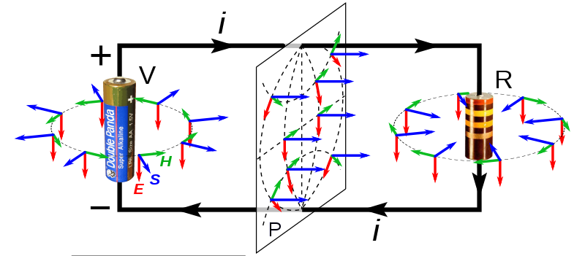


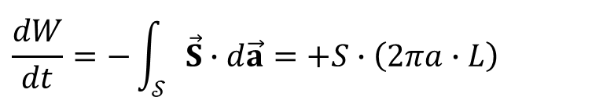
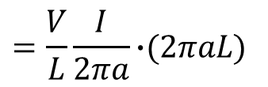
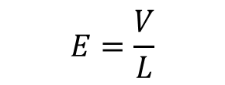





Griffiths, Example 8.1
10
When current flows down a wire, work is done, which shows up as Joule heating of the wire (Eq. 7.7).
Calculate the energy per unit time delivered to the wire using the Poynting vector
The electric field is parallel to the wire
$$\vec{E}$$
$$E=\frac{V}{L}$$
$$\vec{S}$$
The magnetic field is "circumferential"; at the surface it has the value
$$\vec{B}$$
$$B=\frac{μ_{0}I}{2πa}$$
$$S=\frac{1}{μ_{0}}EB=\frac{1}{μ_{0}}\frac{V}{L}\frac{μ_{0}I}{2πa}=\frac{V}{L}\frac{I}{2πa}$$
energy per unit time, per unit area
The magnitude of the Poynting vector
Direction: inward (to the center)
because $\vec{S}↑↓\vec{a}$
perimeter
length
$$\frac{dW}{dt}=−\int_{𝒮}{\vec{S}∙d\vec{a}}=+S∙\left(2πa∙L\right)$$
The energy per unit time passing in through the surface of the wire
$$=\frac{V}{L}\frac{I}{2πa}\text{∙}\text{(}\text{2}\text{π}\text{aL}\text{)}$$
area
That is, Joule’s heating law follows from Maxwell’s equations!
$$=VI$$
So the electrons are getting their energy to generate heat because of the energy flowing into the wire from the field outside! Think about it… or watch https://www.youtube.com/watch?v=69laQk6XRgc
Notes:
10
No you might understand why Umov’s PhD defense took THAT long…

Slide 11










The “continuity” equation for energy
11
$$\frac{dW}{dt}=−\frac{d}{dt}\int_{𝒱}{u dτ−\oint_{𝒮}{\vec{S}∙d\vec{a}}}$$
The Poynting theorem:
$$u=\frac{1}{2}\left({ε_{0}E}^{2}+{\frac{1}{μ_{0}}B}^{2}\right)$$
$$\vec{S}≡\frac{1}{μ_{0}}\left(\vec{E}×\vec{B}\right)$$
$$Energy density:$$
The Poynting vector:
$$\frac{dW}{dt}=0$$
If no work is done on the charges in 𝒱 − if we are in a region of space where there is no charge:
$$\int_{𝒱}{\frac{∂u}{∂t}dτ=−\oint_{𝒮}{\vec{S}∙d\vec{a}}}$$
$$=−\int_{𝒱}{\left(\vec{∇}∙\vec{S}\right) dτ}$$
$$\text{div} \text{theorem}$$
$$\frac{∂u}{∂t}=−\vec{∇}∙\vec{S}$$
Compare with charge conservation
$$\frac{∂ρ}{∂t}=−\vec{∇}∙\vec{J}$$
This is the "continuity equation" for energy. It expresses local conservation of electromagnetic energy
In general, though, electromagnetic energy by itself is not conserved (nor is the energy of the charges) Energy is tossed back and forth between the fields and the charges
Next: What about forces and momentum?
Notes:
11

Slide 12




Question 1: PollEv.com/2023mp
12
A bar magnet is dropped down a vertical copper pipe of slightly larger diameter, about 1 meter long (copper is non-magnetic but highly conductive). How long does it take for it to reach the bottom, as compared to an identical magnet in a non-conductive pipe?
Answer
A. Shorter
B. Longer
C. About the same
Answer B
A “ring” of pipe just below the magnet experiences an increasing upward flux as the magnet approaches, and hence a current $I_{ind}$)will flow in the direction for which the flux it would produce opposes the change (Lenz law). A ring just above the magnet experiences a decreasing flux, so its induced current is such to attract the magnet upward.
Conclusion: the delay is due to the forces exerted on the magnet by induced eddy currents in the pipe
PollEv.com/2023mp, Lecture 22
Notes:
12

Slide 13




Lecture 23: Conservation Laws: Momentum
13
What you should learn:
1. Electromagnetic force
2. Maxwell stress tensor
3. Electromagnetic force via Maxwell’s stress tensor
4. Electromagnetic momentum density
5. Conservation of momentum
Chapters 8.2 except 8.2.4
$$\vec{f}=ε_{0}\left[\left(∇∙\vec{E}\right)\vec{E}+\left(\vec{E}∙∇\right)\vec{E}−\frac{1}{2}∇\left(E^{2}\right)\right]+\frac{1}{{ μ}_{0}}\left[\left(∇∙\vec{B}\right)\vec{B}+\left(\vec{B}∙∇\right)\vec{B}−\frac{1}{2}∇\left(B^{2}\right)\right]− ε_{0}\frac{∂}{∂t}\left(\vec{E}×\vec{B}\right)$$
$$T_{ij} ≡ε_{0}\left(E_{i}E_{j}−\frac{1}{2}δ_{ij}E^{2}\right)+\frac{1}{μ_{0}}\left(B_{i}B_{j}−\frac{1}{2}δ_{ij}B^{2}\right)$$
$$\vec{f}=∇∙\overset{⃡}{T}−ε_{0}μ_{0}\frac{∂\vec{S}}{∂t}$$
$$\vec{g}=ε_{0}μ_{0}\vec{S}=ε_{0}\left(\vec{E}×\vec{B}\right)$$
$$\frac{d{\vec{p}}_{mech}}{dt}=−\frac{d}{dt}\left\{\int_{𝒱}{\vec{g} dτ}\right\}+\oint_{𝒮}{\overset{⃡}{T}∙d\vec{a}}$$
Notes:
13

Slide 14
Notes on upcoming Test 4
14
General:
1. The same settings as for tests #1-3 (2 hours, written)
2. Material: Chapter 7
3. Four problems to solve
4. Formula sheet is given
5. Use of one A4 prefilled with any info, is allowed
Do’s
1. Check yourself with Self-quiz Test 4 at BS
2. Read formulations carefully; realize what you need to do and which parameters are given
3. Always check if you have answered all questions asked
Dont’s
1. Do not hesitate to ask, if something is unclear
2. Do not forget vector notation
3. Do not jump to the conclusion but demonstrate the logical progression
“Mechanism A causes B, which, with C, leads to D. As such, the situation is as E”, for instance, is a more complete formulation which explains why E happens then saying “E happens because of A”
Notes:
14

Slide 15



Question 1: PollEv.com/2023mp
15
Suppose we have a circular parallel plate capacitor of our usual kind. The capacitor is being charged slowly so that there is a nearly uniform electric field inside. This electric field is changing with time which creates magnetic field. Apparently, the energy of the EM fields inside the capacitor increases with time.
From which direction does this energy comes from?
Answer
A. From the direction orthogonal to the plates (=parallel to the wires)
B. From the direction orthogonal to the wires (=parallel to the plates)
Answer B
The energy flux is determined by the Poynting vector $\vec{S}≡\frac{1}{μ_{0}}\left(\vec{E}×\vec{B}\right)$ so that the energy comes from the (radial) direction orthogonal to the wires (=parallel to the plates). See Feynman lectures on physics, vol.2, p.27-7.
PollEv.com/2023mp, Lecture 23
Notes:
15

Slide 16





Conservation laws we have studied
16
$$\frac{∂ρ}{∂t}=−\vec{∇}∙\vec{J}$$
Charge
$$\frac{∂u}{∂t}=−\vec{∇}∙\vec{S}$$
$$\vec{S}≡\frac{1}{μ_{0}}\left(\vec{E}×\vec{B}\right)$$
Poynting’s vector:
Energy
What about momentum? Can we write something like
$$\frac{∂\vec{??}}{∂t}=−\vec{∇}∙???$$
Momentum (left hand side) is a vector but divergence of a vector is a scalar (right hand side)
So the function $???$ at the right hand side cannot be a vector
What is it? (spoiler: it’s a tensor)
Notes:
16

Slide 17













Newton’s third law in electrodynamics
17
Consider two identical point charges, which are forced to move towards the origin with identical speeds as shown. Assume that they must maintain the same direction (they’re mounted on tracks).
Is the third law of Newton valid for electric forces?
Answer
A Yes
B No
C I don’t know
$$\hat{x}$$
$${\vec{F}}_{12}^{elec}$$
Answer A:
Yes, for electric forces
$$q_{2}$$
$$q_{1}=q_{2}$$
$${\vec{F}}_{12}^{elec}={−\vec{F}}_{21}^{elec}$$
$${\vec{v}}_{2}$$
$$q_{1}$$
Action $=$ - Reaction
$$\hat{z}$$
$${\vec{v}}_{1}$$
$${\vec{F}}_{21}^{elec}$$
$$\hat{y}$$
PollEv.com/2023mp, Lecture 22
Notes:
17

Slide 18









Newton’s third law in electrodynamics
18
Consider two identical point charges, which are forced to move towards the origin with identical speeds as shown. Assume that they must maintain the same direction (they’re mounted on tracks).
Is the third law of Newton valid for magnetic forces?
Answer
A Yes
B No
C I don’t know
$$\vec{F}=q \vec{v}×\vec{B}$$
$$\hat{x}$$
$${\vec{F}}_{12}^{elec}$$
$${\vec{B}}_{1}$$
$${\vec{F}}_{12}^{mag}∥ \hat{z}$$
$${\vec{F}}_{21}^{mag}∥ \hat{x}$$
$${\vec{F}}_{12}^{mag}$$
$${\vec{F}}_{21}^{mag}$$
$$q_{2}$$
$$q_{1}=q_{2}$$
Magnetic forces
$${\vec{F}}_{12}^{mag}≠−{\vec{F}}_{21}^{mag}$$
$${\vec{v}}_{2}$$
$$q_{1}$$
Action $≠$ - Reaction
$$\hat{z}$$
$${\vec{v}}_{1}$$
$${\vec{F}}_{21}^{elec}$$
$$\hat{y}$$
$${\vec{B}}_{2}$$
Answer B/C – C because B is correct but this cannot be true!
PollEv.com/2023mp, Lecture 22
Notes:
18

Slide 19

Newton’s third law in electrodynamics
19
So… we cannot use the third law in practice, can we? But it is one of the most fundamental laws!
Solution: the electromagnetic fields themselves carry momentum
$$Reminder from M\&R:to know the momentum \vec{p}, we need to know the force \vec{F}: \frac{d\vec{p}}{dt}=\vec{F}$$
If there are no external forces working on a contained charge distribution, we expect the total momentum (of the charges and of the fields) to be conserved
To derive the total force on a volume, we will define a small volume $dτ$and calculate all the forces $\vec{f}$acting on this volume
$$Then the total force will be found as \vec{F}=\int_{𝒱}{\vec{f} dτ} from where the momentum \vec{p} can be obtained$$
Notes:
19

Slide 20


Newton’s third law in electrodynamics
20
Another example: the Feynman Disk Paradox (Feynman lectures on Physics, vol.2)
When the current is initially flowing through the solenoid, the disk is at rest
As the current decreases, the disk must begin to rotate because of Faraday’s law
However, according to the law of conservation of angular momentum for the disk, we would expect the disk to stay at rest
So… we cannot use the third law in practice, can we? But it is one of the most fundamental laws!
Solution: the electromagnetic fields themselves carry momentum
$$Reminder from M\&R:to know the momentum \vec{p}, we need to know the force \vec{F}: \frac{d\vec{p}}{dt}=\vec{F}$$
If there are no external forces working on a contained charge distribution, we expect the total momentum (of the charges and of the fields) to be conserved
To derive the total force on a volume, we will define a small volume $dτ$and calculate all the forces $\vec{f}$acting on this volume
$$Then the total force will be found as \vec{F}=\int_{𝒱}{\vec{f} dτ} from where the momentum \vec{p} can be obtained$$
Notes:
20

Slide 21








All forces on a moving charge
21
$$\vec{F}=q\left(\vec{E}+\vec{v}×\vec{B}\right)$$
$$\vec{F}$$
$$q\left(\vec{v}×\vec{B}\right)$$
$${q\vec{E}}_{}$$
$${\vec{E}}_{}$$
$${\vec{B}}_{}$$
$$+q$$
$$\vec{v}$$
Notes:
21

Slide 22














All forces on a moving distribution of charges
22
$$\vec{F}=q\left(\vec{E}+\vec{v}×\vec{B}\right)$$
Let’s consider a (moving) distribution of charges with charge density $ρ$and speed $\vec{v}$, in a volume $dτ$
Total charge is $dq=ρ dτ$
$$\vec{f}$$
$$d\vec{F}=\vec{f} dτ$$
$$\vec{F}=\int_{𝒱}{\left(\vec{E}+\vec{v}×\vec{B}\right) ρ dτ}$$
$$=\int_{𝒱}{\left(ρ\vec{E}+ρ\vec{v}×\vec{B}\right) dτ}$$
$$=\int_{𝒱}{\left(ρ\vec{E}+\vec{J}×\vec{B}\right) dτ}$$
$$\vec{J}×\vec{B}$$
$${ρ\vec{E}}_{}$$
$$(was q\vec{E})$$
$$was q\left(\vec{v}×\vec{B}\right)$$
$${\vec{E}}_{}$$
$${\vec{B}}_{}$$
$$+ρ$$
with force per unit volume equal to:
$$\vec{v}$$
$$\vec{J}=ρ\vec{v} (was \vec{v})$$
$$\vec{f}=ρ\vec{E}+\vec{J}×\vec{B}$$
$$dq=ρ dτ$$
Further strategy is the same: Use Maxwell’s equations to eliminate $ρ$ and $\vec{J}$ and leave the fields only
Notes:
22

Slide 23












All forces on a moving distribution of charges
23
$$\vec{f}=ρ\vec{E}+\vec{J}×\vec{B}$$
(Homework: Griffiths, pp. 362-3)
Ampère-Maxwell’s law
Gauss’s law
$$\vec{∇}∙\vec{E}=\frac{1}{ε_{0}}ρ; ρ\vec{E}= ε_{0}\left(\vec{∇}∙\vec{E}\right)\vec{E}$$
$$\vec{∇}×\vec{B}=μ_{0}\vec{J}+{{ μ}_{0}ε}_{0}\frac{∂\vec{E}}{∂t};\vec{J}=\frac{1}{{ μ}_{0}}\left(\vec{∇}×\vec{B}\right)−ε_{0}\frac{∂\vec{E}}{∂t}$$
$$\vec{f}=ε_{0}\left(∇∙\vec{E}\right)\vec{E}+\left[\frac{1}{{ μ}_{0}}\left(∇×\vec{B}\right)−ε_{0}\frac{∂\vec{E}}{∂t}\right]×\vec{B}$$
$$=ε_{0}\left(\vec{∇}∙\vec{E}\right)\vec{E}−ε_{0}\frac{∂\vec{E}}{∂t}×\vec{B}−\frac{1}{{ μ}_{0}}\vec{B}×\left(\vec{∇}×\vec{B}\right)$$
$$\left(\vec{∇}×\vec{B}\right)×\vec{B}=−\vec{B}×\left(\vec{∇}×\vec{B}\right)$$
(VERY useful trick! Memorize!)
$$\frac{∂}{∂t}\left(\vec{E}×\vec{B}\right)=\frac{∂\vec{E}}{∂t}×\vec{B}+\vec{E}×\frac{∂\vec{B}}{∂t}$$
$$; \frac{∂\vec{E}}{∂t}×\vec{B}=\frac{∂}{∂t}\left(\vec{E}×\vec{B}\right)−\vec{E}×\frac{∂\vec{B}}{∂t}$$
Faraday’s law
$$\vec{∇}×\vec{E}=−\frac{∂\vec{B}}{∂t}$$
Watch the vector sequence!
$$\frac{∂\vec{E}}{∂t}×\vec{B}=\frac{∂}{∂t}\left(\vec{E}×\vec{B}\right)+\vec{E}×\left(\vec{∇}×\vec{E}\right)$$
Product rule 4:
$$\vec{∇}\left(E^{2}\right)=2\left(\vec{E}∙\vec{∇}\right)\vec{E}+2\vec{E}×\left(\vec{∇}×\vec{E}\right);$$
$$\vec{E}×\left(\vec{∇}×\vec{E}\right)=\frac{1}{2}\vec{∇}\left(E^{2}\right)−\left(\vec{E}∙\vec{∇}\right)\vec{E}$$
(VERY useful trick! Memorize!)
$$\vec{∇}\left(B^{2}\right)=2\left(\vec{B}∙\vec{∇}\right)\vec{B}+2\vec{B}×\left(\vec{∇}×\vec{B}\right);\vec{B}×\left(\vec{∇}×\vec{B}\right)=\frac{1}{2}\vec{∇}\left(B^{2}\right)−\left(\vec{B}∙\vec{∇}\right)\vec{B}$$
$$\vec{f}=ε_{0}\left(\vec{∇}∙\vec{E}\right)\vec{E}−ε_{0}\left[\frac{∂}{∂t}\left(\vec{E}×B\right)−\left(\vec{E}∙\vec{∇}\right)\vec{E}+\frac{1}{2}\vec{∇}\left(E^{2}\right)\right]−\frac{1}{{ μ}_{0}}\left[\frac{1}{2}\vec{∇}\left(B^{2}\right)−\left(\vec{B}∙\vec{∇}\right)\vec{B}−\left(\vec{∇}∙\vec{B}\right)\vec{B}\right]$$
I simply added this for symmetry because $\vec{∇}∙\vec{B}=0$ anyway (noname law)
All 4 Maxwell’s equations have been used!
Notes:
23

Slide 24


All forces on a moving distribution of charges
24
$$\vec{f}=ε_{0}\left(\vec{∇}∙\vec{E}\right)\vec{E}−ε_{0}\left[\frac{∂}{∂t}\left(\vec{E}×B\right)−\left(\vec{E}∙\vec{∇}\right)\vec{E}+\frac{1}{2}\vec{∇}\left(E^{2}\right)\right]−\frac{1}{{ μ}_{0}}\left[\frac{1}{2}\vec{∇}\left(B^{2}\right)−\left(\vec{B}∙\vec{∇}\right)\vec{B}−\left(\vec{∇}∙\vec{B}\right)\vec{B}\right]$$
Force per unit volume:
$$\vec{f}={ ε}_{0}\left[\left(\vec{∇}∙\vec{E}\right)\vec{E}+\left(\vec{E}∙\vec{∇}\right)\vec{E}−\frac{1}{2}\vec{∇}\left(E^{2}\right)\right]+\frac{1}{{ μ}_{0}}\left[\left(\vec{∇}∙\vec{B}\right)\vec{B}+\left(\vec{B}∙\vec{∇}\right)\vec{B}−\frac{1}{2}\vec{∇}\left(B^{2}\right)\right]− ε_{0}μ_{0}\frac{∂}{∂t}\left[\frac{1}{μ_{0}}\left(\vec{E}×\vec{B}\right)\right]$$
Contribution from electric field
Contribution from magnetic field
Cross-product
$$\vec{S}≡\frac{1}{μ_{0}}\left(\vec{E}×\vec{B}\right)$$
The Poynting vector:
$$\vec{F}=\int_{𝒱}{\vec{f} dτ}; \frac{d\vec{p}}{dt}=\vec{F}$$
This expression contains every aspect of electromagnetism and momentum $\vec{p}$:
…and is relatively easy to compute
It can be written more compactly and conveniently by introducing the Maxwell stress tensor $\overset{⃡}{T}$
Notes:
24

Slide 25










Tensors (Griffiths, 1.1.5)
25
How vectors transform
$$In \overline{𝒮,}\vec{\overline{A}}=\left(\begin{matrix}{\overline{A}}_{y} \\ {\overline{A}}_{z}\end{matrix}\right)$$
$${\overline{A}}_{y}= cosφ{∙A}_{y}+ sinφ{∙A}_{z}$$
$${\overline{A}}_{z}=−sinφ{∙A}_{y}+ cosφ{∙A}_{z}$$
$$\vec{A}$$
In a matrix form
$$\left(\begin{matrix}{\overline{A}}_{y} \\ {\overline{A}}_{z}\end{matrix}\right)=\left(\begin{matrix}cosφ & sinφ \\ −sinφ & cosφ\end{matrix}\right)\left(\begin{matrix}A_{y} \\ A_{z}\end{matrix}\right)$$
$$In 𝒮,\vec{A}=\left(\begin{matrix}A_{y} \\ A_{z}\end{matrix}\right)$$
$$φ$$
2nd-order tensor $\overset{⃡}{R}$
$$\overset{⃡}{R}=\left(\begin{matrix}cosφ & sinφ \\ −sinφ & cosφ\end{matrix}\right)$$
In compact notations
$\vec{\overline{A}}=\overset{⃡}{R}∙\vec{A}$, where stands for the tensor
A scalar (e.g. V, q, L) is the 0st-rank tensor
A vector (e.g. $\vec{E},\vec{B},\vec{S}$) is the 1st-rank tensor
Transformation of coordinates (e.g. $\overset{⃡}{R}$) is the 2nd-rank tensor
Notes:
25
overbar

Slide 26









Tensors
26
More generally
A tensor is an algebraic object that describes a multilinear relationship between sets of algebraic objects related to a vector space
$$\vec{\overline{A}}=\overset{⃡}{R}∙\vec{A}$$
Transformation law is given by
the 2nd-rank tensor
A vector is the 1st-rank tensor
$↔$ stands for a tensor
$${A_{x} A}_{y}{ A}_{z}$$
$$+ +$$
$$× × ×$$
$$\left(\begin{matrix}{\overline{A}}_{x} \\ {\overline{A}}_{y} \\ {\overline{A}}_{z}\end{matrix}\right)=\left(\begin{matrix}R_{xx} & R_{xy} & R_{xz} \\ R_{yx} & R_{yy} & R_{yz} \\ R_{zx} & R_{zy} & R_{zz}\end{matrix}\right)\left(\begin{matrix}A_{x} \\ A_{y} \\ A_{z}\end{matrix}\right)$$
$$,or{ \overline{A}}_{i}=\sum_{j=1}^{3}{R_{ij}A_{j}} \text{with} i,j=x,y,z$$
$${\overline{A}}_{x}=R_{xx}A_{x}+R_{xy}A_{y}+R_{xz}A_{z}$$
$${\overline{A}}_{y}=R_{yx}A_{x}+R_{yy}A_{y}+R_{yz}A_{z}$$
$$\overset{⃡}{R}=\left(\begin{matrix}R_{xx} & R_{xy} & R_{xz} \\ R_{yx} & R_{yy} & R_{yz} \\ R_{zx} & R_{zy} & R_{zz}\end{matrix}\right)$$
$${\overline{A}}_{z}=R_{zx}A_{x}+R_{zy}A_{y}+R_{zz}A_{z}$$
is the 2nd-order tensor
Notes:
26

Slide 27


Plan of further actions
27
Given: the force per unit volume
Goal: re-write expression for $\vec{f}$ in a more compact and convenient form by implementing the electromagnetic field into the Maxwell stress tensor $\overset{⃡}{T}$
Solution:
1. Define Maxwell’s tensor $\overset{⃡}{T}$ with $\vec{E}$ and $\vec{B}$ as components
2. Calculate $\vec{∇}∙\overset{⃡}{T}$
- define the operation $\vec{Vector}∙\overset{⃡}{Tensor}$
- make calcs for one component of the $\vec{E}$ field only; the rest is calculated similarly
3. Compare $\vec{f}$ and $\vec{∇}∙\overset{⃡}{T}$
4. PROFIT !!!
$$\vec{f}=ε_{0}\left[\left(\vec{∇}∙\vec{E}\right)\vec{E}+\left(\vec{E}∙\vec{∇}\right)\vec{E}−\frac{1}{2}\vec{∇}\left(E^{2}\right)\right]+\frac{1}{{ μ}_{0}}\left[\left(\vec{∇}∙\vec{B}\right)\vec{B}+\left(\vec{B}∙\vec{∇}\right)\vec{B}−\frac{1}{2}\vec{∇}\left(B^{2}\right)\right]− ε_{0}μ_{0}\frac{∂}{∂t}\left[\frac{1}{μ_{0}}\left(\vec{E}×\vec{B}\right)\right]$$
$$(spoiler: \vec{f}=\vec{∇}∙\overset{⃡}{T}−ε_{0}μ_{0}\frac{∂\vec{S}}{∂t} )$$
Notes:
27

Slide 28











Definition of Maxwell’s stress tensor
28
$$\overset{⃡}{T}=\left(\begin{matrix}T_{xx} & T_{xy} & T_{xz} \\ T_{yx} & T_{yy} & T_{yz} \\ T_{zx} & T_{zy} & T_{zz}\end{matrix}\right)$$
$$T_{ij} ≡ε_{0}\left(E_{i}E_{j}−\frac{1}{2}δ_{ij}E^{2}\right)+\frac{1}{μ_{0}}\left(B_{i}B_{j}−\frac{1}{2}δ_{ij}B^{2}\right)$$
$$i,j=x,y,z$$
$$NB: E^{2}=E_{x}^{2}+E_{y}^{2}+E_{z}^{2}$$
$$B^{2}=B_{x}^{2}+B_{y}^{2}+B_{z}^{2}$$
$$δ_{ij}=\left\{\begin{matrix}1, i=j \\ 0, i≠j\end{matrix}\right.$$
The Kronecker delta:
$$T_{ij}=T_{ji}$$
-- 6 independent components (not 9!)
$$T_{xx}=ε_{0}\left(E_{x}^{2}−\frac{1}{2}E_{x}^{2}−\frac{1}{2}E_{y}^{2}−{\frac{1}{2}E}_{z}^{2}\right)+\frac{1}{μ_{0}}\left(B_{x}^{2}−\frac{1}{2}B_{x}^{2}−\frac{1}{2}B_{y}^{2}−\frac{1}{2}B_{z}^{2}\right)$$
$$T_{xx}={\frac{1}{2}ε}_{0}\left(E_{x}^{2}−E_{y}^{2}−E_{z}^{2}\right)+\frac{1}{{2μ}_{0}}\left(B_{x}^{2}−B_{y}^{2}−B_{z}^{2}\right)$$
$$T_{yx}=ε_{0}\left(E_{y}E_{x}\right)+\frac{1}{μ_{0}}\left(B_{y}B_{x}\right)$$
$$T_{zx}=ε_{0}\left(E_{z}E_{x}\right)+\frac{1}{μ_{0}}\left(B_{z}B_{x}\right)$$
Notes:
28
NEXT: Mnemonic multiplication rule $\vec{Vector}∙\overset{⃡}{Tensor}$

Slide 29



Mnemonic multiplication rule $\vec{Vector}∙\overset{⃡}{Tensor}$
29
We have considered the $\overset{⃡}{Tensor}∙\vec{Vector}$ operation $\overset{⃡}{R}∙\vec{A}$. But there is also a $\vec{Vector}∙\overset{⃡}{Tensor}$ operation $\vec{a}∙\overset{⃡}{T}$
$$\vec{a}∙\overset{⃡}{T}=\left(\begin{matrix}a_{x} & a_{y} & a_{z}\end{matrix}\right)∙\left(\begin{matrix}T_{xx} & T_{xy} & T_{xz} \\ T_{yx} & T_{yy} & T_{yz} \\ T_{zx} & T_{zy} & T_{zz}\end{matrix}\right)$$
Rotate 90 deg
Multiply with a column and add
${\left(\vec{a}∙\overset{⃡}{T}\right)}_{x}=\begin{matrix}a_{x} \\ a_{y} \\ a_{z}\end{matrix}$ $∙$ $\begin{matrix}T_{xx} & T_{xy} & T_{xz} \\ T_{yx} & T_{yy} & T_{yz} \\ T_{zx} & T_{zy} & T_{zz}\end{matrix}$
${\left(\vec{a}∙\overset{⃡}{T}\right)}_{x}=$ $\begin{matrix}{+a_{x}∙T}_{xx} & T_{xy} & T_{xz} \\ {+a}_{y}{∙T}_{yx} & T_{yy} & T_{yz} \\ {+a}_{z}∙T_{zx} & T_{zy} & T_{zz}\end{matrix}$
Perform on each column
To produce the resulting vector
$$\vec{a}∙\overset{⃡}{T}=\left(\begin{matrix}a_{x}T_{xx}+a_{y}T_{yx}+a_{z}T_{zx} , & a_{x}T_{xy}+a_{y}T_{yy}+a_{z}T_{zy} , & a_{x}T_{xz}+a_{y}T_{yz}+a_{z}T_{zz}\end{matrix}\right)$$
Notes:
29
NEXT: Divergence of the Maxwell stress tensor

Slide 30





Divergence of the Maxwell stress tensor
30
Now we will calculate$\vec{∇}∙\overset{⃡}{T}$ to find $\vec{f}$
$$div≡\vec{∇}∙ =\left(\begin{matrix}\frac{∂}{∂x}, & \frac{∂}{∂y}, & \frac{∂}{∂z}\end{matrix}\right)$$
$$\overset{⃡}{T}=\left(\begin{matrix}T_{xx} & T_{xy} & T_{xz} \\ T_{yx} & T_{yy} & T_{yz} \\ T_{zx} & T_{zy} & T_{zz}\end{matrix}\right)$$
Divergence operator acting on a tensor of the first rank (= a vector) yields a scalar
Divergence operator acting on a tensor of the second rank yields a vector
$$\vec{∇}∙\overset{⃡}{T}=\left(\begin{matrix}{\left(\vec{∇}∙\overset{⃡}{T}\right)}_{x}, & {\left(\vec{∇}∙\overset{⃡}{T}\right)}_{y}, & {\left(\vec{∇}∙\overset{⃡}{T}\right)}_{z}\end{matrix}\right)$$
$${\left(\vec{∇}∙\overset{⃡}{T}\right)}_{x}=\frac{∂}{∂x}T_{xx}+\frac{∂}{∂y}T_{yx}+\frac{∂}{∂z}T_{zx}$$
$${\left(\vec{∇}∙\overset{⃡}{T}\right)}_{y}= \frac{∂}{∂x}T_{xy}+\frac{∂}{∂y}T_{yy}+\frac{∂}{∂z}T_{zy}$$
$${\left(\vec{∇}∙\overset{⃡}{T}\right)}_{z}= \frac{∂}{∂x}T_{xz}+\frac{∂}{∂y}T_{yz}+\frac{∂}{∂z}T_{zz}$$
In what follows, we will calculate only the x-component ${\left(\vec{∇}∙\overset{⃡}{T}\right)}_{x}$ for the electric field only
The x-component for magnetic field and the y- and z-components are calculated similarly
Notes:
30

Slide 31














Divergence of the Maxwell stress tensor
31
We will calculate only the x-component ${\left(∇∙\overset{⃡}{T}\right)}_{x}$ for electric field
$$\overset{⃡}{T}=\left(\begin{matrix}T_{xx} & T_{xy} & T_{xz} \\ T_{yx} & T_{yy} & T_{yz} \\ T_{zx} & T_{zy} & T_{zz}\end{matrix}\right)$$
$$T_{ij} ≡ε_{0}\left(E_{i}E_{j}−\frac{1}{2}δ_{ij}E^{2}\right)+\frac{1}{μ_{0}}\left(B_{i}B_{j}−\frac{1}{2}δ_{ij}B^{2}\right)$$
$$T_{xx}={\frac{1}{2}ε}_{0}\left(E_{x}^{2}−E_{y}^{2}−E_{z}^{2}\right)+\frac{1}{{2μ}_{0}}\left(B_{x}^{2}−B_{y}^{2}−B_{z}^{2}\right)$$
Skipped for the moment; will be considered later
$$T_{yx}=ε_{0}\left(E_{y}E_{x}\right)+\frac{1}{μ_{0}}\left(B_{y}B_{x}\right)$$
$$T_{zx}=ε_{0}\left(E_{z}E_{x}\right)+\frac{1}{μ_{0}}\left(B_{z}B_{x}\right)$$
$${\left(∇∙\overset{⃡}{T}\right)}_{x}=\frac{∂}{∂x}T_{xx}+\frac{∂}{∂y}T_{yx}+\frac{∂}{∂z}T_{zx}$$
$${∂T_{xx}}/{∂x}$$
$${∂T_{yx}}/{∂y}$$
$${∂T_{zx}}/{∂z}$$
I simply add 0 here
$${\left(\vec{∇}∙\overset{⃡}{T}\right)}_{x}= ε_{0}\left\{\begin{aligned} \\ \end{aligned}\right.$$
$$E_{x}\frac{∂E_{x}}{∂x}−E_{y}\frac{∂E_{y}}{∂x}−E_{z}\frac{∂E_{z}}{∂x}$$
$$+E_{y}\frac{∂E_{x}}{∂y}+E_{x}\frac{∂E_{y}}{∂y}$$
$$+E_{z}\frac{∂E_{x}}{∂z}+E_{x}\frac{∂E_{z}}{∂z}$$
$$\left.+E_{x}\frac{∂E_{x}}{∂x}−E_{x}\frac{∂E_{x}}{∂x}\right\}$$
$${\left(∇∙\overset{⃡}{T}\right)}_{x}= ε_{0}∙\left\{E_{x}\frac{∂E_{x}}{∂x}−E_{y}\frac{∂E_{y}}{∂x}−E_{z}\frac{∂E_{z}}{∂x}+E_{y}\frac{∂E_{x}}{∂y}+E_{x}\frac{∂E_{y}}{∂y}+E_{z}\frac{∂E_{x}}{∂z}+E_{x}\frac{∂E_{z}}{∂z}+E_{x}\frac{∂E_{x}}{∂x}−E_{x}\frac{∂E_{x}}{∂x}\right\}$$
Notes:
31

Slide 32









Force per unit volume
32
$${\left(\vec{∇}∙\overset{⃡}{T}\right)}_{x}= ε_{0}∙\left\{E_{x}\frac{∂E_{x}}{∂x}−E_{y}\frac{∂E_{y}}{∂x}−E_{z}\frac{∂E_{z}}{∂x}+E_{y}\frac{∂E_{x}}{∂y}+E_{x}\frac{∂E_{y}}{∂y}+E_{z}\frac{∂E_{x}}{∂z}+E_{x}\frac{∂E_{z}}{∂z}+E_{x}\frac{∂E_{x}}{∂x}−E_{x}\frac{∂E_{x}}{∂x}\right\}$$
$${∂T_{xx}}/{∂x}$$
$${∂T_{yx}}/{∂y}$$
$${∂T_{zx}}/{∂z}$$
I simply add 0 here
$$=ε_{0}∙\left\{{\left(\frac{∂}{∂x}E_{x}+\frac{∂}{∂y}E_{y}+\frac{∂}{∂z}E_{z}\right)E}_{x}+\left(E_{x}\frac{∂}{∂x}+E_{y}\frac{∂}{∂y}+E_{z}\frac{∂}{∂z}\right)E_{x}−\frac{1}{2}\left(\frac{∂}{∂x}E_{x}^{2}+\frac{∂}{∂x}E_{y}^{2}+\frac{∂}{∂x}E_{z}^{2}\right)\right\}$$
$${\left(\vec{∇}∙\overset{⃡}{T}\right)}_{x}= ε_{0}∙\left\{{\left(\vec{∇}∙\vec{E}\right)E}_{x}+\left(\vec{E}∙\vec{∇}\right)E_{x}−\frac{1}{2}{\vec{∇}}_{x}E^{2}\right\}$$
Identical !
$$f_{x}={\left(∇∙\overset{⃡}{T}\right)}_{x}$$
Recall the x-component $f_{x}$of “electric” force ${\vec{f}}_{}$per unit volume:
$$f_{x}={ε_{0}\left[\left(\vec{∇}∙\vec{E}\right)\vec{E}+\left(\vec{E}∙\vec{∇}\right)\vec{E}−\frac{1}{2}\vec{∇}\left(E^{2}\right)\right]}_{x}$$
$$=ε_{0}∙\left\{{\left(\vec{∇}∙\vec{E}\right)E}_{x}+\left(\vec{E}∙\vec{∇}\right)E_{x}−\frac{1}{2}{\vec{∇}}_{x}E^{2}\right\}$$
Repeating similar derivations for magnetic field $\vec{B}$ and for y&z components of $\vec{f}$:
$$\vec{f}= ε_{0}∙\left\{\left(\vec{∇}∙\vec{E}\right)\vec{E}+\left(\vec{E}∙\vec{∇}\right)\vec{E}−\frac{1}{2}\vec{∇}\left(E^{2}\right)\right\} +\frac{1}{μ_{0}}∙\left\{\left(\vec{∇}∙\vec{B}\right)\vec{B}+\left(\vec{B}∙\vec{∇}\right)\vec{B}−\frac{1}{2}\vec{∇}\left(B^{2}\right)\right\}−ε_{0}\frac{∂}{∂t}\left(\vec{E}×\vec{B}\right)$$
$$\vec{f}=\vec{∇}∙\overset{⃡}{T}−ε_{0}μ_{0}\frac{∂\vec{S}}{∂t}$$
$$\vec{S}≡\frac{1}{μ_{0}}\left(\vec{E}×\vec{B}\right)$$
- the Poynting vector
Notes:
32
Del oprerator

Slide 33






The total electromagnetic force on the charges in 𝒱
33
$$\vec{f}=\vec{∇}∙\overset{⃡}{T}−ε_{0}μ_{0}\frac{∂\vec{S}}{∂t}$$
$$\vec{S}≡\frac{1}{μ_{0}}\left(\vec{E}×\vec{B}\right)$$
- the Poynting vector
Fields
Poynting’s vector: fields cross-product
$$\vec{F}=\int_{𝒱}{\vec{f} dτ}$$
The total electromagnetic force on the charges in $𝒱$:
$$\vec{F}=\int_{𝒱}{\left(\vec{∇}∙\overset{⃡}{T}−ε_{0}μ_{0}\frac{∂\vec{S}}{∂t}\right) dτ}$$
divergence theorem
$$\vec{F}=\oint_{𝒮}{\overset{⃡}{T}∙d\vec{a}}−ε_{0}μ_{0}\frac{d}{dt}\int_{𝒱}{\vec{S} dτ}$$
The total electromagnetic force on the charges in $𝒱$
A general recipe: need to find a force? Calculate the integral above!
The Lorentz force law of course always works – but in many situations it is convenient to collect the field terms in the Maxwell stress tensor, and to use tensor algebra to find the answer
$$\vec{F}=\oint_{𝒮}{\overset{⃡}{T}∙d\vec{a}}$$
In the static case the second term drops out
The net force on the volume is the integral of the Maxwell stress tensor over the surface that encloses the volume
Instead of doing a volume integral, we do a surface integral – the stress tensor sniffs out what is going on inside
Notes:
33
In simple situations, such as a point charge moving freely in a homogeneous magnetic field, it is easy to calculate the forces on the charge from the Lorentz force law. When the situation becomes more complicated, this ordinary procedure can become impossibly difficult, with equations spanning multiple lines. It is therefore convenient to collect many of these terms in the Maxwell stress tensor, and to use tensor arithmetic to find the answer to the problem at hand.

Slide 34
















Behind the stress tensor
34
$$\vec{F}=\oint_{𝒮}{\overset{⃡}{T}∙d\vec{a}}$$
In the static case
$\overset{⃡}{T}$ is the force per unit area acting on a surface of the volume under consideration (units: N/m²)
Let’s divide the volume of interest into small sub-volumes, and consider one surface, e.g. $da_{x}$
The force $d\vec{F}$ with components $\left({dF}_{x},{dF}_{y},{dF}_{z}\right)$ acting on the boundary of “this surface” $da_{x}$has:
• a normal component ${dF}_{x}$, or “pressure”
• two tangential components ${dF}_{y}$ and ${dF}_{z}$, or “shears”
$$dF_{z}$$
$$=T_{zx} da_{x}$$
$$z$$
$d\vec{F}$
$$dF_{y}$$
$$=T_{yx} da_{x}$$
$$y$$
$$da_{x}$$
$$dF_{x}$$
$$=T_{xx} da_{x}$$
$$dF_{x}=T_{xx} da_{x}$$
$$dF_{y}=T_{yx} da_{x}$$
“This surface”
$$dF_{z}=T_{zx} da_{x}$$
$$x$$
$T_{xx},T_{yx},T_{zx}$ are components of the stress tensor (of course, in general different at different directions)
Mnemonic: First Force; Second Surface
The integral of the tensor over the surface is the net force on the volume, enclosed by the surface
Notes:
34

Slide 35
½ Lecture 24: Maxwell’s stress tensor
35
What you should learn:
1. Electromagnetic force (done)
2. Maxwell’s stress tensor (done)
3. Electromagnetic force via Maxwell stress tensor
(done)
4. Electromagnetic momentum density
5. Conservation of momentum
Chapters 8.2
$$\vec{f}=ε_{0}\left[\left(∇∙\vec{E}\right)\vec{E}+\left(\vec{E}∙∇\right)\vec{E}−\frac{1}{2}∇\left(E^{2}\right)\right]+\frac{1}{{ μ}_{0}}\left[\left(∇∙\vec{B}\right)\vec{B}+\left(\vec{B}∙∇\right)\vec{B}−\frac{1}{2}∇\left(B^{2}\right)\right]− ε_{0}\frac{∂}{∂t}\left(\vec{E}×\vec{B}\right)$$
$$T_{ij} ≡ε_{0}\left(E_{i}E_{j}−\frac{1}{2}δ_{ij}E^{2}\right)+\frac{1}{μ_{0}}\left(B_{i}B_{j}−\frac{1}{2}δ_{ij}B^{2}\right)$$
$$\vec{f}=∇∙\overset{⃡}{T}−ε_{0}μ_{0}\frac{∂\vec{S}}{∂t}$$
$$\vec{g}=ε_{0}μ_{0}\vec{S}=ε_{0}\left(\vec{E}×\vec{B}\right)$$
$$\frac{d{\vec{p}}_{mech}}{dt}=−\frac{d}{dt}\left\{\int_{𝒱}{\vec{g} dτ}\right\}+\oint_{𝒮}{\overset{⃡}{T}∙d\vec{a}}$$
Notes:
35

Slide 36




Question 1
36
Maxwell’s stress tensor is introduced
Answer
A Just for fun
B To stress the students
C To compact calculations of electromagnetic forces
D To learn new physics
$$\overset{⃡}{T}=\left(\begin{matrix}T_{xx} & T_{xy} & T_{xz} \\ T_{yx} & T_{yy} & T_{yz} \\ T_{zx} & T_{zy} & T_{zz}\end{matrix}\right)$$
$$T_{ij} ≡ε_{0}\left(E_{i}E_{j}−\frac{1}{2}δ_{ij}E^{2}\right)+\frac{1}{μ_{0}}\left(B_{i}B_{j}−\frac{1}{2}δ_{ij}B^{2}\right)$$
Answer C, D
Instead of doing this:
We are doing that:
$$\vec{f}=ε_{0}\left[\left(∇∙\vec{E}\right)\vec{E}+\left(\vec{E}∙∇\right)\vec{E}−\frac{1}{2}∇\left(E^{2}\right)\right]+\frac{1}{{ μ}_{0}}\left[\left(∇∙\vec{B}\right)\vec{B}+\left(\vec{B}∙∇\right)\vec{B}−\frac{1}{2}∇\left(B^{2}\right)\right]− ε_{0}\frac{∂}{∂t}\left(\vec{E}×\vec{B}\right)$$
$$\vec{f}=∇∙\overset{⃡}{T}−ε_{0}μ_{0}\frac{∂\vec{S}}{∂t}$$
PollEv.com/2023mp, Lecture 24
Notes:
36

Slide 37



Question 2
37
Divergence of a 2nd rank tensor is
Answer
A A scalar
B A vector
C Another tensor
$$\vec{∇}∙\overset{⃡}{T}=???$$
Answer B,C
$$\vec{∇}∙\overset{⃡}{T}=\left(\begin{matrix}{\left(\vec{∇}∙\overset{⃡}{T}\right)}_{x}, & {\left(\vec{∇}∙\overset{⃡}{T}\right)}_{y}, & {\left(\vec{∇}∙\overset{⃡}{T}\right)}_{z}\end{matrix}\right)$$
It’s a vector
Which is also a 1st rank tensor
PollEv.com/2023mp, Lecture 24
Notes:
37

Slide 38



















Problem 8.7
38
Consider an infinite parallel-plate capacitor, with the lower plate carrying surface charge density $+σ$, and the upper plate carrying charge density $−σ$.
Determine the electromagnetic force per unit area on the bottom plate
$$z$$
$$−σ$$
$$A$$
$$\vec{F}=\oint_{𝒮}{\overset{⃡}{T}∙d\vec{a}}$$
$$E_{z}=\frac{σ}{ε_{0}}$$
Fields are static:
$$T_{ij} ≡ε_{0}\left(E_{i}E_{j}−\frac{1}{2}δ_{ij}E^{2}\right)+\frac{1}{μ_{0}}\left(B_{i}B_{j}−\frac{1}{2}δ_{ij}B^{2}\right)$$
$$+σ$$
$$d\vec{a}$$
$$\vec{E}=\left(0, 0, \frac{σ}{ε_{0}}\right)$$
$$\overset{⃡}{T}=\frac{1}{2}\frac{σ^{2}}{ε_{0}}\left(\begin{matrix}−1 & 0 & 0 \\ 0 & −1 & 0 \\ 0 & 0 & +1\end{matrix}\right)$$
In a parallel plate capacitor:
$$T_{yx}=ε_{0}\left(E_{y}E_{x}\right)=0$$
Other cross-terms = 0, too. So no shears
$$\left(\begin{matrix}F_{x} \\ F_{y} \\ F_{z}\end{matrix}\right)=\frac{1}{2}\frac{σ^{2}}{ε_{0}}\oint_{𝒮}{\left(\begin{matrix}−1 & 0 & 0 \\ 0 & −1 & 0 \\ 0 & 0 & +1\end{matrix}\right)\left(\begin{matrix}0 \\ 0 \\ da_{z}\end{matrix}\right)}$$
$$T_{xx}=ε_{0}\left[E_{x}^{2}−\frac{1}{2}\left(E_{x}^{2}+E_{y}^{2}+E_{z}^{2}\right)\right] =\frac{1}{2}ε_{0}\left({+E}_{x}^{2}−E_{y}^{2}−E_{z}^{2}\right)=−\frac{1}{2}\frac{σ^{2}}{ε_{0}}$$
$$T_{yy}=ε_{0}\left[E_{y}^{2}−\frac{1}{2}\left(E_{x}^{2}+E_{y}^{2}+E_{z}^{2}\right)\right]=\frac{1}{2}ε_{0}\left({−E}_{x}^{2}+E_{y}^{2}−E_{z}^{2}\right)=−\frac{1}{2}\frac{σ^{2}}{ε_{0}}$$
$F_{x}=F_{y}=0 ∨$; $F_{z}≠0 pressure along z ∨$
$$\vec{F}=\oint_{𝒮}{T_{zz} da_{z}}\hat{z}=\frac{1}{2}\frac{σ^{2}A}{ε_{0}}\hat{z};$$
$$\vec{f}=\frac{σ^{2}}{2ε_{0}}\hat{z}$$
$$T_{zz}=ε_{0}\left[E_{z}^{2}−\frac{1}{2}\left(E_{x}^{2}+E_{y}^{2}+E_{z}^{2}\right)\right]={\frac{1}{2}ε}_{0}\left({−E}_{x}^{2}−E_{y}^{2}+E_{z}^{2}\right)=+\frac{1}{2}\frac{σ^{2}}{ε_{0}}$$
$$From Coulomb^{′}s law: \vec{F}=q\vec{E}=σA\frac{σ}{2ε_{0}}\hat{z}$$
Notes:
38
Blackboard!

Slide 39







Conservation of momentum
39
The second law of Newton: the force on an object equals the rate of change of its momentum ${\vec{p}}_{mech}$:
$$\frac{d{\vec{p}}_{mech}}{dt}=\vec{F}$$
$$\vec{F}=\oint_{𝒮}{\overset{⃡}{T}∙d\vec{a}}−ε_{0}μ_{0}\frac{d}{dt}\int_{𝒱}{\vec{S} dτ}$$
If the forces are electromagnetic, than:
Remember Poynting’s theorem?
$$\frac{d{\vec{p}}_{mech}}{dt}=−\frac{d}{dt}\left\{\int_{𝒱}{ε_{0}μ_{0}\vec{S} dτ}\right\}+\oint_{𝒮}{\overset{⃡}{T}∙d\vec{a}}$$
$$\frac{dW}{dt}=−\frac{d}{dt}\left\{\int_{𝒱}{u dτ}\right\}−\int_{𝒮}{\vec{S}∙d\vec{a}}$$
Momentum stored in the fields in $𝒱$
Momentum per unit time flowing in through the surface $𝒮$
Conservation of momentum law in electrodynamics: if the mechanical momentum ${\vec{p}}_{mech}$ increases, either the field momentum decreases, or else the fields are carrying momentum into the volume through the surface
Electromagnetic momentum density:
$$\vec{g}=ε_{0}μ_{0}\vec{S}=ε_{0}\left(\vec{E}×\vec{B}\right)$$
$$\frac{d{\vec{p}}_{mech}}{dt}=−\frac{d}{dt}\int_{𝒱}{\vec{g} dτ}+\oint_{𝒮}{\overset{⃡}{T}∙d\vec{a}}$$
Note that even perfectly static fields can harbor momentum
Notes:
39

Slide 40







“Continuity equation" for momentum
40
$$\frac{d{\vec{p}}_{mech}}{dt}=0$$
If the mechanical momentum in volume $𝒱$ is not changing
$$\int_{𝒱}{\frac{∂\vec{g}}{∂t}dτ}=\oint_{𝒮}{\overset{⃡}{T}∙d\vec{a}}=\int_{𝒱}{\vec{∇}∙\overset{⃡}{T} dτ}$$
$$\frac{∂\vec{g}}{∂t}=\vec{∇}∙\overset{⃡}{T}$$
Remember conservation
of charge and energy?
$$\frac{∂ρ}{∂t}=−\vec{∇}∙\vec{J}$$
$$\frac{∂u}{∂t}=−\vec{∇}∙\vec{S}$$
where $\vec{g}=ε_{0}μ_{0}\vec{S}=ε_{0}\left(\vec{E}×\vec{B}\right)$ is electromagnetic momentum density
The local conservation of field momentum:
the change of electromagnetic momentum density equals divergence of Maxwell’s stress tensor
NB1: the Poynting vector has appeared in two quite different roles:
• $\vec{S}$ itself is the energy per unit area, per unit time, transported by the electromagnetic fields (energy flux density)
• $ε_{0}μ_{0}\vec{S}$ is the momentum per unit volume stored in the electromagnetic fields (EM momentum density)
NB2: The Maxwell tensor $\overset{⃡}{T}$has appeared in two quite different roles:
• $\overset{⃡}{T}$ itself is the electromagnetic stress (force per unit area) acting on a surface of the volume under consideration
• $−\overset{⃡}{T}$ describes the flow of momentum (so it is the momentum current density, similar to $\vec{J}$ in the charge conservation law) carried by the electromagnetic fields
Notes:
40

Slide 41


Summary of Maxwell’s stress tensor
41
1. The integral of the tensor over the surface is the net force on the volume, enclosed by the surface
2. Physically, $\overset{⃡}{T}$ is the force per unit area (or stress) acting on the surface
3. $T_{ij}$ is the force (per unit area) in the i-th direction acting on an element of surface oriented in the j-th direction
4. It can be a pressure or a shear working on the enclosed volume due to the electromagnetic forces:
• The diagonal elements $T_{xx},T_{yy},$ $T_{zz}$ represent EM pressures
• The off-diagonal elements $T_{xy},T_{xz}$ etc. represent the EM shears
5. The units of the stress tensor elements are N/m²
The total electromagnetic force on the charges in $𝒱$
$$\vec{F}=\oint_{𝒮}{\overset{⃡}{T}∙d\vec{a}}−ε_{0}μ_{0}\frac{d}{dt}\int_{𝒱}{\vec{S} dτ}$$
Notes:
41

Slide 42






Recap Chapter 8
42
$$\frac{∂ρ}{∂t}=−\vec{∇}∙\vec{J}$$
Charge
$$\frac{∂u}{∂t}=−\vec{∇}∙\vec{S}$$
Energy
$$\frac{∂\vec{g}}{∂t}=\vec{∇}∙\overset{⃡}{T}$$
Momentum
$$\vec{S}≡\frac{1}{μ_{0}}\left(\vec{E}×\vec{B}\right)$$
Poynting’s vector:
Electromagnetic momentum density:
$$\vec{g}=ε_{0}μ_{0}\vec{S}$$
Only when the field contribution $\vec{E}×\vec{B}$is included, the conservation laws are sustained
Final note: all conservation laws are already contained in Maxwell’s equations; we simple made them more explicit – and more convenient for calculations
Notes:
42

Slide 43
Web recourses
43
Poynting’s theorem proved by Jonathan Gartner in 16 min: https://www.youtube.com/watch?v=0V0sXA4bau0
Tensors by Brian Storey (12 min):
https://www.youtube.com/watch?v=uO_bW2zzrNU&t=114s
Stress tensor in continuum mechanics (useful! – see the next slide, too)
https://youtu.be/uO_bW2zzrNU
Maxwell stress tensor by Jonathan Gartner (4x12 min):
https://www.youtube.com/watch?v=I7YFhZdi6L0
https://www.youtube.com/watch?v=Qg-_JQV0OZI
https://www.youtube.com/watch?v=2mBIbkHhbkg
https://www.youtube.com/watch?v=qs3W-cg3qIc
½ of example 8.2 Griffiths (17 min)
https://www.youtube.com/watch?v=ebVnQmPgqEI
The Feynman Lectures on Physics, Volume II
https://www.feynmanlectures.caltech.edu/II_toc.html
Notes:
43

Slide 44




Intermezzo: Pressure, stress and tensors
44
Pressure $p$is the force $d{\vec{F}}_{n}$applied perpendicular to the surface of an object per unit area $d\vec{a}$over which that force is distributed.
$$d{\vec{F}}_{n}$$
The pressure is the scalar proportionality constant that relates the two normal vectors:
$$d\vec{a}$$
$$d{\vec{F}}_{n}=−p d\vec{a}$$
The minus sign comes from the fact that the force is considered towards the surface element, while the normal vector points outward.
Concept of pressure is used for gases or liquids
What if we have not gases or liquids, but solid state as in e.g. continuum mechanics?
Notes:
44

Slide 45


Intermezzo: Stress (tensor)
45
Stress is the force across a "small" boundary per unit area of that boundary, for all orientations of the boundary (unlike pressure)
Reaction
Force
Force
Compression
Force
Reaction
Force
Tension
Reaction
Force
Shear
Force
Reaction
So we need an operation that converts one vector (force) into another (reaction): a tensor
$$\vec{Reaction}=\overset{⃡}{Stress tensor}∙\vec{Force}$$
Notes:
45
Stress is defined as the force across a "small" boundary per unit area of that boundary, for all orientations of the boundary.
Being derived from a fundamental physical quantity (force) and a purely geometrical quantity (area), stress is also a fundamental quantity, like velocity, torque or energy, that can be quantified and analyzed without explicit consideration of the nature of the material or of its physical causes.

Slide 46







Total force and the stress tensor
46
To find the total differential force $dF_{i}$ acting along an i-th direction, we have to sum up three forces exerted upon three surfaces:
$$dF_{i}=T_{ix} da_{x}+T_{iy} da_{y}+T_{iz} da_{z} , where i=x,y,z$$
The i-th component of the total force $F_{i}$:
$$F_{i}=\oint_{𝒮}{dF_{i}}$$
$$=\oint_{𝒮_{x}}{T_{ix} da_{x}}+\oint_{𝒮_{y}}{T_{iy} da_{y}}+\oint_{𝒮_{z}}{T_{iz} da_{z}}$$
$$=\sum_{j=x,y,z}{\oint_{𝒮_{j}}{T_{ij} da_{j}}}$$
$\left(\begin{matrix}{dF}_{x} \\ {dF}_{y} \\ {dF}_{z}\end{matrix}\right)=\left(\begin{matrix}T_{xx} & T_{xy} & T_{xz} \\ T_{yx} & T_{yy} & T_{yz} \\ T_{zx} & T_{zy} & T_{zz}\end{matrix}\right)$ $\left(\begin{matrix}da_{x} \\ da_{y} \\ da_{z}\end{matrix}\right)$
$$d\vec{F}=\overset{⃡}{T}∙d\vec{a}$$
$$\vec{F}=\oint_{𝒮}{\overset{⃡}{T}∙d\vec{a}}$$
The total force: integrate over all surfaces:
which implies 3 integrals like above
If we know the stress tensor $\overset{⃡}{T}$, the force $\vec{F}$exerted upon any volume, can be calculated by integrating the stress tensor $\overset{⃡}{T}$over the surface $𝒮$which encloses the volume
Notes:
46

Slide 47















General prove that $\vec{f}=\vec{∇}∙\overset{⃡}{T}$
47
Top
$$T_{xz}+\frac{∂T_{xz}}{∂z}∆z$$
$$z$$
$$T_{xy}+\frac{∂T_{xy}}{∂y}∆y$$
$$∆z$$
Rare
$$T_{xx}+\frac{∂T_{xx}}{∂x}∆x$$
Left
$$T_{xx}$$
$$y$$
Right
Front
$$T_{xy}$$
$$\overset{⃡}{T}=\left(\begin{matrix}T_{xx} & T_{xy} & T_{xz} \\ T_{yx} & T_{yy} & T_{yz} \\ T_{zx} & T_{zy} & T_{zz}\end{matrix}\right)$$
$$∆y$$
$$T_{xz}$$
Bottom
$$∆x$$
$$x$$
$$\vec{∇}∙=\frac{∂}{∂x}+\frac{∂}{∂y}+\frac{∂}{∂z}$$
$${dF}_{x}=T_{xx}da_{x}+T_{xy}da_{y}+T_{xz}da_{z}$$
$$=\left(T_{xx}+\frac{∂T_{xx}}{∂x}∆x−T_{xx}\right)∆y∆z+\left(T_{xy}+\frac{∂T_{xy}}{∂y}∆y−T_{xy}\right)∆x∆z+\left(T_{xz}+\frac{∂T_{xz}}{∂z}∆z−T_{xz}\right)∆x∆y=\left(\frac{∂T_{xx}}{∂x}+\frac{∂T_{xy}}{∂y}+\frac{∂T_{xz}}{∂z}\right)∆x∆y∆z$$
$$Per unit volume: f_{x}=\frac{{dF}_{x}}{∆x∆y∆z }=\frac{∂T_{xx}}{∂x}+\frac{∂T_{xy}}{∂y}+\frac{∂T_{xz}}{∂z}={\left(\vec{∇}∙\overset{⃡}{T}\right)}_{x} , or \vec{f}=\vec{∇}∙\overset{⃡}{T} −net force per unit volume$$
Notes:
47

