Slide 1
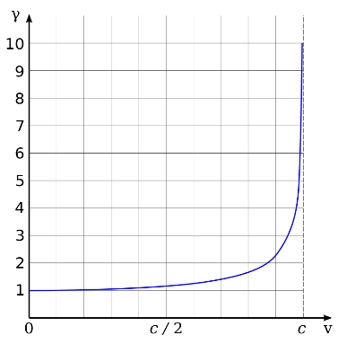

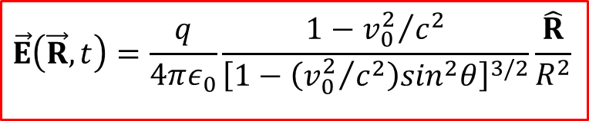

Chapter 12. Electrodynamics and Relativity
1
Lecture 32. How the EM fields transform
What you should learn (Griffiths, Chapter 12.1.1-1.2. and 12.3.2):
1. Einstein’s postulates
2. How the EM fields transform
3. Electric field of a moving charge
$${\vec{E}}^{⊥}=γ_{0}{\vec{E}}_{0}^{⊥}$$
$$E^{∥}=E_{0}^{∥}$$
$$\vec{E}\left(\vec{R},t\right)=\frac{q}{4πε_{0}}\frac{1−{v_{0}^{2}}/{c^{2}}}{{\left[1−\left({v_{0}^{2}}/{c^{2}}\right)\sin^{2}θ\right]}^{3/2}}\frac{\hat{R}}{R^{2}}$$
Notes:
1
Haarlem 18 mei 2017 t/m 18 mei 2020 !!!

Slide 2
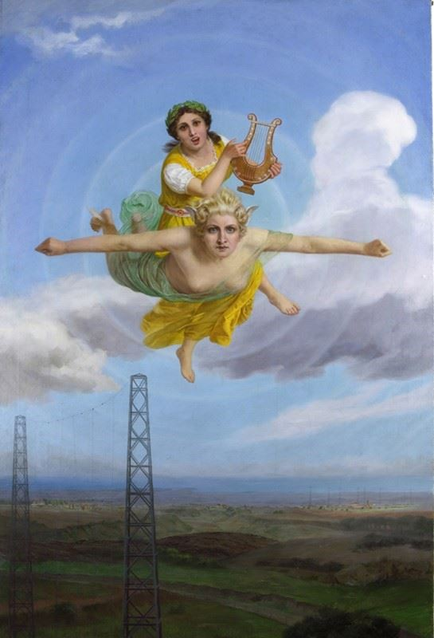
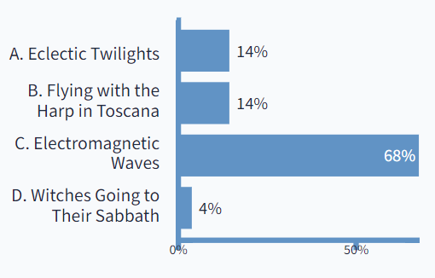
Question 1: PollEv.com/2023mp
2
What in your opinion is depicted on this painting?
Answer
A. Eclectic Twilights
B. Flying with the Harp in Toscana
C. Electromagnetic Waves
D. Witches Going to Their Sabbath
Answer C
“Allegory of Electromagnetic Waves”
attributed to Vittorio Matteo Corcos (1859-1933)
PollEv.com/2023mp, Lecture 32
Notes:
2

Slide 3
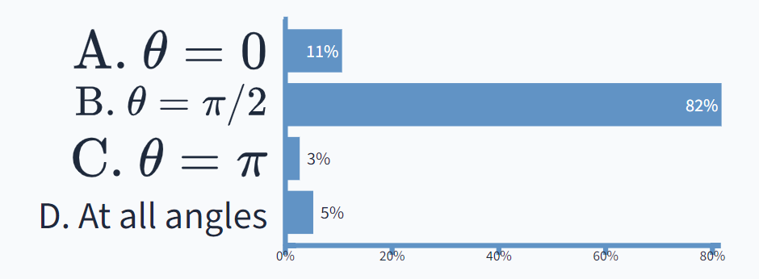

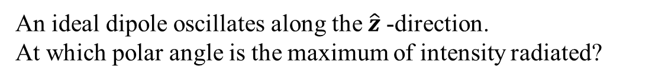

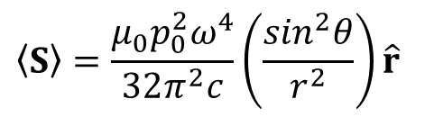



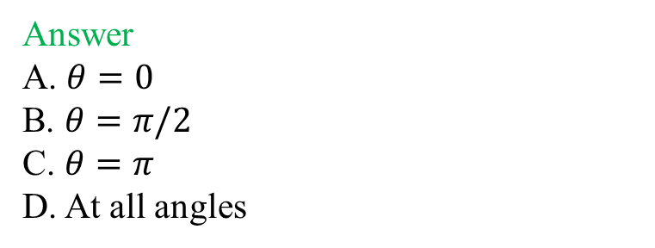

Question 2: PollEv.com/2023mp
3
An ideal dipole oscillates along the $\hat{z}$-direction.
At which polar angle is the maximum of intensity radiated?
$$\hat{z}$$
Answer
A. $θ=0$
B. $θ=π/2$
C. $θ=π$
D. At all angles
$$\vec{E}$$
$$\hat{y}$$
$$\vec{S}$$
$$\vec{B}$$
$$\hat{x}$$
Answer B
$$\left\langle S\right\rangle =\frac{μ_{0}p_{0}^{2}ω^{4}}{32π^{2}c}\left(\frac{\sin^{2}θ}{r^{2}}\right)\hat{r}$$
The maximum is in the equatorial plane, i.e. $θ=π/2$
PollEv.com/2023mp, Lecture 32
Notes:
3

Slide 4
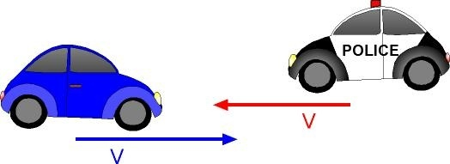
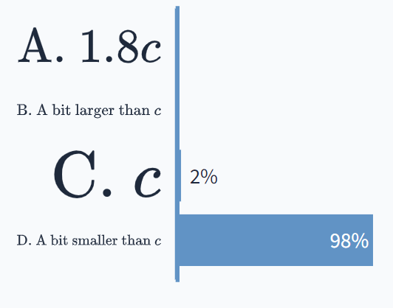
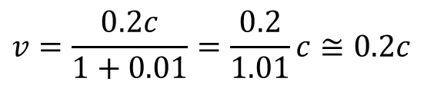
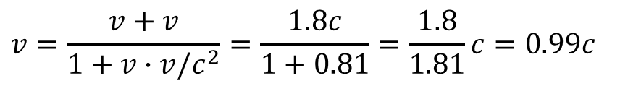
Question 3: PollEv.com/2023mp
4
Recall the Mechanics and Relativity course!
According to the ground observer, two cars are moving in opposite directions with the speed of each of them of v = 0.9c.
What is their relative speed?
Answer
A. 1.8c
B. A bit larger then c
C. c
D. A bit smaller then c
Answer D
$$v=\frac{v+v}{1+v∙v/c^{2}}=\frac{1.8c}{1+0.81}=\frac{1.8}{1.81}c=0.99c$$
$$v=\frac{0.2c}{1+0.01}=\frac{0.2}{1.01}c≅0.2c$$
If v = 0.1c,
PollEv.com/2023mp, Lecture 32
Notes:
4

Slide 5
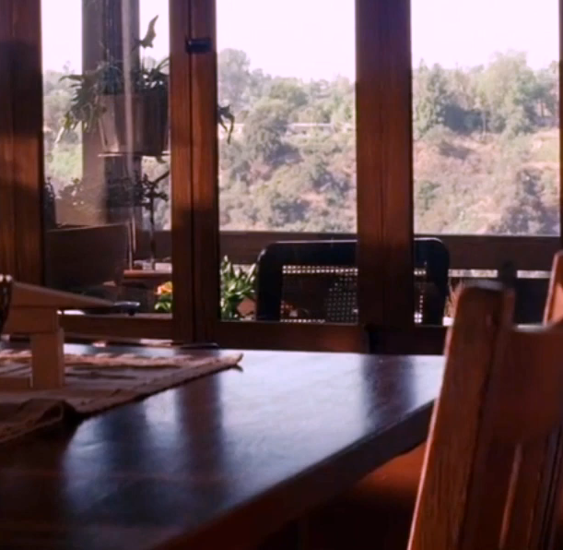
Principle of relativity
5
Classical mechanics obeys the principle of relativity: the same laws apply in any inertial reference frame An inertial frame of reference is a system which moves with constant velocity with a rectilinear motion
An accelerometer (e.g. a snooker ball) in this system detects zero acceleration
The principle of relativity is hardly new; it was stated clearly by Galileo
Question: does it also apply to the laws of electrodynamics?
At first glance, the answer would seem to be no
A charge in motion produces a magnetic field, whereas a charge at rest does not
A charge carried along by the train would generate a magnetic field, but someone on the train, applying the laws of electrodynamics in that system, would predict no magnetic field
The Lorentz force refers to the velocity of the charge
It certainly appears, therefore, that electromagnetic theory presupposes the existence of a unique stationary reference frame, with respect to which all velocities are to be measured
…or does it not?
Notes:
5
Snooker in the train as an example.
A ball rolled upon the table as an experimental demonstration

Slide 6
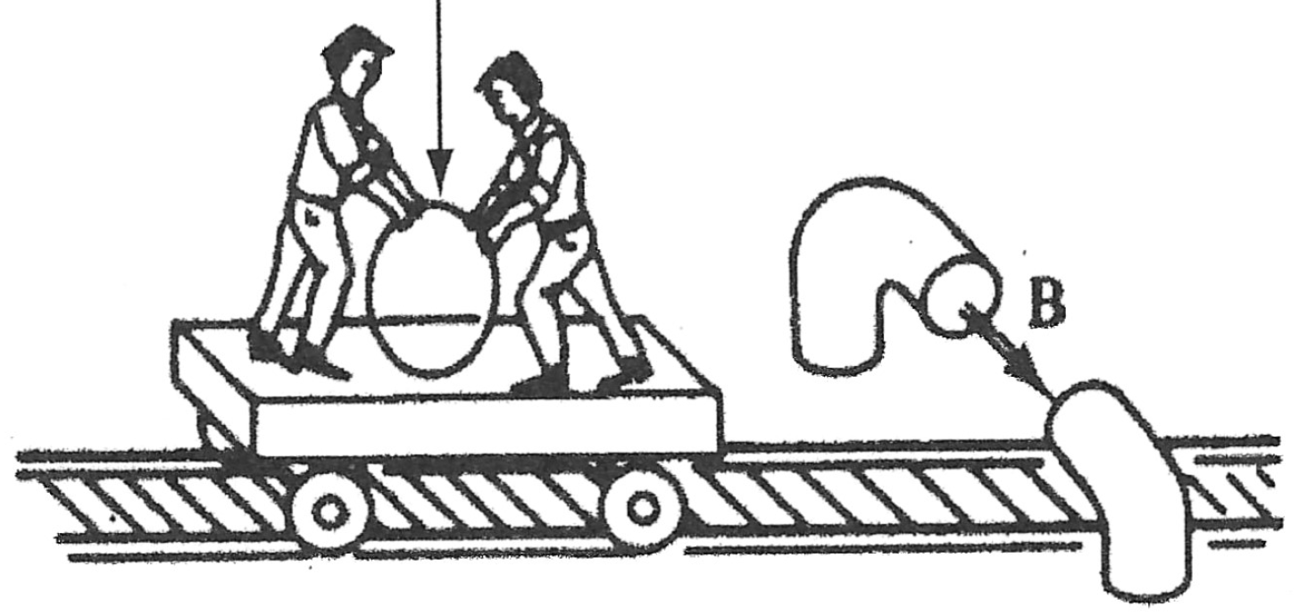

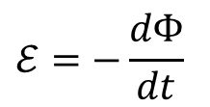
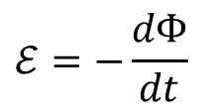
However… what an extraordinary coincidence!
6
Wire loop
Giant magnet
$$\vec{B}$$
For the ground observer, as the loop rides through the magnetic field, a motional emf is established because of magnetic force on the charges
$$ℰ=−\frac{dΦ}{dt}$$
because of magnetic field
If someone on the train naively applied the laws of electrodynamics in that system, what would the prediction be? No magnetic force, because the loop is at rest. But as the magnet flies by, the magnetic field in the freight car changes, and a changing magnetic field induces an electric field due to Faraday’s law:
$$ℰ=−\frac{dΦ}{dt}$$
because of electric field
People on the train will get the right answer, even though their physical interpretation of the process appears completely wrong! …or does it?
Notes:
6

Slide 7
The concept of ether
7
Einstein's predecessors had no doubts which observer was right, and which is not
They thought of electric and magnetic fields as strains in an invisible jellylike medium called ether, which permeated all of space
The speed of the charge was to be measured with respect to the ether - only then would the laws of electrodynamics be valid
The train observer is wrong, because that frame is moving relative to the ether
But how do we know the ground observer isn't moving relative to the ether, too?
Because of the earth movement, we should be traveling at over 50 km/s with respect to the ether so we must face an "ether wind" of high velocity
So who sits in the “right” system of coordinates?
Suddenly it becomes a matter of crucial importance to find the ether frame, experimentally, or else all our calculations will be invalid
Notes:
7

Slide 8
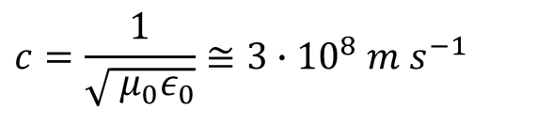
Ether wind
8
In principle, any electromagnetic experiment would suffice: any discrepancy between experiment and theory could be subscribed to the ether movement. However, (i) the experimental accuracy was not sufficient and (ii) there might be “lucky” coincidences
Among the results of classical electrodynamics is the prediction that electromagnetic waves travel through the vacuum at a speed
relative (presumably) to the ether
$$c=\frac{1}{\sqrt{{{ μ}_{0}ε}_{0}}}≅3∙{10}^{8} m s^{−1}$$
Speed of light
Ether wind
In principle one should be able to detect the ether wind by simply measuring the speed of light in various directions
While the idea of this experiment could not be simpler, its execution is another matter, because light travels so inconveniently fast
Notes:
8

Slide 9
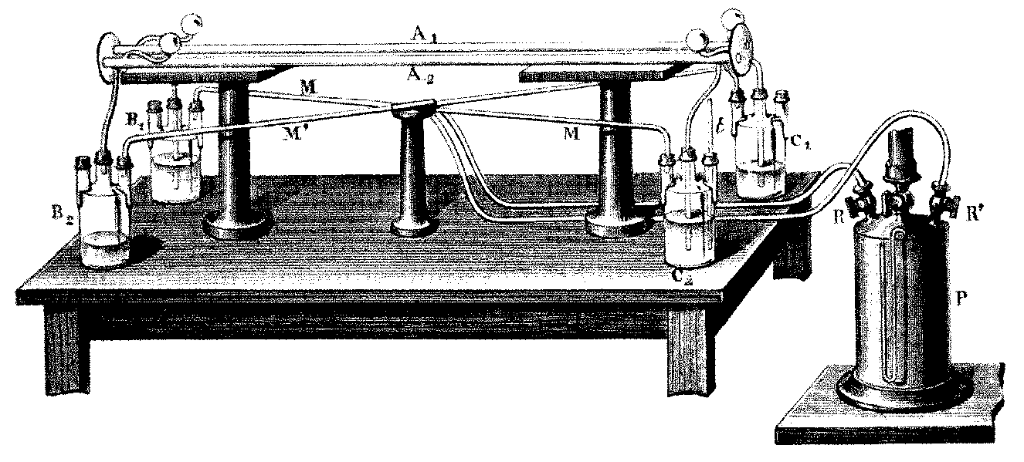

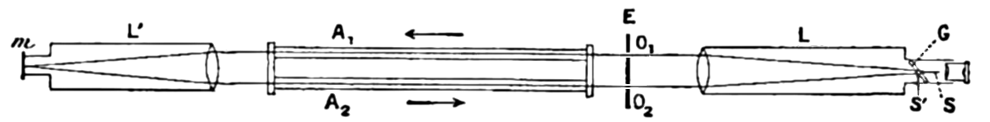


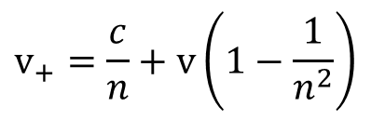


The Fizeau experiment (1851)
9
Idea: light traveling through a moving medium would be dragged along by the medium
$$v_{−}=\frac{c}{n}−v$$
$$v$$
$$v_{+}=\frac{c}{n}+v$$
$$v_{+}=\frac{c}{n}+v\left(1−\frac{1}{n^{2}}\right)$$
Fizeau found that
i.e. the magnitude of the dragging was much lower than expected
Fresnel’s old idea: a medium moving through the stationary ether drags light with only a fraction of the medium speed
Notes:
9

Slide 10
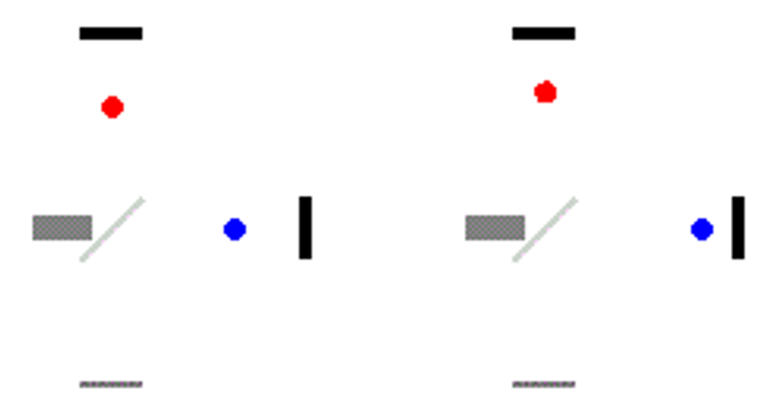
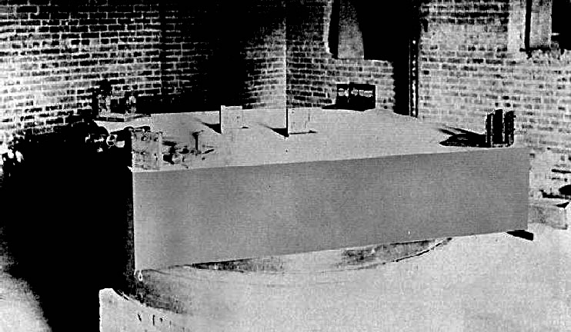
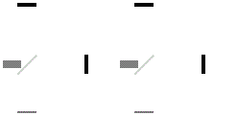
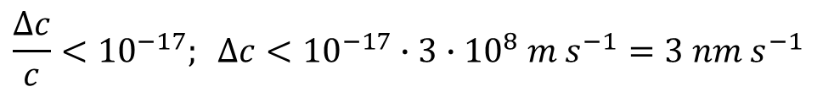
Michelson and Morley experiment (1887)
10
Michelson-Morley setup
Animation is hidden below the screenshot!
https://www.youtube.com/watch?v=k6gd3bQLiFc
https://www.youtube.com/watch?v=Ip_jdcA8fcw
What they were trying to do, was compare the speed of light in different directions
What they in fact discovered was that this speed is exactly the same in all directions
$$\frac{∆c}{c}<{10}^{−17}; ∆c<{10}^{−17}∙3∙{10}^{8} m s^{−1}=3 nm s^{−1}$$
Modern measurements:
Physical Review D. 80, 105011 (2009)
Notes:
10
Cliveland, Ohaio 1887
The result was VERY perplexing at the time!
Michelson didn’t believe his own results till the end of his life
Michelson and Morley themselves interpreted their experiment as confirmation of the "ether drag" hypothesis, which held that the earth somehow pulls the ether along with it.
Fitzgerald and Lorentz suggested that the ether wind physically compresses all matter (including the Michelson-Morley apparatus itself) in just the right way to compensate for, and thereby conceal, the variation in speed with direction.

Slide 11
Einstein, Annalen der Physik 17, p.891 (1905)
11
Notes:
11

Slide 12
Einstein, Annalen der Physik 17, p.891 (1905)
12
It is known that Maxwell's electrodynamics-as usually understood at the present time-when applied to moving bodies, leads to asymmetries which do not appear to be inherent in the phenomena. Take, for example, the reciprocal electrodynamic action of a magnet and a conductor. The observable phenomenon here depends only on the relative motion of the conductor and the magnet, whereas the customary view draws a sharp distinction between the two cases in which either one or the other of these bodies is in motion. For if the magnet is in motion and the conductor at rest, there arises in the neighborhood of the magnet an electric field ... producing a current at the places where parts of the conductor are situated. But if the magnet is stationary and the conductor in motion, no electric field arises in the neighborhood of the magnet. In the conductor, however, we find an electromotive force ... which gives rise-assuming equality of relative motion in the two cases discussed-to electric currents of the same path and intensity as those produced by the electric forces in the former case.
Examples of this sort, together with unsuccessful attempts to discover any motion of the earth relative to the "light medium," suggest that the phenomena of electrodynamics as well as of mechanics possess no properties corresponding to the idea of absolute rest.
Notes:
12

Slide 13
Einstein postulates
13
Zur Elektrodynamik bewegter Körper, Annalen der Physik 17, p.891 (1905)
If the interpretations on emf differ (one calling the process electric, the other magnetic), so be it; their actual predictions are in agreement
Einstein’s postulates:
1. The principle of relativity. The laws of physics apply in all inertial reference systems
2. The universal speed of light. The speed of light in vacuum is the same for all inertial observers, regardless of the motion of the source or the observer
The first elevates Galileo's observation about classical mechanics to the status of a general law, applying to all of physics. It states that there is no absolute rest system
The second might be considered Einstein's response to the Michelson-Morley experiment (even though he appears to have had no clue of it). The speed of light is a universal constant, the same in all directions in vacuum
There is no ether wind because there is no ether
More accurately formulating, the hypothesis of ether is no longer needed
Notes:
13
Lorentz invariancy is a property on any physical theory. This goes far beyound calssical electrodtnamics

Slide 14
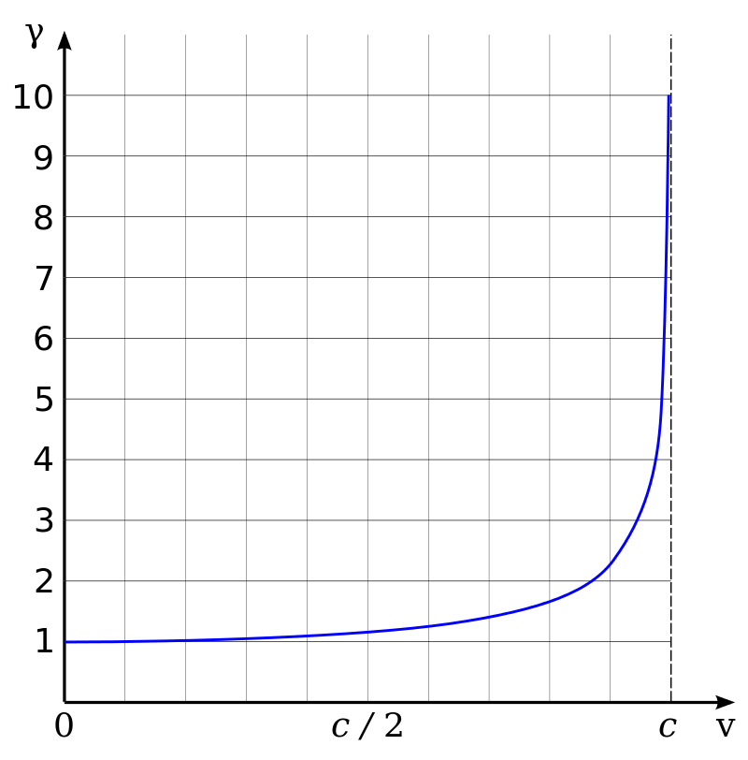
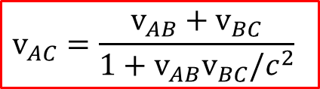
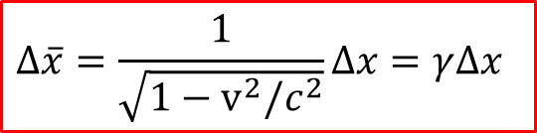
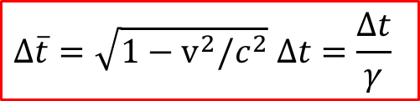

Einstein mechanics: summary
14
1. Two events that are simultaneous in one inertial system are not, in general, simultaneous in another
Lorentz factor
2. Moving clocks run slow (time dilation)
The interval in the moving system is shorter
$$γ≡\frac{1}{\sqrt{1−v^{2}/c^{2}}}$$
$$∆\overline{t}=\sqrt{1−v^{2}/c^{2}} ∆t=\frac{∆t}{γ}$$
The overbar: measurements made in the moving system
3. Moving objects are shortened (Lorentz contraction)
$$∆\overline{x}=\frac{1}{\sqrt{1−v^{2}/c^{2}}}∆x=γ∆x$$
4. Einstein's velocity addition rule
$$v_{AC}=\frac{v_{AB}+v_{BC}}{1+v_{AB}v_{BC}/c^{2}}$$
https://www.youtube.com/watch?v=88WTEQwvJ9g
Notes:
14

Slide 15

How the electromagnetic fields transform
15
Unlike Newtonian mechanics, classical electrodynamics is already consistent with special relativity
Maxwell's equations and the Lorentz force law can be applied legitimately in any inertial system
Of course, what one observer interprets as an electrical process another may regard as magnetic by another observer, but the actual physics they predict will be identical
The problem we are going to solve, is:
Given the fields in $𝒮$, what are the fields in $\overline{𝒮}$?
We will not be changing the rules of electrodynamics in the slightest; rather, we will be expressing these rules in a notation that exposes and illuminates their relativistic character
Charge is invariant
Important experimental fact:
The charge of a particle is a fixed number, independent of how fast it happens to be moving
We assume that the transformation rules are the same no matter how the fields were produced: electric fields associated with changing magnetic fields transform the same way as those set up by stationary charges
The plan of actions:
1. We will consider a number of simple situations to learn how the fields are transformed
2. Then we will re-write Maxwell’s equations with these rules in mind via the field tensor
Notes:
15
Consider atoms that are neutral even at high speed

Slide 16
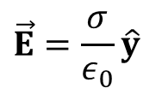
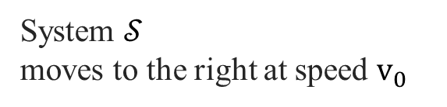


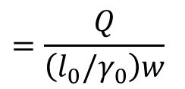
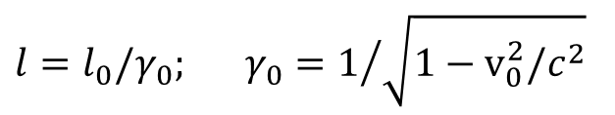




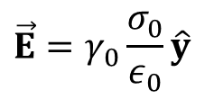
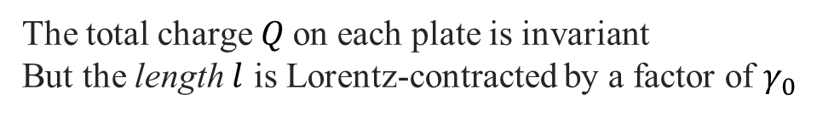

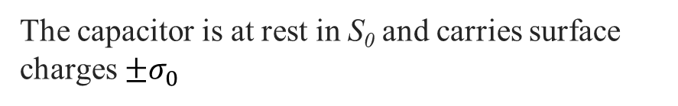



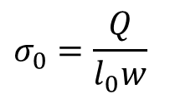
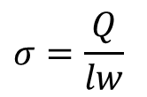
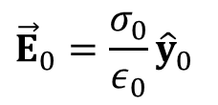
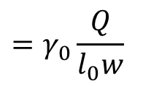

How the Fields transform: ${\vec{E}}^{⊥}$
16
System $𝒮_{0}$
System $𝒮$
moves to the right at speed $v_{0}$
$$v_{0}$$
-$σ_{0}$
-$σ_{}$
$$σ_{0}=\frac{Q}{l_{0}w}$$
$$v_{0}$$
$$E_{0}$$
$$+σ_{0}$$
$$E_{}$$
$$+σ_{}$$
$$\vec{E}=\frac{σ}{ε_{0}}\hat{y}$$
The capacitor is at rest in S₀ and carries surface charges $±σ_{0}$
The total charge $Q$on each plate is invariant
But the length $l$ is Lorentz-contracted by a factor of $γ_{0}$
$$l=l_{0}/γ_{0}; γ_{0}=1/{\sqrt{1−v_{0}^{2}/c^{2}}}$$
$${\vec{E}}_{0}=\frac{σ_{0}}{ε_{0}}{\hat{y}}_{0}$$
The charge per unit area is increased:
$$σ=\frac{Q}{lw}$$
$$=\frac{Q}{\left({l_{0}/γ}_{0}\right)w}$$
$$=γ_{0}\frac{Q}{l_{0}w}$$
$$\vec{E}=γ_{0}\frac{σ_{0}}{ε_{0}}\hat{y}$$
$$=γ_{0}σ_{0};$$
$${\vec{E}}^{⊥}=γ_{0}{\vec{E}}_{0}^{⊥}$$
$⊥$: components of $\vec{E}$ that are perpendicular to the direction of motion of $𝒮$
Notes:
16

Slide 17


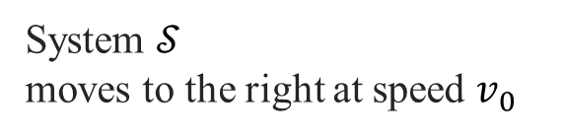

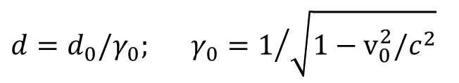


How the Fields transform:${ \vec{E}}^{∥}$
17
To get the rule for parallel components, consider the capacitor lined up with the $\text{y}\text{−}\text{z}$plane
System $𝒮$
moves to the right at speed $v_{0}$
$$+σ$$
-$σ_{}$
$$v_{0}$$
$$v_{0}$$
$$d=d_{0}/γ_{0}; γ_{0}=1/{\sqrt{1−v_{0}^{2}/c^{2}}}$$
The plate separation d is Lorentz-contracted, whereas Q, l and w (and hence also $σ$) are the same in both frames
Since the field does not depend on $d$, it follows that
$$E^{∥}=E_{0}^{∥}$$
Parallel component of the electric field is invariant
Notes:
17

Slide 18

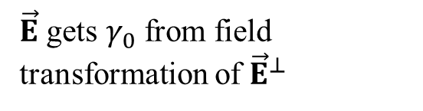


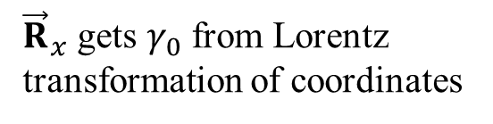

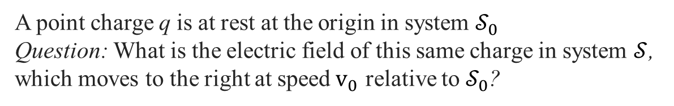








Electric field of a point charge in uniform motion
18
A point charge q is at rest at the origin in system $𝒮_{0}$
Question: What is the electric field of this same charge in system $𝒮$, which moves to the right at speed$v_{0}$ relative to $𝒮_{0}$?
$$\vec{E}$$
$${\vec{E}}^{⊥}=γ_{0}{\vec{E}}_{0}^{⊥}$$
$$E^{∥}=E_{0}^{∥}$$
In terms of the $𝒮$ coordinates of observation point P
$$R$$
$$\vec{E}\left(\vec{R},t\right)=\frac{q}{4πε_{0}}\frac{1−{v_{0}^{2}}/{c^{2}}}{{\left[1−\left({v_{0}^{2}}/{c^{2}}\right)\sin^{2}θ\right]}^{3/2}}\frac{\hat{R}}{R^{2}}$$
$$\vec{R}$$
$${\vec{v}}_{0}$$
Vector from $q$ to $P$
$$q$$
$$θ$$
$$\vec{R}$$
$$P$$
${\vec{R}}_{x}$ gets $γ_{0}$ from Lorentz transformation of coordinates
$\vec{E}$ gets $γ_{0}$ from field transformation of ${\vec{E}}^{⊥}$
The $\vec{E}$field points away from the instantaneous (as opposed to the retarded) position of the charge!
Example 12.14; tutorials
Notes:
18

Slide 19
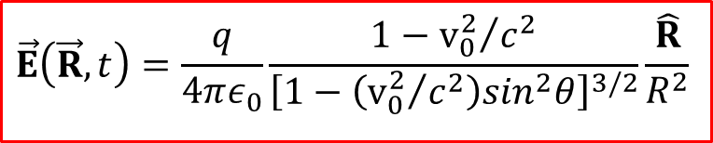
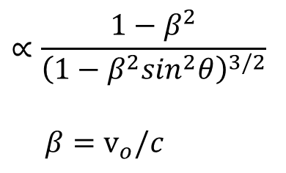
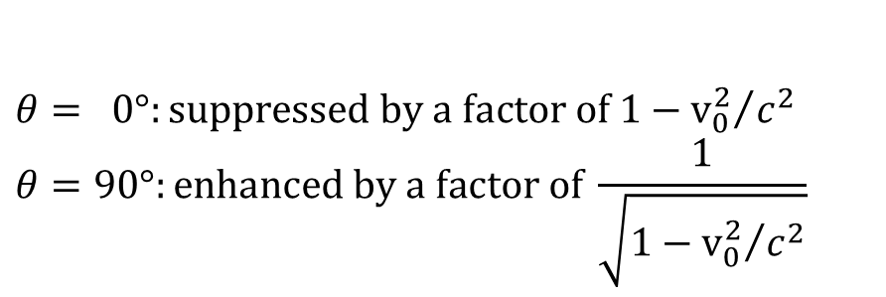
Electric field of a point charge in uniform motion
19
How does the electric field of a charge moving with the speed of $v_{0}$ = 0.99c, looks like for a ground system observer?
$$\vec{E}$$
$$∝\frac{1−β^{2}}{{\left(1−β^{2}\sin^{2}θ\right)}^{3/2}}$$
$$β=v_{o}/c$$
$$R$$
$$\vec{R}$$
$${\vec{v}}_{0}$$
$$q$$
$$θ$$
$$θ= 0°:suppressed by a factor of 1−{v_{0}^{2}}/{c^{2}}$$
$$θ=90°:enhanced by a factor of \frac{1}{\sqrt{1−{v_{0}^{2}}/{c^{2}}}}$$
$$\vec{E}\left(\vec{R},t\right)=\frac{q}{4πε_{0}}\frac{1−{v_{0}^{2}}/{c^{2}}}{{\left[1−\left({v_{0}^{2}}/{c^{2}}\right)\sin^{2}θ\right]}^{3/2}}\frac{\hat{R}}{R^{2}}$$
Notes:
19

Slide 20









How the Fields transform: ${\overline{E}}_{y}$ and ${\overline{B}}_{z}$
20
To derive the general rule, we must start out in a system with both electric and magnetic fields For this purpose, $𝒮$ itself will serve nicely!
System $𝒮$ moves to the right
with speed $v_{0}$
$$K_{−}=+σv_{0}\hat{x}$$
$$v_{0}$$
$$v_{0}$$
$$E_{y}$$
$$K_{+}=−σv_{0}\hat{x}$$
From the point of view in$𝒮$, there is the surface charge $σ=γ_{0}σ_{0}$ which produces the electric field
$$\vec{E}=γ_{0}\frac{σ_{0}}{ε_{0}}\hat{y}$$
But there are surface currents ${\vec{K}}_{±}=∓σv_{0}\hat{x}$
which produce the magnetic field
Notes:
20

Slide 21




















Intermezzo: Magnetic filed of infinite plane
21
Example 5.8 (p.235):
The surface current $K_{+}$ induces a magnetic field $B_{z}$
$$B_{z}$$
The lower plate
From Ampère’s law:
$${\vec{K}}_{+}$$
$$\oint_{C}{\vec{B}∙d\vec{l}}=μ_{0}I_{encl}$$
$${\vec{K}}_{+}$$
$$\oint_{C}{\vec{B}∙d\vec{l}}=2B_{z}w; I_{encl}=Kw$$
$$w$$
$$B_{z}=\frac{μ_{0}K}{2}$$
$$B_{z}$$
Both plates (side view)
$⨂{ }⨂$ $⨂$
$$B=0$$
$⨀$ $⨀$ $⨀$
The fields above the capacitor will be cancelled by the currents from the two plates
$${\vec{K}}_{−}$$
$$B_{z}=2∙\frac{μ_{0}K}{2}$$
$⨂{ }⨂$ $⨂$
The fields in the gap will be doubled by the currents from the two plates $B_{z}=μ_{0}K$
$⨂{ }⨂$ $⨂$
$${\vec{K}}_{+}$$
$⨀$ $⨀$ $⨀$
The fields below the capacitor will be cancelled by the currents from the two plates
$$B=0$$
$⨂{ }⨂$ $⨂$
Notes:
21

Slide 22




















How the Fields transform: ${\overline{E}}_{y}$ and ${\overline{B}}_{z}$
22
To derive the general rule, we must start out in a system with both electric and magnetic fields
For this purpose, $𝒮$ itself will serve nicely!
System $𝒮$ moves to the right
with speed $v_{0}$
$\overline{v}$relative to $𝒮_{0}$
$$B_{z}$$
$v$ relative to $𝒮$
$${\vec{K}}_{−}=+σv_{0}\hat{x}$$
$$v_{0}$$
$$v_{0}$$
$$E_{y}$$
$${\vec{K}}_{+}=−σv_{0}\hat{x}$$
From the point of view in$𝒮$, there is the surface charge $σ=γ_{0}σ_{0}$ which produces the electric field
In a third system $\overline{𝒮}$ traveling to the right with speed $v$ relative to $𝒮$
$$E_{y}=γ_{0}\frac{σ_{0}}{ε_{0}}$$
$${\overline{E}}_{y}=\frac{\overline{σ}}{ε_{0}};{\overline{B}}_{z}=−μ_{0}\overline{σ}\overline{v}$$
But there also are surface currents ${\vec{K}}_{±}=∓σv_{0}\hat{x}$
which produce the magnetic field
where $\overline{v}$ is the velocity of$\overline{𝒮}$ relative to $𝒮_{0}$
How to transform $\vec{E}$ and $\vec{B}$ from $𝒮$to $\overline{𝒮}$?
$𝒮_{0}$ will be acting as a reference frame!
$$B_{z}=μ_{0}K$$
$$=−μ_{0}σv_{0}$$
$$=\left\{σ=γ_{0}σ_{0}\right\}$$
$$=−μ_{0}γ_{0}σ_{0}v_{0}$$
Note that $E_{y}⊥B_{z}$
Notes:
22

Slide 23














How the Fields transform: ${\overline{E}}_{y}$ and ${\overline{B}}_{z}$
23
In system $\overline{𝒮}$ (traveling to the right with speed $v$ relative to system $𝒮$ and with speed $\overline{v}$ relative to $𝒮_{0}$)
$$in \overline{𝒮}:{\overline{E}}_{y}=\frac{\overline{σ}}{ε_{0}};{\overline{B}}_{z}=−μ_{0}\overline{σ}\overline{v}$$
$${\overline{E}}_{y}=\frac{\overline{σ}}{ε_{0}};{\overline{B}}_{z}=−μ_{0}\overline{σ}\overline{v}$$
$\overline{v}$relative to $𝒮_{0}$
$v$ relative to $𝒮$
$$\overline{v}=\frac{v+v_{0}}{1+vv_{0}/c^{2}} \left(wrt 𝒮_{0}\right) and \overline{γ}=\frac{1}{\sqrt{1−{\overline{v}}^{2}/c^{2}}}$$
with
We want to express ${\overline{E}}_{y}$ and ${\overline{B}}_{z}$ in system $\overline{𝒮}$ in terms of electromagnetic field in system $𝒮$, where
$$E_{y}=\frac{σ}{ε_{0}};B_{z}=−μ_{0}σv_{0} \text{wrt} 𝒮_{0}$$
We will calculate the parameters wrt $𝒮_{0}$ system
Surface charge densities scale as
$$\overline{σ}=\overline{γ}σ_{0} \left(\overline{𝒮}{→𝒮}_{0}\right);σ=γ_{0}σ_{0} \left(𝒮{→𝒮}_{0}\right)$$
$${\overline{E}}_{y}=\frac{\overline{σ}}{ε_{0}}=\left(wrt 𝒮_{0}, \overline{γ}E_{0}\right)\frac{\overline{γ}σ_{0}}{ε_{0}}$$
$$=\left(wrt 𝒮,E_{0}/γ_{0}\right)\frac{\overline{γ}}{γ_{0}}\frac{σ}{ε_{0}}$$
$$\frac{\overline{γ}}{γ_{0}}!$$
So we have to calculate
$$\left\{\overline{σ}=\frac{\overline{γ}}{γ_{0}}σ\right\}$$
$$=−μ_{0}\frac{\overline{γ}}{γ_{0}}σ\overline{v}$$
$$=\frac{\overline{γ}}{γ_{0}}\frac{v+v_{0}}{1+vv_{0}/c^{2}}\left(−μ_{0}σ\right)$$
$${\overline{B}}_{z}=−μ_{0}\overline{σ}\overline{v}=$$
Notes:
23
Blackboard!

Slide 24





Lecture 33. How the EM fields transform
24
What you should learn (Griffiths, Chapter 12.3.2-4):
1. How the EM fields transform
2. Special case I. $\vec{B}=\vec{0}$ in 𝒮
3. Special case II. $\vec{E}=\vec{0}$ in $𝒮$
4. The Lorentz transformation matrix $Λ_{ν}^{μ}$ and 4-vectors
$${{\overline{E}}_{x}=E}_{x}; {\overline{E}}_{y}=γ\left(E_{y}−vB_{z}\right); {\overline{E}}_{z}=γ\left(E_{z}+vB_{y}\right)$$
$${{\overline{B}}_{x}=B}_{x}; {\overline{B}}_{y}=γ\left(B_{y}+\frac{v}{c^{2}}E_{z}\right); {\overline{B}}_{z}=γ\left(B_{z}−\frac{v}{c^{2}}E_{y}\right)$$
$$\vec{\overline{B}}=−\frac{1}{c^{2}}\left(\vec{v}×\vec{\overline{E}}\right)$$
$$\vec{\overline{E}}=\vec{v}×\vec{\overline{B}}$$
$${\overline{x}}^{μ}=Λ_{ν}^{μ}x^{ν}$$
Notes:
24

Slide 25






Question 1: PollEv.com/2023mp
25
How does the electric field of a charge moving with the speed of v = 0.99c, looks like for a ground system observer?
Answer
A. Like an apple
B. Like a pancake
C. Like an orange
D. Like a mango
Answer B
PollEv.com/2023mp, Lecture 33
Notes:
25

Slide 26


















How the Fields transform: ${\overline{E}}_{y}$ and ${\overline{B}}_{z}$
26
We want to express ${\overline{E}}_{y}$ and ${\overline{B}}_{z}$ in system $\overline{𝒮}$ in terms of electromagnetic fields in system $𝒮$
$$𝒮_{0}:E_{0}=\frac{σ_{0}}{ε_{0}};B=0$$
$$σ=γ_{0}σ_{0}$$
$$E_{y}=\frac{σ}{ε_{0}}$$
$$B_{z}=−μ_{0}σv_{0}$$
$$v_{0}$$
$$\overline{σ}=\overline{γ}σ_{0}$$
$${\overline{E}}_{y}=\frac{\overline{σ}}{ε_{0}}$$
$${\overline{B}}_{z}=−μ_{0}\overline{σ}\overline{v}$$
$$\overline{v}=\frac{v+v_{0}}{1+vv_{0}/c^{2}}$$
$$𝒮: E_{y};B_{z}$$
$$\overline{σ} −?$$
$${\overline{E}}_{y}−?$$
$${\overline{B}}_{z}−?$$
$$\overline{γ}=\frac{1}{\sqrt{1−{\overline{v}}^{2}/c^{2}}}$$
$$v$$
$$\overline{𝒮}: {\overline{E}}_{y};{\overline{B}}_{z}$$
$$\overline{σ}=\overline{γ}σ_{0} \left(\overline{𝒮}{→𝒮}_{0}\right); σ_{0}=\frac{σ}{γ_{0}} \left(𝒮_{0}→𝒮\right) so that \overline{σ}=\frac{\overline{γ}}{γ_{0}}σ \left(\overline{𝒮}→𝒮\right)$$
Surface charge densities scale as
$${\overline{E}}_{y}=\frac{\overline{σ}}{ε_{0}}=$$
$$\left\{\overline{σ}=\frac{\overline{γ}}{γ_{0}}σ\right\}$$
$$=\frac{\overline{γ}}{γ_{0}}\frac{σ}{ε_{0}}$$
$$\frac{\overline{γ}}{γ_{0}}!$$
$$\left\{\overline{σ}=\frac{\overline{γ}}{γ_{0}}σ\right\}$$
So we need to calculate
$${\overline{B}}_{z}=−μ_{0}\overline{σ}\overline{v}=$$
$$=−μ_{0}\frac{\overline{γ}}{γ_{0}}σ\overline{v}$$
$$=\frac{\overline{γ}}{γ_{0}}\frac{v+v_{0}}{1+vv_{0}/c^{2}}\left(−μ_{0}σ\right)$$
Notes:
26
Blackboard!

Slide 27














How the Fields transform: ${\overline{E}}_{y}$ and ${\overline{B}}_{z}$
27
$$\frac{\overline{γ}}{γ_{0}}=\frac{\sqrt{1−v_{0}^{2}/c^{2}}}{\sqrt{1−{\overline{v}}^{2}/c^{2}}}=\frac{\sqrt{1−v_{0}^{2}/c^{2}}}{\sqrt{1−{\left(\frac{v+v_{0}}{1+vv_{0}/c^{2}}\right)}^{2}\frac{1}{c^{2}}}}=\frac{\sqrt{1−v_{0}^{2}/c^{2}} c{\left(1+vv_{0}/c^{2}\right)}^{}}{\sqrt{c^{2}+2vv_{0}+\frac{v^{2}v_{0}^{2}}{c^{2}}−v^{2}−2vv_{0}−v_{0}^{2}}}=\frac{\sqrt{1−v_{0}^{2}/c^{2}} c^{2}{\left(1+vv_{0}/c^{2}\right)}^{}}{\sqrt{c^{4}+v^{2}v_{0}^{2}−v^{2}c^{2}−v_{0}^{2}c^{2}}}$$
$$=\frac{\sqrt{1−v_{0}^{2}/c^{2}} c^{2}\left(1+vv_{0}/c^{2}\right)}{\sqrt{\left(c^{2}−v_{0}^{2}\right)\left(c^{2}−v^{2}\right)}}=\frac{\sqrt{1−v_{0}^{2}/c^{2}} \left(1+vv_{0}/c^{2}\right)}{\sqrt{\left(1−v_{0}^{2}/c^{2}\right)\left(1−v^{2}/c^{2}\right)}}=\frac{\left(1+vv_{0}/c^{2}\right)}{\sqrt{\left(1−v^{2}/c^{2}\right)}}=γ\left(1+\frac{vv_{0}}{c^{2}}\right)$$
$$v:\overline{𝒮} wrt 𝒮$$
$$γ=\frac{1}{\sqrt{1−v^{2}/c^{2}}}$$
$${ε_{0}μ_{0}c}^{2}=1$$
$${\overline{E}}_{y}=\frac{\overline{γ}}{γ_{0}}\frac{σ}{ε_{0}}$$
$$=γ\left(1+\frac{vv_{0}}{c^{2}}\right)\frac{σ}{ε_{0}}$$
$$=γ\left(\frac{σ}{ε_{0}}+\frac{v v_{0}μ_{0}σ}{c^{2}μ_{0}ε_{0}}\right)$$
$$=\left\{B_{z}=−μ_{0}σv_{0}\right\}$$
$$= γ\left(E_{y}−vB_{z}\right)$$
$${\overline{B}}_{z}=\frac{\overline{γ}}{γ_{0}}\frac{v+v_{0}}{1+vv_{0}/c^{2}}\left(−μ_{0}σ\right)$$
$$=−γ\left(1+\frac{vv_{0}}{c^{2}}\right)\frac{v+v_{0}}{1+\frac{vv_{0}}{c^{2}}}μ_{0}σ$$
$$=γ\left(−μ_{0}σv_{0}−μ_{0}ε_{0}v\frac{σ}{ε_{0}}\right)$$
$$=γ\left(B_{z}−\frac{v}{c^{2}}E_{y}\right)$$
These are the fields is the system $\overline{𝒮},$ traveling to the right with speed $v$ relative to $𝒮$
Note that electric and magnetic fields are interwound
Notes:
27
Blackboard!

Slide 28










How the Fields transform: ${\overline{E}}_{z}$ and ${\overline{B}}_{y}$
28
We simply align the same capacitor parallel to the xy plane instead of the xz plane
System $𝒮$ moves to the right
with speed $v_{0}$
$$B_{y}$$
System $𝒮$ moves to the right
with speed $v_{0}$
$${\vec{K}}_{+}$$
$$B_{z}$$
$${\vec{K}}_{−}=+σv_{0}\hat{x}$$
$$v_{0}$$
$$E_{z}$$
$$v_{0}$$
$$v_{0}$$
$$E_{y}$$
$${\vec{K}}_{+}=−σv_{0}\hat{x}$$
$${\vec{K}}_{−}$$
The fields in $𝒮$ were:
$$E_{y}=\frac{σ}{ε_{0}};B_{z}=−μ_{0}σv_{0}$$
The fields in $𝒮$ are now:
$$E_{z}=\frac{σ}{ε_{0}};B_{y}=μ_{0}σv_{0}$$
The rest of the argument is identical: everywhere we had $E_{y}$ before, read $E_{z}$, and everywhere we had $B_{z}$, read ${−B}_{y}$:
$${\overline{E}}_{y}=γ\left(E_{y}−vB_{z}\right)$$
$${\overline{E}}_{z}=γ\left(E_{z}+vB_{y}\right)$$
We had:
We have now:
$${ \overline{B}}_{z}=γ\left(B_{z}−\frac{v}{c^{2}}E_{y}\right)$$
$${\overline{B}}_{y}=γ\left(B_{y}+\frac{v}{c^{2}}E_{z}\right)$$
Notes:
28

Slide 29






How the Fields transform: ${\overline{B}}_{x}$
29
As for the x components, we have already seen (by orienting the capacitor parallel to the yz plane) that ${{\overline{E}}_{x}=E}_{x}$
For magnetic field: let’s take a long solenoid aligned parallel to the x-axis
$$B_{x}=μ_{0}nI$$
$$n=\frac{N}{L}$$
with n being number of turns per unit length
$${\overline{B}}_{x}=μ_{0}\overline{n}\overline{I}$$
In system $\overline{𝒮}$ (moves to the right)
The length contracts
so that n increases
$$\overline{L}=\frac{L}{γ}$$
$$\overline{n}=\frac{N}{\overline{L}}=γ\frac{N}{L}=γn$$
$$I=\frac{dQ}{dt}$$
Current (charge per unit time):
Q is conserved but time dilates
The $𝒮$ clock, which rides along with the solenoid, runs slow, so in $\overline{𝒮}$:
$$\overline{I}=\frac{dQ}{d\overline{t}}$$
$$=\frac{dQ}{dt}\frac{dt}{d\overline{t}}$$
$$=\frac{1}{γ}I$$
$$=μ_{0 }γn\frac{1}{γ}I$$
$${\overline{B}}_{x}=μ_{0}\overline{n}\overline{I}$$
$${= B}_{x}$$
The components of $\vec{E}$ and $\vec{B}$ parallel to the motion are unchanged
Notes:
29

Slide 30

The set of transformation rules
30
$${{\overline{E}}_{x}=E}_{x}; {\overline{E}}_{y}=γ\left(E_{y}−vB_{z}\right); {\overline{E}}_{z}=γ\left(E_{z}+vB_{y}\right)$$
$${{\overline{B}}_{x}=B}_{x}; {\overline{B}}_{y}=γ\left(B_{y}+\frac{v}{c^{2}}E_{z}\right); {\overline{B}}_{z}=γ\left(B_{z}−\frac{v}{c^{2}}E_{y}\right)$$
If either $\vec{E}$ or $\vec{B}$ are inclined to the axis, you should find their projections, transform them and reconstruct the fields
Problem 12.43
Notes:
30

Slide 31













The set of transformation rules: special cases
31
$${{\overline{E}}_{x}=E}_{x}; {\overline{E}}_{y}=γ\left(E_{y}−vB_{z}\right); {\overline{E}}_{z}=γ\left(E_{z}+vB_{y}\right)$$
$${{\overline{B}}_{x}=B}_{x}; {\overline{B}}_{y}=γ\left(B_{y}+\frac{v}{c^{2}}E_{z}\right); {\overline{B}}_{z}=γ\left(B_{z}−\frac{v}{c^{2}}E_{y}\right)$$
Special case 1 $\vec{B}=\vec{0}$ in $𝒮$
$$\vec{\overline{B}}=γ\frac{v}{c^{2}}\left(E_{z}\hat{y}−E_{y}\hat{z}\right)$$
$$=\frac{v}{c^{2}}\left({γE}_{z}\hat{y}−{γE}_{y}\hat{z}\right)$$
$$=\frac{v}{c^{2}}\left({\overline{E}}_{z}\hat{y}−{\overline{E}}_{y}\hat{z}\right)$$
$$\vec{v}=v \hat{x}$$
$$−\vec{v}×\vec{\overline{E}}=−\left|\begin{matrix}\hat{x} & \hat{y} & \hat{z} \\ v & 0 & 0 \\ {\overline{E}}_{x} & {\overline{E}}_{y} & {\overline{E}}_{z}\end{matrix}\right|$$
$$=−\left(−v{\overline{E}}_{z}\hat{y}+v{\overline{E}}_{y}\hat{z}\right)$$
$$=v\left({\overline{E}}_{z}\hat{y}−{\overline{E}}_{y}\hat{z}\right)$$
$$\vec{\overline{B}}=−\frac{1}{c^{2}}\left(\vec{v}×\vec{\overline{E}}\right)$$
Special case 2$\vec{E}=\vec{0}$ in $𝒮$
$$\vec{\overline{E}}=−γv\left(B_{z}\hat{y}−B_{y}\hat{z}\right)$$
$$=−v\left({\overline{B}}_{z}\hat{y}−{\overline{B}}_{y}\hat{z}\right)$$
$$\vec{v}×\vec{\overline{B}}=\left|\begin{matrix}\hat{x} & \hat{y} & \hat{z} \\ v & 0 & 0 \\ {\overline{B}}_{x} & {\overline{B}}_{y} & {\overline{B}}_{z}\end{matrix}\right|=−v{\overline{B}}_{z}\hat{y}+v{\overline{B}}_{y}\hat{z}=−v\left({\overline{B}}_{z}\hat{y}−{\overline{B}}_{y}\hat{z}\right)$$
$$\vec{\overline{E}}=\vec{v}×\vec{\overline{B}}$$
If either $\vec{E}$ and $\vec{B}$ is zero (at a particular point) in one system, then in any other system the fields (at that point) are very simply related
Notes:
31

Slide 32













EM field of a point charge in uniform motion
32
$$\vec{E}$$
Example 12.5; tutorials
$\vec{B}$
$$R$$
$$\vec{R}$$
$$\vec{v}$$
$$+q$$
$${\vec{v}}_{}$$
$$+q$$
$$θ$$
$$\vec{E}=\frac{q}{4πε_{0}}\frac{1−{v^{2}}/{c^{2}}}{{\left[1−\left({v^{2}}/{c^{2}}\right)\sin^{2}θ\right]}^{3/2}}\frac{\hat{R}}{R^{2}}$$
$$\vec{B}=\frac{1}{c^{2}}\left(\vec{v}×\vec{E}\right)$$
$$If v≪c,\vec{E}≈\frac{q}{4πε_{0}}\frac{\hat{R}}{R^{2}} −Coulomb^{′}s law$$
$$If v≪c,\vec{B}\left(r,t\right)≈\frac{μ_{0}}{4π}\frac{q}{R^{2}}\left(\vec{v}×\hat{R}\right)−Bio−{Savart}^{′}s law$$
There had to be such a thing as magnetism!
Notes:
32

Slide 33

















Force between two identical and parallelly-moving charges
33
Consider two particles with charges q and velocities $\vec{v}$ moving into the same direction in parallel trajectories
Calculate the force between these two particles in the lab (i.e. the rest) system of coordinates
$${\vec{F}}_{E}=q\vec{E}=\frac{q^{2}}{4πε_{0}}\frac{1−β^{2}}{{\left(1−\left({v^{2}}/{c^{2}}\right)\sin^{2}θ\right)}^{3/2}}\frac{\hat{r}}{r^{2}}$$
$$=\frac{q^{2}}{4πε_{0}}\frac{1}{\sqrt{1−\left({v^{2}}/{c^{2}}\right)}}\frac{\hat{r}}{r^{2}}$$
$$\vec{v}$$
$$\vec{v}$$
$$θ=90°$$
$$\vec{B}=\frac{1}{c^{2}}\left(\vec{v}×\vec{E}\right)$$
$$r$$
$$=\frac{1}{c^{2}}q\left(\vec{v}×\vec{v}×\vec{E}\right)$$
$$=\frac{1}{c^{2}}\frac{q^{2}}{4πε_{0}}\frac{1}{\sqrt{1−\left({v^{2}}/{c^{2}}\right)}}\frac{\left(\vec{v}×\vec{v}×\hat{r}\right)}{r^{2}}$$
$${\vec{F}}_{B}=q\left(\vec{v}×\vec{B}\right)$$
$$\vec{v}×\vec{v}×\hat{r}=\left\{Rule \#2\right\}$$
$$=\vec{v}\left(\vec{v}∙\hat{r}\right)−\hat{r} \left(\vec{v}∙\vec{v}\right)$$
$$=−v^{2}\hat{r}$$
$${\vec{F}}_{B}=\frac{1}{c^{2}}\frac{q^{2}}{4πε_{0}}\frac{1}{\sqrt{1−\left({v^{2}}/{c^{2}}\right)}}\frac{−v^{2}\hat{r}}{r^{2}}$$
$$=−\frac{v^{2}}{c^{2}}{\vec{F}}_{E}$$
Magnetic
Electric
$$=\sqrt{1−\left({v^{2}}/{c^{2}}\right)}\frac{q^{2}}{4πε_{0}}\frac{\hat{r}}{r^{2}}$$
$$\vec{F}=\frac{q^{2}}{4πε_{0}}\frac{1}{\sqrt{1−\left({v^{2}}/{c^{2}}\right)}}\frac{\hat{r}}{r^{2}}\left(1−\frac{v^{2}}{c^{2}}\right)$$
Electric
Magnetic
At $v→c$ the “magnetic” component fully compensates the “electric” component so that $\vec{F}=0$
(of course, moving a mass particle with $v=c$ is impossible)
Notes:
33

Slide 34











Question 2: PollEv.com/2023mp
34
$$\vec{F}=\sqrt{1−\left({v^{2}}/{c^{2}}\right)}\frac{q^{2}}{4πε_{0}}\frac{\hat{r}}{r^{2}}$$
In the rest system of coordinates, the force between the charges was calculated as
What is the force ${\vec{F}}_{q}$ in the frame of moving charges?
Answer
A.
B.
C.
D. Other
$$\vec{v}$$
$$\vec{v}$$
$${\vec{F}}_{q}=\sqrt{1−\left({v^{2}}/{c^{2}}\right)}\frac{q^{2}}{4πε_{0}}\frac{\hat{r}}{r^{2}}$$
$${\vec{F}}_{q}=\frac{q^{2}}{4πε_{0}}\frac{\hat{r}}{r^{2}}$$
$$r$$
$${\vec{F}}_{q}=\frac{1}{\sqrt{1−\left({v^{2}}/{c^{2}}\right)}}\frac{q^{2}}{4πε_{0}}\frac{\hat{r}}{r^{2}}$$
Answer B
Electric
In the “charge” system of coordinates
$${\vec{F}}_{q}=\frac{q^{2}}{4πε_{0}}\frac{\hat{r}}{r^{2}};$$
$$\vec{F}=\sqrt{1−\left({v^{2}}/{c^{2}}\right)}{ \vec{F}}_{q}=\frac{1}{γ}{\vec{F}}_{q}$$
(see Griffiths, Section 12.2.4)
PollEv.com/2023mp, Lecture 33
Notes:
34

Slide 35




























Summary of situations on “how the EM fields transform”
35
$$𝒮$$
$$\overline{y}$$
$$\overline{y}$$
$$B_{y}$$
$$B_{z}$$
$\overline{𝒮}$
$${\vec{K}}_{+}$$
$\overline{𝒮}$
$${\vec{K}}_{−}=+σv_{0}\hat{x}$$
$$v_{0}$$
$$v$$
$$v$$
$$E_{z}$$
$$v_{0}$$
$$E_{y}$$
$$\overline{x}$$
$$v_{0}$$
$$\overline{x}$$
$${\vec{K}}_{+}=−σv_{0}\hat{x}$$
$$\overline{z}$$
$$\overline{z}$$
$${\overline{E}}_{y}=γ\left(E_{y}−vB_{z}\right);{\overline{B}}_{z}=γ\left(B_{z}−\frac{v}{c^{2}}E_{y}\right)$$
$${\vec{K}}_{−}$$
$${\overline{E}}_{z}=γ\left(E_{z}+vB_{y}\right); {\overline{B}}_{y}=γ\left(B_{y}+\frac{v}{c^{2}}E_{z}\right)$$
$$v_{0}$$
$$v_{0}$$
$${{\overline{E}}_{x}=E}_{x}$$
$${{\overline{B}}_{x}=B}_{x}$$
Notes:
35

Slide 36

Electrodynamics in tensor notations
36
As we have learnt how the electromagnetic fields are transformed,
can we reformulate the laws of electrodynamics?
The components of $\vec{E}$ and $\vec{B}$ are stirred together when you go from one inertial system to another
In fact, they form an antisymmetric, second-rank tensor
Our plan is:
1. We will recast Lorentz’s transformations in a matrix form
2. We will consider an antisymmetric tensor that obeys Lorentz’s transformations
3. We will calculate how the elements of such a tensor transform
4. Finally, we will assign $\vec{E}$ and $\vec{B}$ (which transformations we have already learnt) to the elements of such a tensor
5. Hence, we will obtain the electromagnetic tensor (in fact, two of them)
6. We reformulate electrodynamics in tensor notations
(This approach is similar to the one we used for the Maxwell stress tensor)
Notes:
36

Slide 37






Lorentz transformations
37
Suppose we know the coordinates $\left(x,y,z,t\right)$ of a particular event E in one inertial system $𝒮$
We would like to calculate the coordinates $\left(\overline{x},\overline{y,}\overline{z},\overline{t}\right)$ of that same event in some other inertial system $\overline{𝒮}$
Let $\overline{𝒮}$ slide along the x-axis at speed $v$ with respect to $𝒮$
The clock is started at the moment when the origins $𝒪$and $\overline{𝒪}$coincide
$$v$$
Event
Lorentz transformations
$\overline{𝒮}$
$$\left(i\right) \overline{t}=γ\left[t−\left(v/{c^{2}}\right) x\right]$$
$$\left(ii\right) \overline{x}=γ\left(x−vt\right)$$
$$\left(iii\right) \overline{y}=y$$
$$\left(iv\right) \overline{z}=z$$
$$𝒮$$
$$γ≡\frac{1}{\sqrt{1−v^{2}/c^{2}}}$$
Notes:
37

Slide 38





The Lorentz transformation matrix
38
We introduce the following notations:
$$x^{0}≡ct, { x}^{1}≡x, { x}^{2}≡y,{ x}^{3}≡z$$
NB: top indices are not “powers”!
$$\left\{\begin{matrix}\begin{matrix}\left(i\right) \overline{t}=γ\left[t−\left(v/{c^{2}}\right)x\right] \\ \left(ii\right) \overline{x}=γ\left(x−vt\right) \end{matrix} \\ \begin{matrix}\left(iii\right) \overline{y}=y \\ \left(iv\right) \overline{z}=z \end{matrix}\end{matrix}\right. ⇒ \left\{\begin{matrix}\begin{matrix}{\overline{x}}^{0}=γ\left(x^{0}−βx^{1}\right) \\ {\overline{x}}^{1}=γ\left(x^{1}−βx^{0}\right)\end{matrix} \\ \begin{matrix}{\overline{x}}^{2}=x^{2} \\ {\overline{x}}^{3}=x^{3}\end{matrix} \end{matrix}\right.$$
$$β≡\frac{v}{c}$$
$$γ≡\frac{1}{\sqrt{1−{v^{2}}/{c^{2}}}}=\frac{1}{\sqrt{1−β^{2}}}$$
$μ$ (row)
$\left(\begin{matrix}\begin{matrix}{\overline{x}}^{0} \\ {\overline{x}}^{1}\end{matrix} \\ \begin{matrix}{\overline{x}}^{2} \\ {\overline{x}}^{3}\end{matrix}\end{matrix}\right)=\left(\begin{matrix}\begin{matrix}γ & −γβ \\ −γβ & γ\end{matrix} & \begin{matrix}0 & 0 \\ 0 & 0\end{matrix} \\ \begin{matrix}0 & 0 \\ 0 & 0\end{matrix} & \begin{matrix}1 & 0 \\ 0 & 1\end{matrix}\end{matrix}\right)$ $\left(\begin{matrix}\begin{matrix}x^{0} \\ x^{1}\end{matrix} \\ \begin{matrix}x^{2} \\ x^{3}\end{matrix}\end{matrix}\right)$
$$or {\overline{x}}^{μ}=\sum_{ν=0}^{3}{\left(Λ_{ν}^{μ}\right)}x^{ν} \text{with} μ \text{=} \text{0,1,2,3}$$
In the matrix form:
$$ν$$
(column)
$$Λ=\left(\begin{matrix}\begin{matrix}γ & −γβ \\ −γβ & γ\end{matrix} & \begin{matrix}0 & 0 \\ 0 & 0\end{matrix} \\ \begin{matrix}0 & 0 \\ 0 & 0\end{matrix} & \begin{matrix}1 & 0 \\ 0 & 1\end{matrix}\end{matrix}\right)$$
where $Λ$ is the Lorentz transformation matrix
Notes:
38
Blackboard!

Slide 39


Einstein summation convention
39
$${\overline{x}}^{μ}=\sum_{ν=0}^{3}{\left(Λ_{ν}^{μ}\right)}x^{ν} \text{with} μ \text{=} \text{0,1,2,3}$$
We imply summation whenever a Greek index is repeated in a product:
$${\overline{x}}^{μ}=Λ_{ν}^{μ}x^{ν}$$
This is called the Einstein summation convention
Notes:
39
Blackboard!

Slide 40

4-Vectors
40
We define a 4-vector $a^{ν}$as any set of four components that transform in the same manner as the coordinates $\left(x^{0},x^{1},x^{2},x^{3}\right)$under Lorentz transformations ${\overline{x}}^{μ}=Λ_{ν}^{μ}x^{ν}$:
$${\overline{a}}^{μ}=\sum_{ν=0}^{3}{\left(Λ_{ν}^{μ}\right)}a^{ν}, or {\overline{a}}^{μ}=Λ_{ν}^{μ}a^{ν}$$
Ordinary velocity
$$η^{μ}≡\frac{dx^{μ}}{dτ}$$
$$η^{0}=\frac{c}{\sqrt{1−{u^{2}}/{c^{2}}}};\vec{η}=\frac{1}{\sqrt{1−{u^{2}}/{c^{2}}}}\vec{u}$$
Proper velocity is a 4-vector:
$$\vec{η}≡\frac{d\vec{l}}{dτ}:$$
$d\vec{l}$ is measured on the ground (rest) system
$dτ$ is measured in the moving system
$$p^{0}c=E=\frac{mc^{2}}{\sqrt{1−{u^{2}}/{c^{2}}}};\vec{p}≡m\vec{η}$$
$p^{μ}≡mη^{μ}$
Relativistic momentum is a 4-vector:
Notes:
40
“Propre” is French for “own”

Slide 41
A (second-rank) tensor $t^{λσ}$
41
$${\overline{a}}^{μ}=Λ_{ν}^{μ}a^{ν} \left(=\sum_{ν=0}^{3}{\left(Λ_{ν}^{μ}\right)}a^{ν}\right)$$
A 4-vector transforms as
(summation over $ν$implied)
$μ$ (row)
$$Λ=\left(\begin{matrix}\begin{matrix}γ & −γβ \\ −γβ & γ\end{matrix} & \begin{matrix}0 & 0 \\ 0 & 0\end{matrix} \\ \begin{matrix}0 & 0 \\ 0 & 0\end{matrix} & \begin{matrix}1 & 0 \\ 0 & 1\end{matrix}\end{matrix}\right)$$
the Lorentz
transformation matrix
$$ν$$
(column)
A (second-rank) tensor $t^{λσ}$is an object with two indices, which transforms with two factors of $Λ$ (one for each index):
$$t^{μν}=\left\{\begin{matrix}\begin{matrix}t^{00} & t^{01} \\ t^{10} & t^{11}\end{matrix} & \begin{matrix}t^{02} & t^{03} \\ t^{12} & t^{13}\end{matrix} \\ \begin{matrix}t^{20} & t^{21} \\ t^{30} & t^{31}\end{matrix} & \begin{matrix}t^{22} & t^{23} \\ t^{32} & t^{33}\end{matrix}\end{matrix}\right\}$$
$${\overline{t}}^{μν}=Λ_{λ}^{μ}Λ_{σ}^{ν}t^{λσ}$$
Notes:
41

Slide 42


Lorentz transformations of the tensor $t^{λσ}$
42
$$t^{μν}={−t}^{νμ} =\left\{\begin{matrix}\begin{matrix}0 & t^{01} \\ {−t}^{01} & 0\end{matrix} & \begin{matrix}t^{02} & t^{03} \\ t^{12} & t^{13}\end{matrix} \\ \begin{matrix}{−t}^{02} & {−t}^{12} \\ {−t}^{03} & −t^{13}\end{matrix} & \begin{matrix}0 & t^{23} \\ {−t}^{23} & 0\end{matrix}\end{matrix}\right\}$$
We will consider an antisymmetric tensor
that has 6 independent elements
Let's see how the transformation rule ${\overline{t}}^{μν}=Λ_{λ}^{μ}Λ_{σ}^{ν}t^{λσ}$ works for such an antisymmetric tensor
$$Λ=\left(\begin{matrix}\begin{matrix}γ & −γβ \\ −γβ & γ\end{matrix} & \begin{matrix}0 & 0 \\ 0 & 0\end{matrix} \\ \begin{matrix}0 & 0 \\ 0 & 0\end{matrix} & \begin{matrix}1 & 0 \\ 0 & 1\end{matrix}\end{matrix}\right)$$
$${\overline{t}}^{01}=Λ_{λ}^{0}Λ_{σ}^{1}t^{λσ}$$
$$μ$$
$$Λ_{0}^{0}=γ; Λ_{1}^{0}=−γβ; Λ_{2}^{0}=Λ_{3}^{0}=0$$
$$Λ_{0}^{1}=−γβ; Λ_{1}^{1}=γ; Λ_{2}^{1}=Λ_{3}^{1}=0$$
$${t^{10}=−t}^{01}$$
$$Λ_{ν}^{μ}$$
$$ν$$
$${\overline{t}}^{01}=Λ_{0}^{0}Λ_{0}^{1}t^{00}+Λ_{0}^{0}Λ_{1}^{1}t^{01}+Λ_{1}^{0}Λ_{0}^{1}t^{10}+Λ_{1}^{0}Λ_{1}^{1}t^{11}$$
$$={−βγ}^{2}0\text{+} γ^{2}t^{01}−γ^{2}β^{2}t^{01}{−βγ}^{2}0$$
$$=\left(γ^{2}−γ^{2}β^{2}\right)t^{01}=t^{01}$$
Other components =0
$$γ^{−2}=1−β^{2}$$
$${\overline{t}}^{02}=Λ_{λ}^{0}Λ_{σ}^{2}t^{λσ}$$
$$Λ_{0}^{0}=γ; Λ_{1}^{0}=−γβ; Λ_{2}^{0}=Λ_{3}^{0}=0$$
$$Λ_{0}^{2}=0; Λ_{1}^{2}=0; Λ_{2}^{2}=1;Λ_{3}^{2}=0$$
Other components =0
$${\overline{t}}^{02}=Λ_{0}^{0}Λ_{0}^{2}t^{00}+Λ_{0}^{0}Λ_{1}^{2}t^{01}+Λ_{0}^{0}Λ_{2}^{2}t^{02}+Λ_{0}^{0}Λ_{3}^{2}t^{03}+Λ_{1}^{0}Λ_{0}^{2}t^{10}+Λ_{1}^{0}Λ_{1}^{2}t^{11}+Λ_{1}^{0}Λ_{2}^{2}t^{12}+Λ_{1}^{0}Λ_{3}^{2}t^{13}$$
$$=γ∙0∙t^{00}\text{+}γ∙0∙t^{01}+γ∙1∙t^{02}+γ∙0∙t^{03}−γβ0t^{10}−γβ0t^{11}−γβ1t^{12}−γβ0t^{13}$$
$=γt^{02} −γβt^{12} =γ\left(t^{02}−βt^{12}\right)$
Notes:
42

Slide 43





The field tensor
43
$${\overline{t}}^{01}=t^{01},{ \overline{t}}^{02}=γ\left(t^{02}−{βt}^{12}\right),{ \overline{t}}^{03}=γ\left(t^{03}+{βt}^{31}\right)$$
$${\overline{t}}^{23}=t^{23},{ \overline{t}}^{31}=γ\left(t^{31}+{βt}^{03}\right),{ \overline{t}}^{12}=γ\left(t^{12}−{βt}^{02}\right)$$
Continuing:
Compare to
the known:
$${{\overline{E}}_{x}=E}_{x}; {\overline{E}}_{y}=γ\left(E_{y}−vB_{z}\right); {\overline{E}}_{z}=γ\left(E_{z}+vB_{y}\right)$$
$${{\overline{B}}_{x}=B}_{x}; {\overline{B}}_{y}=γ\left(B_{y}+\frac{v}{c^{2}}E_{z}\right); {\overline{B}}_{z}=γ\left(B_{z}−\frac{v}{c^{2}}E_{y}\right)$$
$${\overline{E}}_{x}/c=E_{x}/c; {\overline{E}}_{y}/c=γ\left(E_{y}/c−βB_{z}\right);{ {\overline{E}}_{z}}/c=γ\left(E_{z}/c+βB_{y}\right)$$
$${\overline{t}}^{01}=t^{01},{ \overline{t}}^{02}=γ\left( t^{02}−βt^{12}\right),{ \overline{t}}^{03}=γ\left( t^{03}+βt^{31}\right)$$
${\overline{B}}_{x}=B_{x}; {\overline{ B}}_{y}=γ\left(B_{y}+βE_{z}/c\right); {\overline{B}}_{z}=γ\left(B_{z}−βE_{y}/c\right)$
$${\overline{t}}^{23}=t^{23},{ \overline{t}}^{31}=γ\left(t^{31}+βt^{03}\right),{ \overline{t}}^{12}=γ\left(t^{12}−βt^{02}\right)$$
$$t^{01}≡E_{x}/c;{ { t}^{02}≡E}_{y}/c;{ t}^{03}≡{E_{z}}/c$$
$$t^{23}≡B_{x};{ t}^{31}≡B_{y}; { t}^{12}≡B_{z}$$
$$F^{μν}=\left\{\begin{matrix}\begin{matrix}0 & E_{x}/c \\ −E_{x}/c & 0\end{matrix} & \begin{matrix}E_{y}/c & E_{z}/c \\ B_{z} & −B_{y}\end{matrix} \\ \begin{matrix}−E_{y}/c & {−B}_{z} \\ −E_{z}/c & B_{y}\end{matrix} & \begin{matrix}0 & B_{x} \\ −B_{x} & 0\end{matrix}\end{matrix}\right\}$$
Now we can construct the field tensor $F^{μν}$ by direct comparison:
Notes:
43

Slide 44

Lecture 34. Electrodynamics in tensor notations
44
What you should learn (Griffiths, Chapter 12.3.4-3.5):
1. Field tensors
2. Current density 4-vector
3. Maxwell's equations
4. 4-vector potential
5. The field tensor and 4-vector potential
$$F^{μν}=\left\{\begin{matrix}\begin{matrix}0 & E_{x}/c \\ −E_{x}/c & 0\end{matrix} & \begin{matrix}E_{y}/c & E_{z}/c \\ B_{z} & −B_{y}\end{matrix} \\ \begin{matrix}−E_{y}/c & {−B}_{z} \\ −E_{z}/c & B_{y}\end{matrix} & \begin{matrix}0 & B_{x} \\ −B_{x} & 0\end{matrix}\end{matrix}\right\}$$
$$G^{μν}=\left\{\begin{matrix}\begin{matrix}0 & B_{x} \\ −B_{x} & 0\end{matrix} & \begin{matrix}B_{y} & B_{z} \\ −E_{z}/c & E_{y}/c\end{matrix} \\ \begin{matrix}−B_{y} & E_{z}/c \\ −B_{z} & {−E}_{y}/c\end{matrix} & \begin{matrix}0 & −E_{x}/c \\ E_{x}/c & 0\end{matrix}\end{matrix}\right\}$$
$$J^{μ}=\left(cρ,{ J}_{x},{ J}_{y}, { J}_{z}\right)$$
$$\frac{∂F^{μν}}{∂x^{ν}}=μ_{0}J^{μ}; \frac{∂G^{μν}}{∂x^{ν}}=0$$
$$A^{μ}=\left(V/c, A_{x},A_{y},A_{z}\right)$$
$$F^{μν}=\frac{∂A^{ν}}{∂x_{μ}}−\frac{∂A^{μ}}{∂x_{ν}}$$
Notes:
44

Slide 45
The dual field tensor $G^{μν}$
45
$${\overline{t}}^{01}=t^{01},{ \overline{t}}^{02}=γ\left(t^{02}−{βt}^{12}\right),{ \overline{t}}^{03}=γ\left(t^{03}+{βt}^{31}\right)$$
$${\overline{t}}^{23}=t^{23},{ \overline{t}}^{31}=γ\left(t^{31}+{βt}^{03}\right),{ \overline{t}}^{12}=γ\left(t^{12}−{βt}^{02}\right)$$
Continuing:
Compare to
the known:
$${{\overline{E}}_{x}=E}_{x}; {\overline{E}}_{y}=γ\left(E_{y}−vB_{z}\right); {\overline{E}}_{z}=γ\left(E_{z}+vB_{y}\right)$$
$${{\overline{B}}_{x}=B}_{x}; {\overline{B}}_{y}=γ\left(B_{y}+\frac{v}{c^{2}}E_{z}\right); {\overline{B}}_{z}=γ\left(B_{z}−\frac{v}{c^{2}}E_{y}\right)$$
Now compare the 1st line to the second line, and vice versa
${\overline{B}}_{x}=B_{x}; {\overline{ B}}_{y}=γ\left(B_{y}+βE_{z}/c\right); {\overline{B}}_{z}=γ\left(B_{z}−βE_{y}/c\right)$
$${\overline{t}}^{01}=t^{01},{ \overline{t}}^{02}=γ\left(t^{02}−βt^{12}\right),{ \overline{t}}^{03}=γ\left(t^{03}+βt^{31}\right)$$
$$−{{\overline{E}}_{x}}/c=−{E_{x}}/c;−{{\overline{E}}_{y}}/c=γ\left(−{E_{y}}/c+βB_{z}\right); −{{\overline{E}}_{z}}/c=γ\left(−{E_{z}}/c−βB_{y}\right)$$
$${\overline{t}}^{23}=t^{23},{ \overline{t}}^{31}=γ\left(t^{31}+βt^{03}\right),{ \overline{t}}^{12}=γ\left(t^{12} −βt^{02}\right)$$
Now we can construct the dual field tensor $G^{μν}$ by direct comparison:
$t^{01}≡G^{01}≡B_{x}; t^{02}≡G^{02}≡B_{y};{{ t}^{03}≡G}^{03}≡$ $B_{z}$
$$t^{23}≡G^{23}≡−{E_{x}}/c;{{ t}^{31} ≡G}^{31}≡−{E_{y}}/c; t^{12}≡G^{12}≡−{E_{z}}/c$$
Notes:
45

Slide 46
The field tensors
46
$$F^{μν}=\left\{\begin{matrix}\begin{matrix}0 & E_{x}/c \\ −E_{x}/c & 0\end{matrix} & \begin{matrix}E_{y}/c & E_{z}/c \\ B_{z} & −B_{y}\end{matrix} \\ \begin{matrix}−E_{y}/c & {−B}_{z} \\ −E_{z}/c & B_{y}\end{matrix} & \begin{matrix}0 & B_{x} \\ −B_{x} & 0\end{matrix}\end{matrix}\right\}$$
The field tensor:
$$G^{μν}=\left\{\begin{matrix}\begin{matrix}0 & B_{x} \\ −B_{x} & 0\end{matrix} & \begin{matrix}B_{y} & B_{z} \\ −E_{z}/c & E_{y}/c\end{matrix} \\ \begin{matrix}−B_{y} & E_{z}/c \\ −B_{z} & {−E}_{y}/c\end{matrix} & \begin{matrix}0 & −E_{x}/c \\ E_{x}/c & 0\end{matrix}\end{matrix}\right\}$$
The dual field tensor:
$(\vec{E}/c→\vec{B};\vec{B}→−\vec{E}/c$)
These two tensors represent the electromagnetic field in relativistic notations
The field-transformation rules which we derived earlier
are fully consistent with Lorentz-transformation of the field tensors
$${{\overline{E}}_{x}=E}_{x}; {\overline{E}}_{y}=γ\left(E_{y}−vB_{z}\right); {\overline{E}}_{z}=γ\left(E_{z}+vB_{y}\right)$$
$${{\overline{B}}_{x}=B}_{x}; {\overline{B}}_{y}=γ\left(B_{y}+\frac{v}{c^{2}}E_{z}\right); {\overline{B}}_{z}=γ\left(B_{z}−\frac{v}{c^{2}}E_{y}\right)$$
What about Maxwell’s equations?
First, we have to consider the field sources, charge $ρ$ and current $\vec{J}$ densities
Notes:
46

Slide 47








How do $ρ$ and $\vec{J}$ transform?
47
Now we must determine how the sources of the fields, $ρ$ and $\vec{J}$, transform
Imagine a cloud of charge drifting by; we concentrate on an infinitesimal volume V, which contains charge Q moving at velocity $\vec{u}$
The charge density is
The current density is
$$ρ=\frac{Q}{V}$$
$$\vec{J}=ρ\vec{u}$$
Let us express these quantities in terms of the proper charge density $ρ_{0}$,
i.e. the density in the rest system of the charge:
$$ρ_{0}=\frac{Q}{V_{0}}$$
, where $V_{0}$is the rest volume of the cloud
$ρ_{0}$ is the charge density for an observer moving with charges
Due to one-dimension Lorentz-contraction
$$V=\sqrt{1−{u^{2}}/{c^{2}}} V_{0}$$
$$ρ=\frac{Q}{\sqrt{1−{u^{2}}/{c^{2}}} V_{0}}$$
$$=ρ_{0}\frac{1}{\sqrt{1−{u^{2}}/{c^{2}}}}$$
$$\vec{J}=ρ_{0}\frac{\vec{u}}{\sqrt{1−{u^{2}}/{c^{2}}}}$$
Notes:
47

Slide 48













Current density four-vector
48
$$ρ=ρ_{0}\frac{1}{\sqrt{1−{u^{2}}/{c^{2}}}}; \vec{J}=ρ_{0}\frac{\vec{u}}{\sqrt{1−{u^{2}}/{c^{2}}}}$$
$$\vec{η}≡\frac{d\vec{l}}{dτ}=\frac{\vec{u}}{\sqrt{1−{u^{2}}/{c^{2}}}}$$
The spatial components of $\vec{J}$ are the proper velocity
multiplied by the invariant $ρ_{0}$
$$J^{0}=cρ$$
$$=ρ_{0}\frac{c}{\sqrt{1−{u^{2}}/{c^{2}}}}$$
$$=ρ_{0}η^{0} with η^{0}=\frac{c}{\sqrt{1−{u^{2}}/{c^{2}}}}$$
Charge density $ρ$multiplied by $c$, forms
Charge density is related to time, while current density is related to space (charge moving in space)
Charge density and current density go together to make a current density four-vector (because $η^{μ}$is a 4-vector):
$$J^{μ}=ρ_{0}η^{μ}=\left(cρ,{ J}_{x},{ J}_{y}, { J}_{z}\right), i.e. { \overline{J}}^{μ}=Λ_{ν}^{μ}J^{ν}$$
which unifies charge density (related to electricity) and current density (related to magnetism) in one electromagnetic entity $J^{μ}$
$$\frac{∂ρ}{∂t}=−∇∙\vec{J}, {}_{}^{}or ∇∙\vec{J}+\frac{∂ρ}{∂t}=0$$
Let us recast the continuity equation
$$∇∙\vec{J}=\frac{∂J_{x}}{∂x}+\frac{∂J_{y}}{∂y}+\frac{∂J_{z}}{∂z}=\sum_{i=1}^{3}{\frac{∂J^{i}}{∂x^{i}}}$$
$$=\left\{x^{0}≡ct\right\}=\frac{∂J^{0}}{∂x^{0}}$$
$$\frac{∂ρ}{∂t}=\frac{1}{c}\frac{∂J^{0}}{∂t}$$
$${ x}^{1}≡x, { x}^{2}≡y,{ x}^{3}≡z$$
$$\frac{∂J^{μ}}{∂x^{μ}}=0$$
The current density four-vector is divergence-less
NB: summation over $μ$ implied
Notes:
48
$d\vec{l}$ is measured on the ground (rest) system
$dτ$ is measured in the moving system

Slide 49



Maxwell’s equations in tensor notations
49
The laws of electrodynamics (Maxwell's equations) can be reformulated in tensor notations
$$\frac{∂F^{μν}}{∂x^{ν}}=μ_{0}J^{μ}; \frac{∂G^{μν}}{∂x^{ν}}=0$$
NB: summation over $ν$ implied
$$F^{μν}=\left\{\begin{matrix}\begin{matrix}0 & E_{x}/c \\ −E_{x}/c & 0\end{matrix} & \begin{matrix}E_{y}/c & E_{z}/c \\ B_{z} & −B_{y}\end{matrix} \\ \begin{matrix}−E_{y}/c & {−B}_{z} \\ −E_{z}/c & B_{y}\end{matrix} & \begin{matrix}0 & B_{x} \\ −B_{x} & 0\end{matrix}\end{matrix}\right\}$$
$$G^{μν}=\left\{\begin{matrix}\begin{matrix}0 & B_{x} \\ −B_{x} & 0\end{matrix} & \begin{matrix}B_{y} & B_{z} \\ −E_{z}/c & E_{y}/c\end{matrix} \\ \begin{matrix}−B_{y} & E_{z}/c \\ −B_{z} & {−E}_{y}/c\end{matrix} & \begin{matrix}0 & −E_{x}/c \\ E_{x}/c & 0\end{matrix}\end{matrix}\right\}$$
Each of these stands for four equations -- one for every value of $μ$
For $μ=0$:
$$\frac{∂F^{0ν}}{∂x^{ν}}=\frac{∂F^{00}}{∂x^{0}}+\frac{∂F^{01}}{∂x^{1}}+\frac{∂F^{02}}{∂x^{2}}+\frac{∂F^{03}}{∂x^{3}}$$
$$=0+\frac{1}{c}\frac{∂E_{x}}{∂x}+\frac{1}{c}\frac{∂E_{y}}{∂y}+\frac{1}{c}\frac{∂E_{z}}{∂z}$$
$$=\frac{1}{c}\left(∇∙\vec{E}\right)$$
$$=μ_{0}\frac{1}{ε_{0}μ_{0}}\frac{c}{c^{2}}ρ$$
$$=\frac{1}{c}\frac{1}{ε_{0}}ρ$$
$$μ_{0}J^{0}=μ_{0}cρ$$
$$∇∙\vec{E}=\frac{1}{ε_{0}}ρ$$
- Gauss’ law
Notes:
49

Slide 50
Maxwell’s equations in tensor notations
50
The laws of electrodynamics (Maxwell's equations) can be reformulated in tensor notations
$$\frac{∂F^{μν}}{∂x^{ν}}=μ_{0}J^{μ}; \frac{∂G^{μν}}{∂x^{ν}}=0$$
NB: summation over $ν$ implied
$$F^{μν}=\left\{\begin{matrix}\begin{matrix}0 & E_{x}/c \\ −E_{x}/c & 0\end{matrix} & \begin{matrix}E_{y}/c & E_{z}/c \\ B_{z} & −B_{y}\end{matrix} \\ \begin{matrix}−E_{y}/c & {−B}_{z} \\ −E_{z}/c & B_{y}\end{matrix} & \begin{matrix}0 & B_{x} \\ −B_{x} & 0\end{matrix}\end{matrix}\right\}$$
$$G^{μν}=\left\{\begin{matrix}\begin{matrix}0 & B_{x} \\ −B_{x} & 0\end{matrix} & \begin{matrix}B_{y} & B_{z} \\ −E_{z}/c & E_{y}/c\end{matrix} \\ \begin{matrix}−B_{y} & E_{z}/c \\ −B_{z} & {−E}_{y}/c\end{matrix} & \begin{matrix}0 & −E_{x}/c \\ E_{x}/c & 0\end{matrix}\end{matrix}\right\}$$
Each of these stands for four equations -- one for every value of $μ$
$${\left(∇×\vec{B}\right)}_{x}=\left|\begin{matrix}\hat{x} & \hat{y} & \hat{z} \\ \frac{∂}{∂x} & \frac{∂}{∂y} & \frac{∂}{∂z} \\ B_{x} & B_{y} & B_{z}\end{matrix}\right|$$
$$\frac{∂F^{1ν}}{∂x^{ν}}=\frac{∂F^{10}}{∂x^{0}}+\frac{∂F^{11}}{∂x^{1}}+\frac{∂F^{12}}{∂x^{2}}+\frac{∂F^{13}}{∂x^{3}}$$
For $μ=1$:
$$=−\frac{1}{c}\frac{∂E_{x}}{c ∂t}+0+\frac{∂B_{z}}{∂y}−\frac{∂B_{y}}{∂z}$$
$${=\left(−{{ μ}_{0}ε}_{0}\frac{∂\vec{E}}{∂t}+∇×\vec{B}\right)}_{x};$$
$$μ_{0}J^{1}=μ_{0}J_{x}$$
$$=\frac{∂B_{z}}{∂y}−\frac{∂B_{y}}{∂z}$$
$$x^{0}≡ct$$
$$∇×\vec{B}=μ_{0}\vec{J}+{{ μ}_{0}ε}_{0}\frac{∂\vec{E}}{∂t}$$
Combining with similar results for $μ=2\&3$:
- Ampère-Maxwell’s law
Notes:
50

Slide 51

Maxwell’s equations in tensor notations
51
The laws of electrodynamics (Maxwell's equations) can be reformulated in tensor notations
$$\frac{∂F^{μν}}{∂x^{ν}}=μ_{0}J^{μ}; \frac{∂G^{μν}}{∂x^{ν}}=0$$
NB: summation over $ν$ implied
$$F^{μν}=\left\{\begin{matrix}\begin{matrix}0 & E_{x}/c \\ −E_{x}/c & 0\end{matrix} & \begin{matrix}E_{y}/c & E_{z}/c \\ B_{z} & −B_{y}\end{matrix} \\ \begin{matrix}−E_{y}/c & {−B}_{z} \\ −E_{z}/c & B_{y}\end{matrix} & \begin{matrix}0 & B_{x} \\ −B_{x} & 0\end{matrix}\end{matrix}\right\}$$
$$G^{μν}=\left\{\begin{matrix}\begin{matrix}0 & B_{x} \\ −B_{x} & 0\end{matrix} & \begin{matrix}B_{y} & B_{z} \\ −E_{z}/c & E_{y}/c\end{matrix} \\ \begin{matrix}−B_{y} & E_{z}/c \\ −B_{z} & {−E}_{y}/c\end{matrix} & \begin{matrix}0 & −E_{x}/c \\ E_{x}/c & 0\end{matrix}\end{matrix}\right\}$$
Each of these stands for four equations -- one for every value of $μ$
$$\frac{∂G^{0ν}}{∂x^{ν}}=\frac{∂G^{00}}{∂x^{0}}+\frac{∂G^{01}}{∂x^{1}}+\frac{∂G^{02}}{∂x^{2}}+\frac{∂G^{03}}{∂x^{3}}$$
$$=0+\frac{∂B_{x}}{∂x}+\frac{∂B_{y}}{∂y}+\frac{∂B_{z}}{∂z}$$
For $μ=0$:
$$=∇∙\vec{B}$$
$$∇∙\vec{B}=0$$
- noname law
Notes:
51

Slide 52
Maxwell’s equations in tensor notations
52
The laws of electrodynamics (Maxwell's equations) can be reformulated in tensor notations
$$\frac{∂F^{μν}}{∂x^{ν}}=μ_{0}J^{μ}; \frac{∂G^{μν}}{∂x^{ν}}=0$$
NB: summation over $ν$ implied
$$F^{μν}=\left\{\begin{matrix}\begin{matrix}0 & E_{x}/c \\ −E_{x}/c & 0\end{matrix} & \begin{matrix}E_{y}/c & E_{z}/c \\ B_{z} & −B_{y}\end{matrix} \\ \begin{matrix}−E_{y}/c & −B_{z} \\ −E_{z}/c & B_{y}\end{matrix} & \begin{matrix}0 & B_{x} \\ −B_{x} & 0\end{matrix}\end{matrix}\right\}$$
$$G^{μν}=\left\{\begin{matrix}\begin{matrix}0 & B_{x} \\ −B_{x} & 0\end{matrix} & \begin{matrix}B_{y} & B_{z} \\ −E_{z}/c & E_{y}/c\end{matrix} \\ \begin{matrix}−B_{y} & E_{z}/c \\ −B_{z} & {−E}_{y}/c\end{matrix} & \begin{matrix}0 & −E_{x}/c \\ E_{x}/c & 0\end{matrix}\end{matrix}\right\}$$
Each of these stands for four equations -- one for every value of $μ$
$${\left(∇×\vec{E}\right)}_{x}=\left|\begin{matrix}\hat{x} & \hat{y} & \hat{z} \\ \frac{∂}{∂x} & \frac{∂}{∂y} & \frac{∂}{∂z} \\ E_{x} & E_{y} & E_{z}\end{matrix}\right|$$
$$\frac{∂G^{1ν}}{∂x^{ν}}=\frac{∂G^{10}}{∂x^{0}}+\frac{∂G^{11}}{∂x^{1}}+\frac{∂G^{12}}{∂x^{2}}+\frac{∂G^{13}}{∂x^{3}}$$
For $μ=1$:
$$=−\frac{∂B_{x}}{c ∂t}+0−\frac{1}{c}\frac{∂E_{z}}{∂y}+\frac{1}{c}\frac{∂E_{y}}{∂z}$$
$${=−\frac{1}{c}\left(\frac{∂\vec{B}}{∂t}+∇×\vec{E}\right)}_{x}$$
$$=\frac{∂E_{z}}{∂y}−\frac{∂E_{y}}{∂z}$$
$$∇×\vec{E}=−\frac{∂\vec{B}}{∂t}$$
Combining with similar results for $μ=2\&3$:
- Faraday’s law
Notes:
52

Slide 53

Maxwell’s equations in tensor notations: Summary
53
$$∇∙\vec{E}=\frac{1}{ε_{0}}ρ$$
$$F^{μν}=\left\{\begin{matrix}\begin{matrix}0 & E_{x}/c \\ −E_{x}/c & 0\end{matrix} & \begin{matrix}E_{y}/c & E_{z}/c \\ B_{z} & −B_{y}\end{matrix} \\ \begin{matrix}−E_{y}/c & {−B}_{z} \\ −E_{z}/c & B_{y}\end{matrix} & \begin{matrix}0 & B_{x} \\ −B_{x} & 0\end{matrix}\end{matrix}\right\}$$
$$\frac{∂F^{μν}}{∂x^{ν}}=μ_{0}J^{μ}$$
$$∇×\vec{B}=μ_{0}\vec{J}+{{ μ}_{0}ε}_{0}\frac{∂\vec{E}}{∂t}$$
$$J^{μ}=ρ_{0}η^{μ}=\left(cρ,{ J}_{x},{ J}_{y}, { J}_{z}\right) \text{with} { J}_{0}≡cρ$$
$$∇×\vec{E}=−\frac{∂\vec{B}}{∂t}$$
$$G^{μν}=\left\{\begin{matrix}\begin{matrix}0 & B_{x} \\ −B_{x} & 0\end{matrix} & \begin{matrix}B_{y} & B_{z} \\ −E_{z}/c & E_{y}/c\end{matrix} \\ \begin{matrix}−B_{y} & E_{z}/c \\ −B_{z} & {−E}_{y}/c\end{matrix} & \begin{matrix}0 & −E_{x}/c \\ E_{x}/c & 0\end{matrix}\end{matrix}\right\}$$
$$\frac{∂G^{μν}}{∂x^{ν}}=0$$
$$∇∙\vec{B}=0$$
What about potentials $V$ and $\vec{A}$?
Notes:
53

Slide 54









Relativistic potentials and Lorenz gauge
54
$$\vec{E}=−\vec{∇}V−\frac{∂\vec{A}}{∂t}; \vec{B}=\vec{∇}×\vec{A}$$
$$\frac{∂G^{μν}}{∂x^{ν}}=0$$
The potential definition automatically takes care of the homogeneous Maxwell equation
$$\vec{∇}∙\vec{B}=0 and \vec{∇}×\vec{E}=−\frac{∂\vec{B}}{∂t}$$
as the potentials are defined on basis of noname’s and Faraday’s laws
(see Problems 12.54 and 12.57 for the prove)
Our current concern should be the field tensor $F^{μν}$
V and $\vec{A}$ together constitute a four-vector potential:
$$A^{μ}=\left(V/c, A_{x},A_{y},A_{z}\right), i.e. { \overline{A}}^{μ}=Λ_{ν}^{μ}A^{ν}$$
This is – amongst other reasons – why potentials are preferential to the fields
$${{ μ}_{0}ε}_{0}\frac{∂V}{∂t}+\vec{∇}∙\vec{A}=0$$
The Lorenz gauge
in relativistic notations becomes
$${{ μ}_{0}ε}_{0}\frac{∂V}{∂t}+\vec{∇}∙\vec{A}={{ μ}_{0}ε}_{0}c^{2}\frac{∂(V/c)}{ ∂(ct)}+\frac{∂A_{x}}{∂x}+\frac{∂A_{y}}{∂y}+\frac{∂A_{z}}{∂z}$$
$$=\frac{∂A^{0}}{∂x^{0}}+\frac{∂A^{1}}{∂x^{1}}+\frac{∂A^{2}}{∂x^{2}}+\frac{∂A^{3}}{∂x^{3}}=\frac{∂A^{ν}}{∂x^{ν}}$$
$$1$$
$$\frac{∂A^{ν}}{∂x^{ν}}=0$$
Notes:
54
$${c^{2}{ μ}_{0}ε}_{0}=1$$

Slide 55

Contravariant and covariant vectors
55
$$□^{2}V=−\frac{1}{ε_{0}}ρ; □^{2}\vec{A}=−μ_{0}\vec{J} ?$$
What about the wave equations for potentials
The contravariant vector $x^{μ}=\left(x^{0},x^{1},x^{2},x^{3}\right)=(ct, x,y,z)$
The covariant vector $x_{μ}=\left(x_{0},x_{1},x_{2},x_{3}\right)≡\left({−x}^{0},x^{1},x^{2},x^{3}\right)=(−ct, x,y,z)$
Upper indices designate contravariant vectors
Lower indices are for covariant vectors
Raising or lowering the temporal index costs a minus sign in $x_{0}={−x}^{0}$
Raising or lowering a spatial index changes nothing in $x_{1}=x^{1},x_{2}=x^{2},x_{3}=x^{3}$
Statement: The field tensor $F^{μν}$can be written as
$$F^{μν}=\frac{∂A^{ν}}{∂x_{μ}}−\frac{∂A^{μ}}{∂x_{ν}}$$
NB: Observe that the differentiation is with respect to the covariant vectors $∂x_{μ}$and $∂x_{ν}$
Notes:
55

Slide 56





Field tensor expressed in relativistic potentials
56
$$F^{μν}=\left\{\begin{matrix}\begin{matrix}0 & E_{x}/c \\ −E_{x}/c & 0\end{matrix} & \begin{matrix}E_{y}/c & E_{z}/c \\ B_{z} & −B_{y}\end{matrix} \\ \begin{matrix}−E_{y}/c & {−B}_{z} \\ −E_{z}/c & B_{y}\end{matrix} & \begin{matrix}0 & B_{x} \\ −B_{x} & 0\end{matrix}\end{matrix}\right\}$$
$$\vec{E}=−\vec{∇}V−\frac{∂\vec{A}}{∂t}$$
$$F^{μν}=\frac{∂A^{ν}}{∂x_{μ}}−\frac{∂A^{μ}}{∂x_{ν}}$$
$$\vec{B}=\vec{∇}×\vec{A}$$
$$A^{μ}=\left(V/c, A_{x},A_{y},A_{z}\right)$$
Let's evaluate components of $F^{μν}$ in terms of $A^{μ}$ explicitly
For $μ=0,ν=1$:
$$F^{01}=\frac{∂A^{1}}{∂x_{0}}−\frac{∂A^{0}}{∂x_{1}}$$
$$=\frac{∂A_{x}}{∂\left(−ct\right)}−\frac{1}{c}\frac{∂V}{∂x}$$
$$=\frac{1}{c}{\left(−\frac{∂A}{∂t}−\vec{∇}V\right)}_{x}$$
$$=\frac{E_{x}}{c}$$
covariant vector!
For $μ=0,ν=2,3$: similarly yields $E_{y}/c$ and $E_{z}/c$, respectively
$${\left(\vec{∇}×\vec{A}\right)}_{z}=\left|\begin{matrix}\hat{x} & \hat{y} & \hat{z} \\ \frac{∂}{∂x} & \frac{∂}{∂y} & \frac{∂}{∂z} \\ A_{x} & A_{y} & A_{z}\end{matrix}\right|$$
For $μ=1,ν=$2:
$$F^{12}=\frac{∂A^{2}}{∂x_{1}}−\frac{∂A^{1}}{∂x_{2}}$$
$$=\frac{∂A_{y}}{∂x}−\frac{∂A_{x}}{∂y}$$
$$={\left(\vec{∇}×\vec{A}\right)}_{z}$$
$$=B_{z}$$
For $F^{23}$ and $F^{31}$, we obtain $B_{x}$ and $B_{y}$, respectively
$$=\frac{∂A_{y}}{∂x}−\frac{∂A_{x}}{∂y}$$
Notes:
56

Slide 57


The whole Griffiths in one equation
57
$$\frac{∂F^{μν}}{∂x^{ν}}=μ_{0}J^{μ} with { F}^{μν}=\frac{∂A^{ν}}{∂x_{μ}}−\frac{∂A^{μ}}{∂x_{ν}}$$
The inhomogeneous equation becomes
$$\frac{∂}{∂x^{ν}}\left(\frac{∂A^{ν}}{∂x_{μ}}−\frac{∂A^{μ}}{∂x_{ν}}\right)=μ_{0}J^{μ}$$
$$or \frac{∂}{∂x_{μ}}\left(\frac{∂A^{ν}}{∂x^{ν}}\right)−\frac{∂}{∂x_{ν}}\left(\frac{∂A^{μ}}{∂x^{ν}}\right)=μ_{0}J^{μ}$$
contravariant
covariant
$$\frac{∂A^{ν}}{∂x^{ν}}=0$$
-- the Lorenz gauge in relativistic notations
$$□^{2}≡∇^{2}−\frac{1}{c^{2}}\frac{∂^{2}}{∂t^{2}}=\frac{∂}{∂x_{ν}}\frac{∂}{∂x^{ν}}$$
Introducing the d'Alembertian
$$□^{2}A^{μ}=−μ_{0}J^{μ}$$
$$□^{2}V=−\frac{1}{ε_{0}}ρ; □^{2}\vec{A}=−μ_{0}\vec{J}$$
This is generalization of our previous result in a single 4-vector equation
which represents the most elegant and compact formulation of Maxwell's equations
and which appears not more difficult than the very first equation in this course
$$\vec{F}=\frac{1}{4πε_{0}}\frac{qQ}{𝓇^{2}}\hat{𝓻}$$
Notes:
57

Slide 58

Limitations of classical electrodynamics
58
Classical electrodynamics represents a classical field theory approximation of the fundamental theory of quantum electrodynamics
Some predictions of classical electrodynamics (e.g. lifetime of an atom) are simply not correct. Quantum mechanics is needed to account for materials properties
Quantum features, such as photon–photon scattering, quantum optics, quantum entanglement, quantum computing and quantum cryptography, are completely missed
All charges considered by classical electrodynamics are point charges which leads to the infinite field energy of a point charge. Classical electrodynamics does not account for “internal” structure of charges; it fails at the spatial scale shorter than ~1 fm (size of proton)
Nevertheless, in many situations deviations from classical electrodynamics are immeasurably small so it remains – after 150 years of its discovery – a very useful theory!
Notes:
58

Slide 59
Final notes on Maxwell’s equations in vacuum
59
Maxwell's equations are not exact: they represent a classical field theory approximation of the fundamental theory of quantum electrodynamics
Some quantum features, such as photon–photon scattering, quantum optics and quantum entanglement, are completely missed
However, in many situations deviations from Maxwell's equations are immeasurably small
Notes:
59
8 equations for 6 variables

