Slide 1

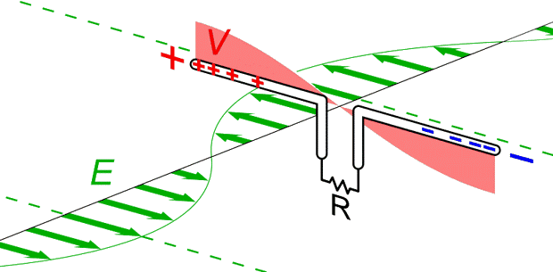
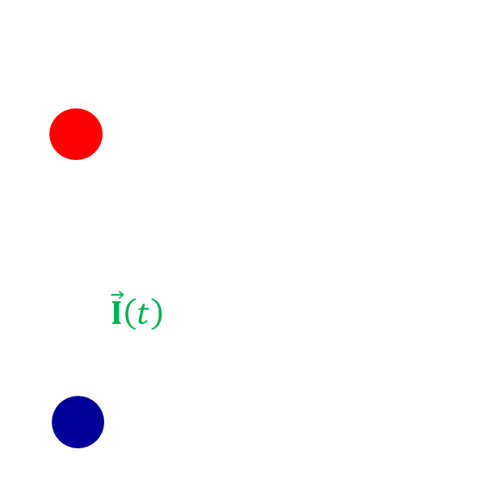
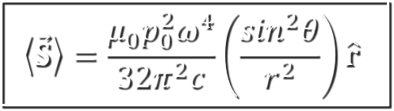
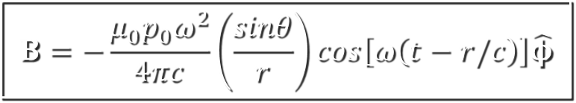
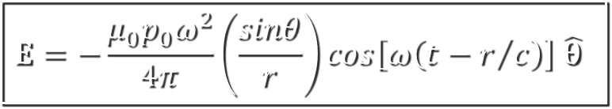
Chapter 11. Radiation. Lecture 30
What you should learn (Griffiths Chapter 11.1.1-2):
1. What is Radiation?
2. Electric dipole radiation
3. EM field of the oscillating dipole
4. Properties of spherical waves
5. The radiated intensity
$$E=−\frac{μ_{0}p_{0}ω^{2}}{4π}\left(\frac{sinθ}{r}\right)cos\left[ω\left(t−r/c\right)\right] \hat{θ}$$
$$B=−\frac{μ_{0}p_{0}ω^{2}}{4πc}\left(\frac{sinθ}{r}\right)cos\left[ω\left(t−r/c\right)\right]\hat{φ}$$
$$\left\langle \vec{S}\right\rangle =\frac{μ_{0}p_{0}^{2}ω^{4}}{32π^{2}c}\left(\frac{\sin^{2}θ}{r^{2}}\right)\hat{r}$$
Photo © Maxim Pchenitchnikov
Notes:
1

Slide 2
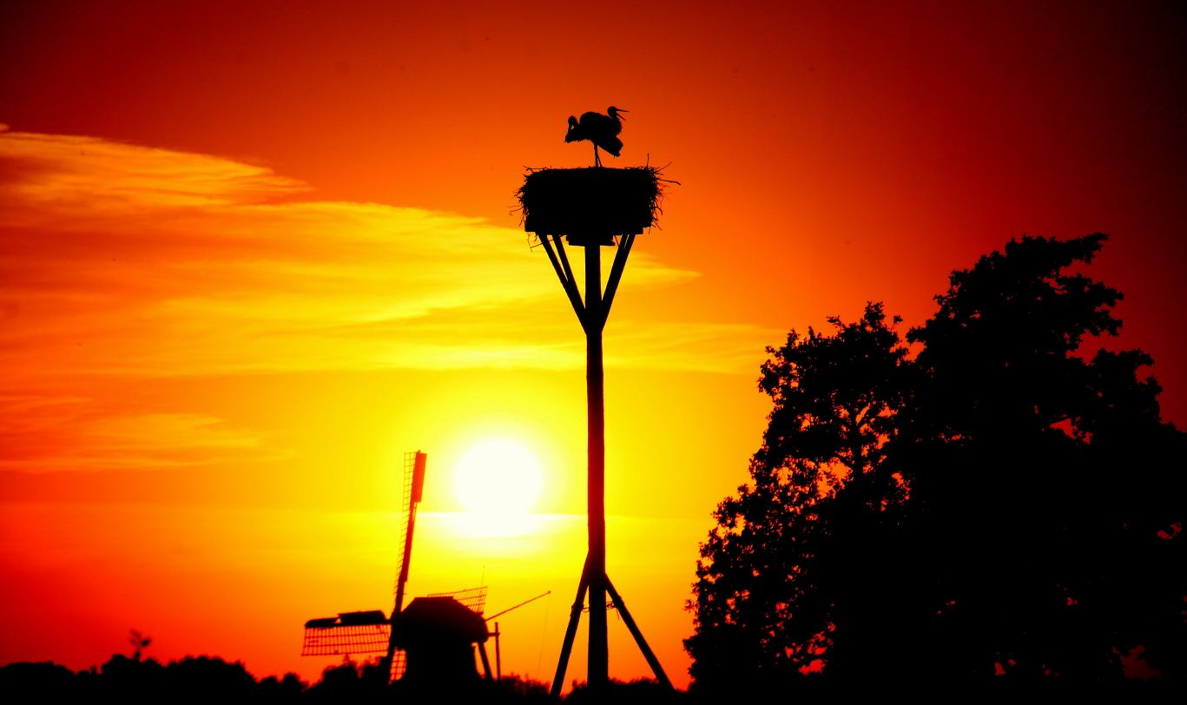

What is “(electromagnetic) radiation”?
2
Electromagnetic radiation, in classical electrodynamics, is the flow of energy at the universal speed of light through free space (or through a material medium) in the form of electromagnetic waves such as radio waves, visible light, and gamma rays
After having been created, EM radiation becomes detached from its source and travels on its own
Notes:
2
Sunlight takes about 8.3 minutes to reach Earth
Background ~1 mm (160 GHz); 2.7 K temperature

Slide 3
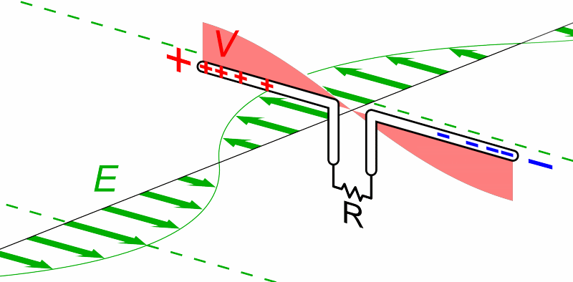
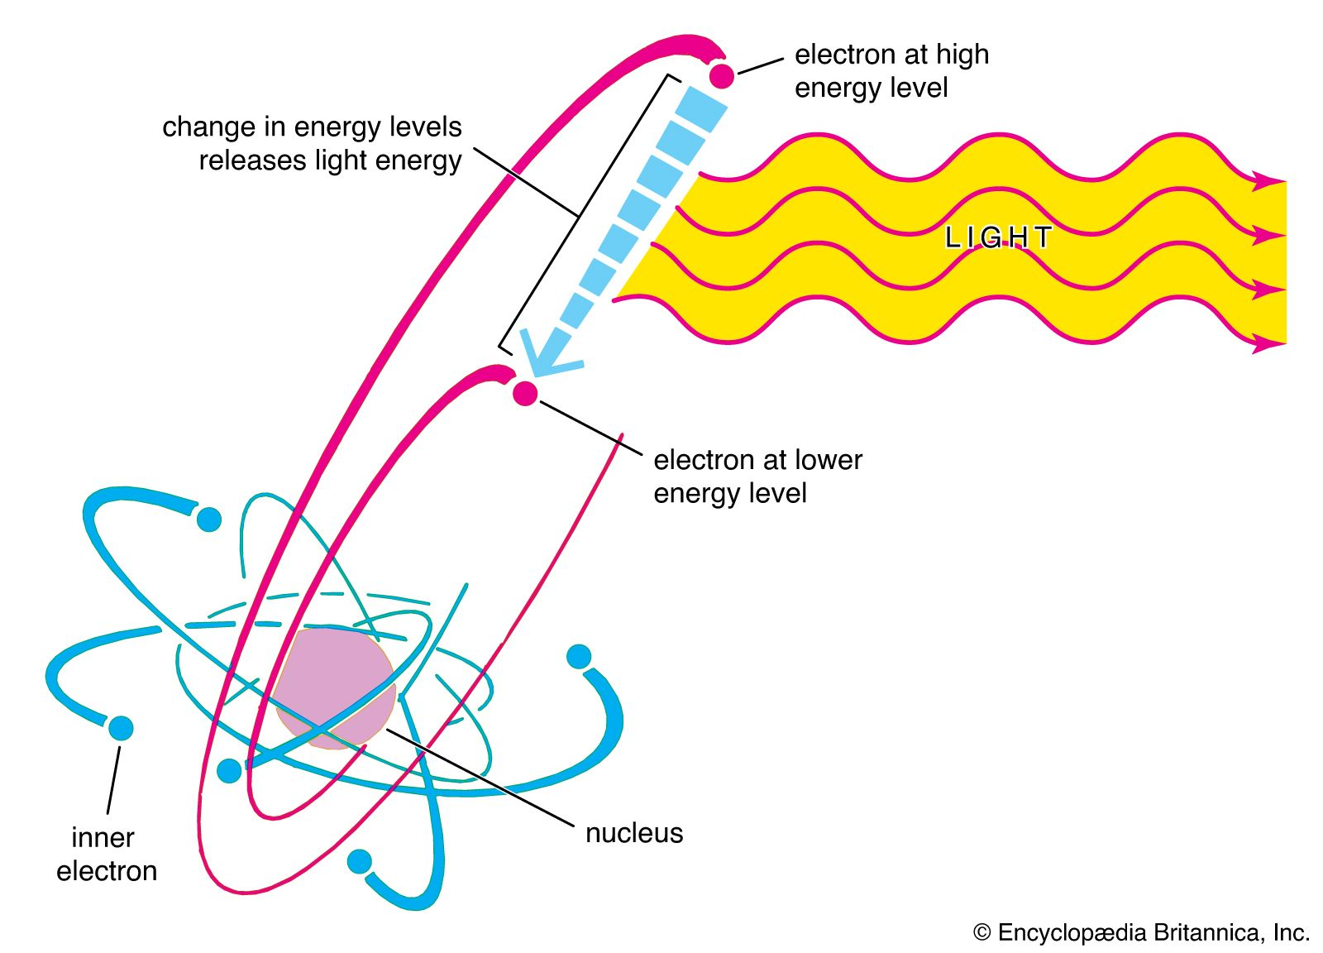
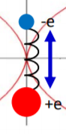
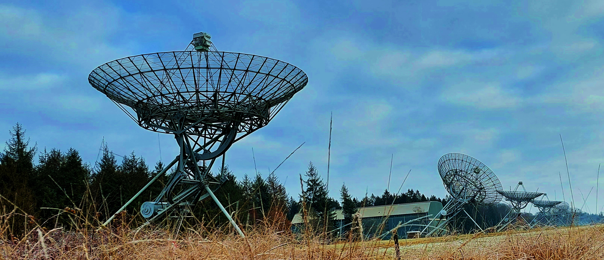
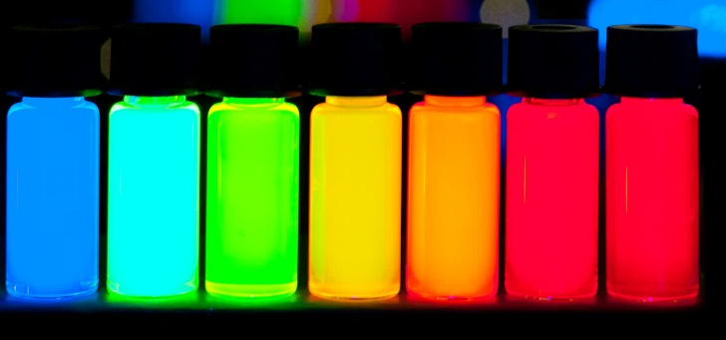
Electromagnetic radiation examples
3
EM wave emitting by a dipole antenna
EM wave emitting by atomic/molecular dipoles
Notes:
3

Slide 4
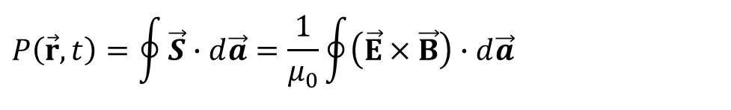
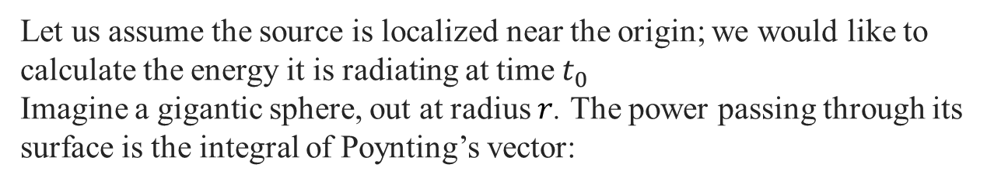
How is radiation created?
4
Let us assume the source is localized near the origin; we would like to calculate the energy it is radiating at time $t_{0}$
Imagine a gigantic sphere, out at radius $r$. The power passing through its surface is the integral of Poynting’s vector:
$$r$$
$$P\left(\vec{r},t\right)=\oint{\vec{S}∙d\vec{a}}=\frac{1}{μ_{0}}\oint{\left(\vec{E}×\vec{B}\right)∙d\vec{a}}$$
Source
The area of the sphere is $4πr^{2}$
For radiation to occur, the Poynting vector must decrease at large $r$ no faster than $1/r^{2}$
Coulomb's law: electrostatic fields $E\sim r^{−2}$ (or even faster, if the total charge is zero)
The Biot-Savart law: magnetostatic fields $B\sim r^{−2}$ (or even faster)
$S\sim r^{−4}$ so that static charged and currents cannot not radiate
Therefore, we need to assume that electromagnetic radiation is produced whenever a charged particle, such as an electron, changes its velocity — i.e., whenever it is accelerated or decelerated
Notes:
4

Slide 5
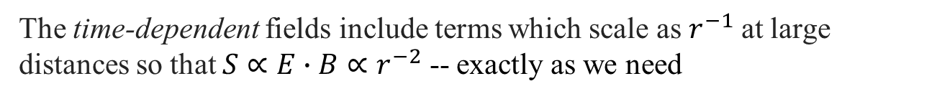
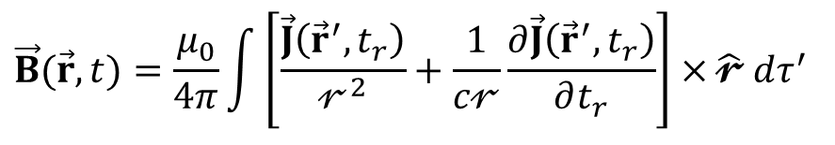
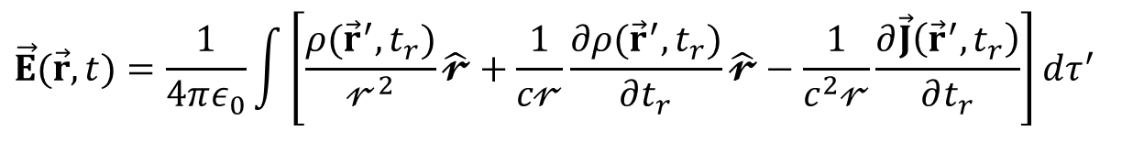
Time-dependent $\dot{ρ}$and $\dot{\vec{J}}$ emit radiation
5
Jefimenko’s equations for $\vec{E}$and $\vec{B}$:
$$\vec{E}(\vec{r},t)=\frac{1}{4πε_{0}}\int{\left[\frac{ρ({\vec{r}}^{′},t_{r})}{𝓇^{2}}\hat{𝓻}+\frac{1}{c𝓇}\frac{∂ρ({\vec{r}}^{′},t_{r})}{∂t_{r}}\hat{𝓻}−\frac{1}{c^{2}𝓇}\frac{∂\vec{J}\left({\vec{r}}^{′},t_{r}\right)}{∂t_{r}}\right]}dτ^{′}$$
$$r$$
$$\vec{B}(\vec{r},t)=\frac{μ_{0}}{4π}\int{\left[\frac{\vec{J}\left({\vec{r}}^{′},t_{r}\right)}{𝓇^{2}}+\frac{1}{c𝓇}\frac{∂\vec{J}\left({\vec{r}}^{′},t_{r}\right)}{∂t_{r}}\right]×}\hat{𝓻} dτ^{′}$$
Source
The time-dependent fields include terms which scale as $r^{−1}$at large distances so that ${S∝E∙B∝r}^{−2}$ -- exactly as we need
These terms involve time derivatives $\dot{ρ}$and $\dot{\vec{J}}$ which are responsible for electromagnetic radiation
Therefore, electromagnetic radiation is produced whenever a charged particle, such as an electron, changes its velocity —i.e., whenever it is accelerated or decelerated
Notes:
5

Slide 6


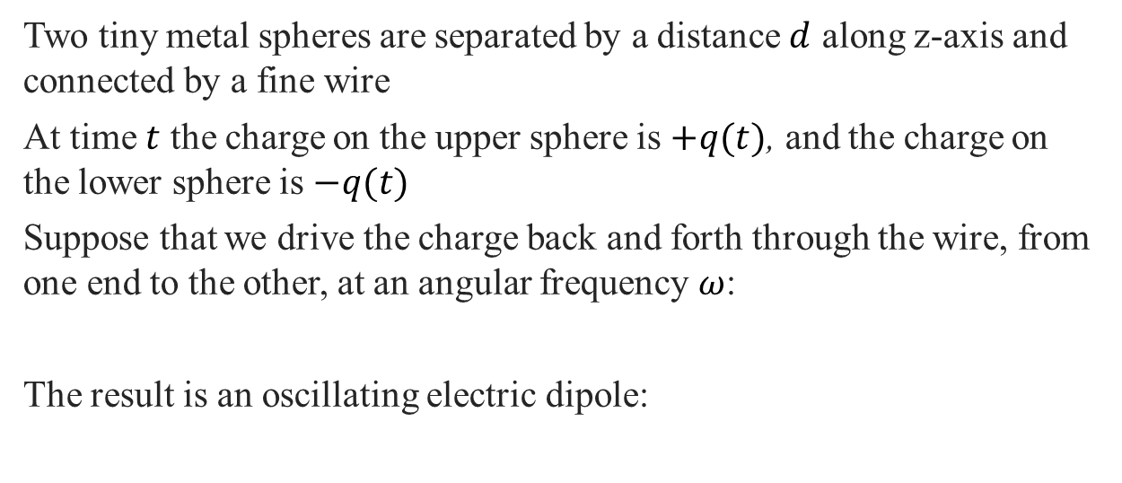
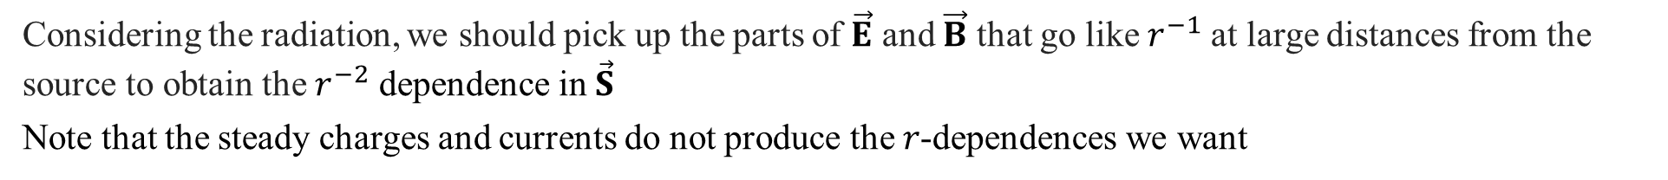





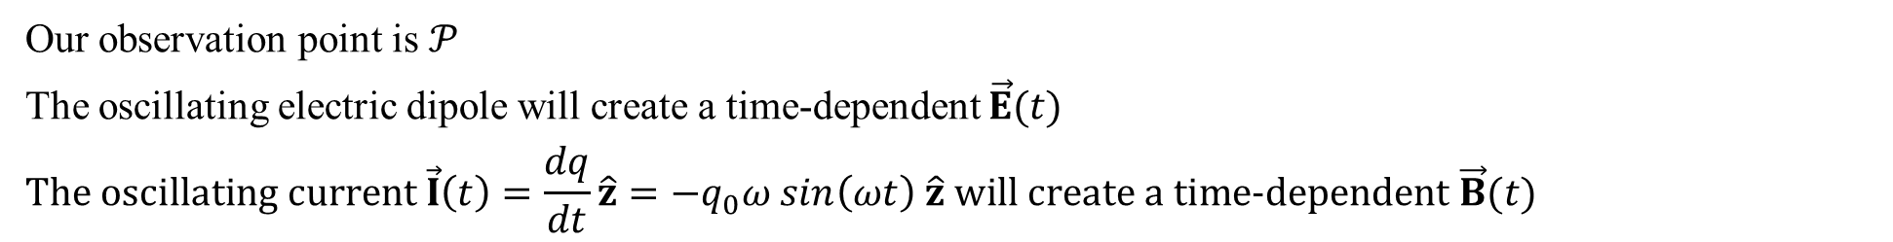




Electric dipole radiation: Setting up the model
6
Two tiny metal spheres are separated by a distance $d$ along z-axis and connected by a fine wire
At time $t$ the charge on the upper sphere is $+q(t)$, and the charge on the lower sphere is $−q(t)$
Suppose that we drive the charge back and forth through the wire, from one end to the other, at an angular frequency $ω$:
The result is an oscillating electric dipole:
$${q(t)=q}_{0} cos\left(ωt\right)$$
$$z$$
$$+q(t)$$
$$𝒫$$
$$\vec{r}$$
$$θ$$
$${q(t)=q}_{0} cos\left(ωt\right)$$
$$d$$
$$\vec{I}\left(t\right)=\frac{dq}{dt}\hat{z}$$
$$=−q_{0}ω sin\left(ωt\right) \hat{z}$$
$$y$$
$$\vec{p}\left(t\right)=p_{0}cos\left(ωt\right) \hat{z}, where p_{0}=q_{0}d$$
$$−q(t)$$
Our observation point is $𝒫$
The oscillating electric dipole will create a time-dependent $\vec{E}(t)$
$$The oscillating current \vec{I}\left(t\right)=\frac{dq}{dt}\hat{z}=−q_{0}ω sin\left(ωt\right) \hat{z} will create a time−dependent \vec{B}(t)$$
Considering the radiation, we should pick up the parts of $\vec{E}$ and $\vec{B}$ that go like $r^{−1}$at large distances from the source to obtain the $r^{−2}$ dependence in $\vec{S}$
Note that the steady charges and currents do not produce the 𝑟-dependences we want
Notes:
6
We will consider only this case while there could be many more configurations which emit radiation – and not necessarily “electric” “dipole” ones

Slide 7
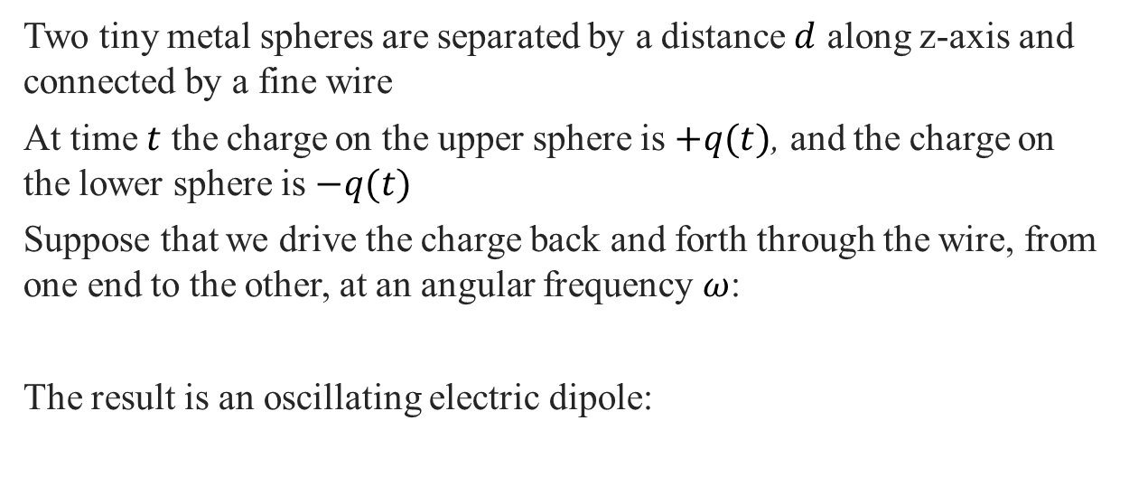
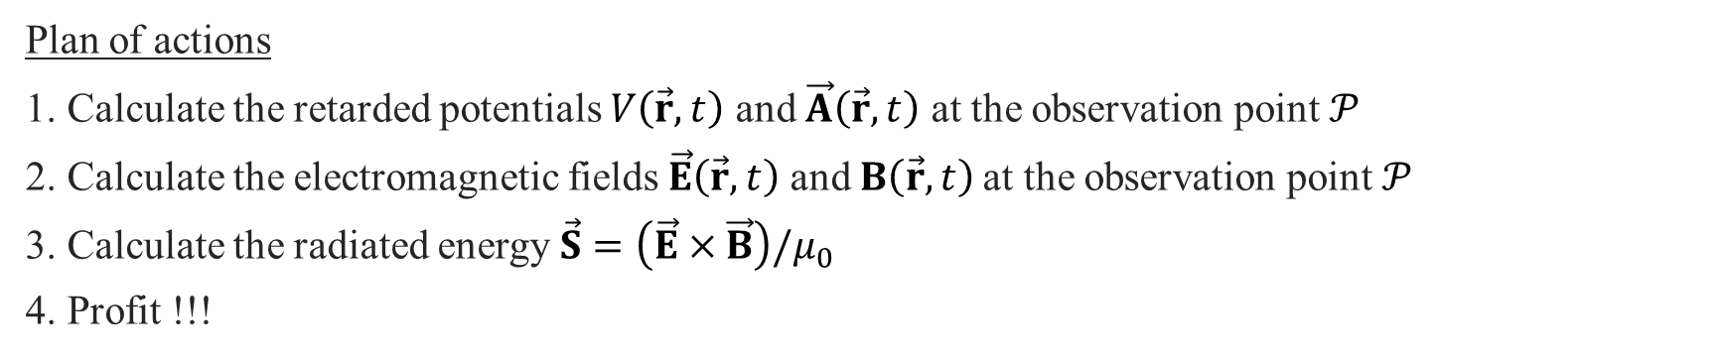


Electric dipole radiation: Plan of actions
7
Two tiny metal spheres are separated by a distance $d$ along z-axis and connected by a fine wire
At time $t$ the charge on the upper sphere is $+q(t)$, and the charge on the lower sphere is $−q(t)$
Suppose that we drive the charge back and forth through the wire, from one end to the other, at an angular frequency $ω$:
The result is an oscillating electric dipole:
$${q(t)=q}_{0} cos\left(ωt\right)$$
$$z$$
$$+q(t)$$
$$𝒫$$
$$\vec{r}$$
$$θ$$
$${q(t)=q}_{0} cos\left(ωt\right)$$
$$d$$
$$\vec{I}\left(t\right)=\frac{dq}{dt}\hat{z}$$
$$=−q_{0}ω sin\left(ωt\right) \hat{z}$$
$$y$$
$$\vec{p}\left(t\right)=p_{0}cos\left(ωt\right) \hat{z}, where p_{0}=q_{0}d$$
$$−q(t)$$
Plan of actions
1. Calculate the retarded potentials $V\left(\vec{r},t\right)$ and $\vec{A}\left(\vec{r},t\right)$ at the observation point $𝒫$
2. Calculate the electromagnetic fields$\vec{E}\left(\vec{r},t\right)$ and $B\left(\vec{r},t\right)$at the observation point $𝒫$
3. Calculate the radiated energy $\vec{S}=\left(\vec{E}×\vec{B}\right)/μ_{0}$
4. Profit !!!
Notes:
7
We will consider only this case while there could be many more configurations which emit radiation – and not necessarily “electric” “dipole” ones

Slide 8



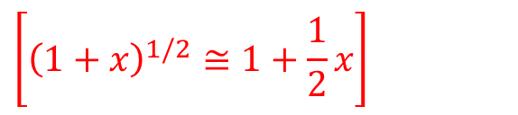

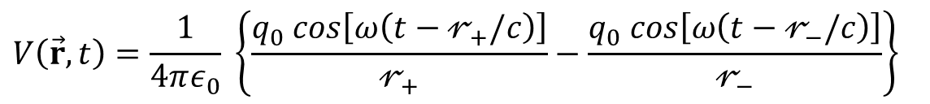
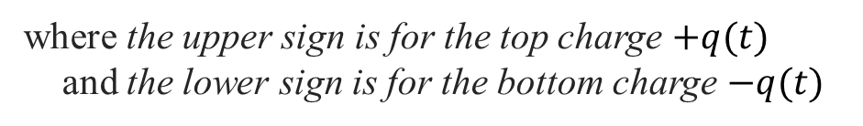
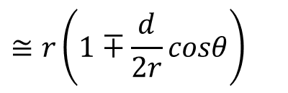

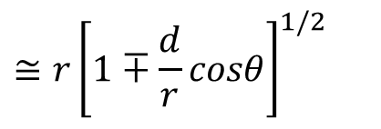

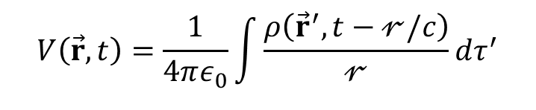
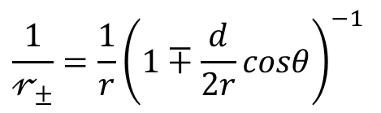

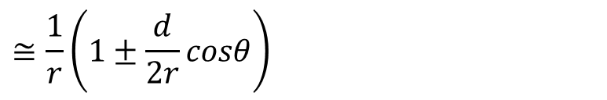
Step 1a. Retarded potentials: $V\left(\vec{r},t\right)$; $𝓇_{±}$ and $𝓇_{±}^{−1}$ terms
8
$$V\left(\vec{r},t\right)=\frac{1}{4πε_{0}}\int{\frac{ρ\left({\vec{r}}^{′}, t−𝓇/c\right)}{𝓇}}dτ^{′}$$
$${q(t)=q}_{0} cos\left(ωt\right)$$
$$z$$
$$+q(t)$$
$$𝓇_{+}$$
For two point charges ${q(t)=q}_{0} cos\left(ωt\right)$:
$$𝒫$$
$$V\left(\vec{r},t\right)=\frac{1}{4πε_{0}} \left\{\frac{q_{0} cos\left[ω\left(t−𝓇_{+}/c\right)\right]}{𝓇_{+}}−\frac{q_{0} cos\left[ω\left(t−𝓇_{−}/c\right)\right]}{𝓇_{−}}\right\}$$
$$\vec{r}$$
$$θ$$
$$𝓇_{−}$$
By the law of cosines,
$$𝓇_{±}=\sqrt{r^{2}∓rdcosθ+{(d/2)}^{2}}$$
$$d$$
$$y$$
where the upper sign is for the top charge $+q(t)$
and the lower sign is for the bottom charge $−q(t)$
Approximation 1: $d≪r$
$$−q(t)$$
This converts a physical dipole into a perfect dipole
$$≅r{\left[1∓\frac{d}{r}cosθ\right]}^{1/2}$$
$$\left[{\left(1+x\right)}^{1/2}≅1+\frac{1}{2}x\right]$$
$$≅r\left(1∓\frac{d}{2r}cosθ\right)$$
$$𝓇_{±}=r\sqrt{1∓\left(d/r\right)cosθ+{(d/2r)}^{2}}$$
$$\frac{1}{𝓇_{±}}=\frac{1}{r}{\left(1∓\frac{d}{2r}cosθ\right)}^{−1}$$
$$≅\frac{1}{r}\left(1±\frac{d}{2r}cosθ\right)$$
$$≅\left[{\left(1+x\right)}^{−1}≅1−x\right]$$
Notes:
8

Slide 9

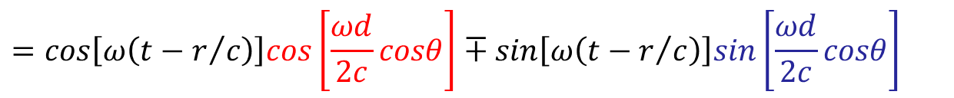

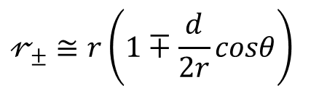
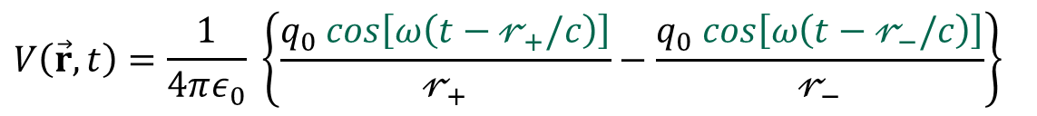
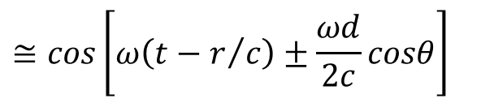
Step 1a. Retarded potentials: $V\left(\vec{r},t\right)$; $cos\left[ω\left(t−𝓇_{±}/c\right)\right]$ terms
9
$$V\left(\vec{r},t\right)=\frac{1}{4πε_{0}} \left\{\frac{q_{0} cos\left[ω\left(t−𝓇_{+}/c\right)\right]}{𝓇_{+}}−\frac{q_{0} cos\left[ω\left(t−𝓇_{−}/c\right)\right]}{𝓇_{−}}\right\}$$
$${q(t)=q}_{0} cos\left(ωt\right)$$
$$z$$
$$+q(t)$$
$$𝓇_{+}$$
$$𝓇_{±}≅r\left(1∓\frac{d}{2r}cosθ\right)$$
$$𝒫$$
$$\vec{r}$$
$$≅cos\left[ω\left(t−r/c\right)±\frac{ωd}{2c}cosθ\right]$$
$$θ$$
$$cos\left[ω\left(t−𝓇_{±}/c\right)\right]$$
$$𝓇_{−}$$
$$d$$
$$\cos\left(A+B\right)=\cos{A}\cos{B}−\sin{A}\sin{B}$$
$$y$$
$$=cos\left[ω\left(t−r/c\right)\right]cos\left[\frac{ωd}{2c}cosθ\right]∓sin\left[ω\left(t−r/c\right)\right]sin\left[\frac{ωd}{2c}cosθ\right]$$
$$−q(t)$$
Approximation 2: $d≪c/ω$, or $d≪λ$
The dipole size is much smaller than the wavelength (of the radiation to be emitted)
$$\frac{ωd}{c}≪1: cos\left[\frac{ωd}{2c}cosθ\right]≅1; sin\left[\frac{ωd}{2c}cosθ\right]≅\frac{ωd}{2c}cosθ$$
$$cos\left[ω\left(t−𝓇_{±}/c\right)\right]≅cos\left[ω\left(t−r/c\right)\right]∓\frac{ωd}{2c}cosθ sin\left[ω\left(t−r/c\right)\right]$$
Notes:
9

Slide 10
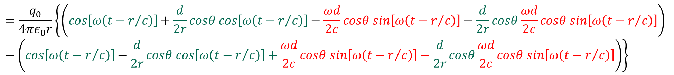
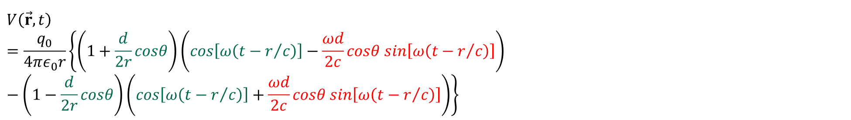
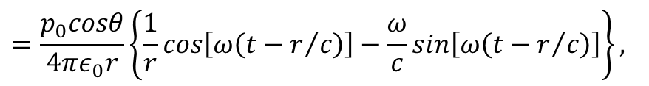

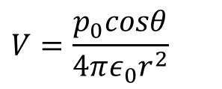
Step 1a. Retarded potentials: $V\left(\vec{r},t\right)$
10
$$V\left(\vec{r},t\right)=\frac{1}{4πε_{0}}\left\{\frac{q_{0} cos\left[ω\left(t−𝓇_{+}/c\right)\right]}{𝓇_{+}}−\frac{q_{0} cos\left[ω\left(t−𝓇_{−}/c\right)\right]}{𝓇_{−}}\right\}$$
$$cos\left[ω\left(t−𝓇_{±}/c\right)\right]≅cos\left[ω\left(t−r/c\right)\right]∓\frac{ωd}{2c}cosθ sin\left[ω\left(t−r/c\right)\right]; \frac{1}{𝓇_{±}}≅\frac{1}{r}\left(1±\frac{d}{2r}cosθ\right)$$
$$V\left(\vec{r},t\right)=\frac{q_{0}}{4πε_{0}r}\left\{\left(1+\frac{d}{2r}cosθ\right)\left(cos\left[ω\left(t−r/c\right)\right]−\frac{ωd}{2c}cosθ sin\left[ω\left(t−r/c\right)\right]\right)−\left(1−\frac{d}{2r}cosθ\right)\left(cos\left[ω\left(t−r/c\right)\right]+\frac{ωd}{2c}cosθ sin\left[ω\left(t−r/c\right)\right]\right)\right\}$$
$$=\frac{q_{0}}{4πε_{0}r}\left\{\left(cos\left[ω\left(t−r/c\right)\right]+\frac{d}{2r}cosθ cos\left[ω\left(t−r/c\right)\right]−\frac{ωd}{2c}cosθ sin\left[ω\left(t−r/c\right)\right]−\frac{d}{2r}cosθ\frac{ωd}{2c}cosθ sin\left[ω\left(t−r/c\right)\right]\right)−\left(cos\left[ω\left(t−r/c\right)\right]−\frac{d}{2r}cosθ cos\left[ω\left(t−r/c\right)\right]+\frac{ωd}{2c}cosθ sin\left[ω\left(t−r/c\right)\right]−\frac{d}{2r}cosθ\frac{ωd}{2c}cosθ sin\left[ω\left(t−r/c\right)\right]\right)\right\}$$
$$=\frac{q_{0}}{4πε_{0}r}\left\{\frac{d}{r}cosθ cos\left[ω\left(t−r/c\right)\right]−\frac{ωd}{c}cosθ sin\left[ω\left(t−r/c\right)\right]\right\}$$
$$=\frac{p_{0}cosθ}{4πε_{0}r}\left\{\frac{1}{r}cos\left[ω\left(t−r/c\right)\right]−\frac{ω}{c}sin\left[ω\left(t−r/c\right)\right]\right\},$$
where $p_{0}=q_{0}d$
$$V=\frac{p_{0}cosθ}{4πε_{0}r^{2}}$$
Interim check: if $ω=0$, the old result for dipole potential (Eq.3.102):
Notes:
10
Let’s begin to collect everything!

Slide 11

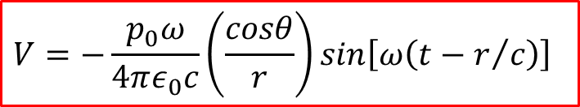

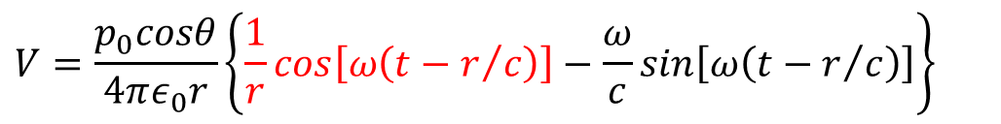
Step 1a. Retarded potentials: $V\left(\vec{r},t\right)$
11
$$V=\frac{p_{0}cosθ}{4πε_{0}r}\left\{\frac{1}{r}cos\left[ω\left(t−r/c\right)\right]−\frac{ω}{c}sin\left[ω\left(t−r/c\right)\right]\right\}$$
We are interested in the fields that survive at large distances from the source
Approximation 3: $r≫c/ω$, or $r≫λ$
The zone $r≫λ$ is called the radiation zone
$$V=−\frac{p_{0}ω}{4πε_{0}c}\left(\frac{cosθ}{r}\right)sin\left[ω\left(t−r/c\right)\right]$$
Hierarchy of approximations
Appr. 1 converts physical dipole into a perfect dipole
$$d≪λ≪r$$
Appr. 2
The dipole size is smaller than the wavelength
Appr. 3
The fields survive at large distances: the radiation zone
Notes:
11

Slide 12
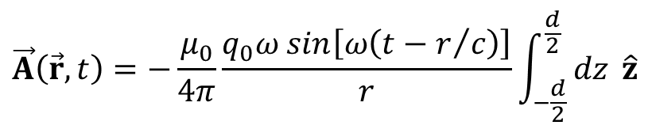
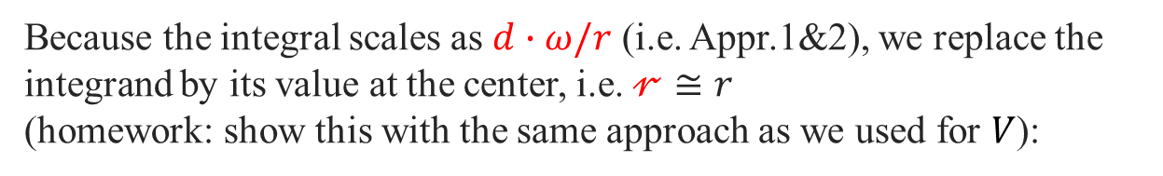
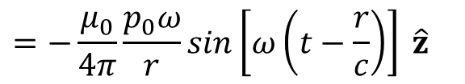

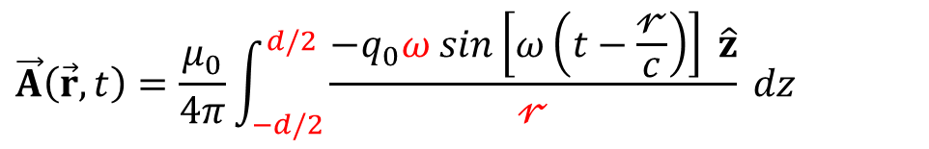

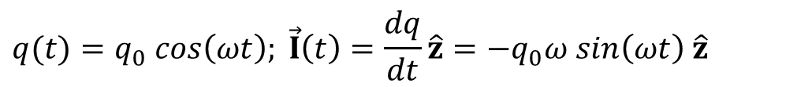



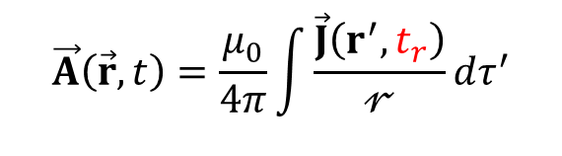
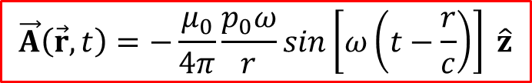


Step 1b. Retarded potentials: $\vec{A}\left(\vec{r},t\right)$
12
$$\vec{A}\left(\vec{r},t\right)=\frac{μ_{0}}{4π}\int{\frac{\vec{J}\left(r^{′},t_{r}\right)}{𝓇}}dτ^{′}$$
$${q(t)=q}_{0} cos\left(ωt\right)$$
$$z$$
$${q(t)=q}_{0} cos\left(ωt\right); \vec{I}\left(t\right)=\frac{dq}{dt}\hat{z}=−q_{0}ω sin\left(ωt\right) \hat{z}$$
$$+q(t)$$
$$𝓇$$
$$𝒫$$
$$\vec{J}\left(t\right)=−q_{0}ω sin\left(ωt\right)δ\left(x\right)δ\left(y\right)\hat{z}$$
$$dz$$
$$θ$$
$$z$$
$$\vec{r}$$
$$\vec{A}\left(\vec{r},t\right)=\frac{μ_{0}}{4π}\int_{−d/2}^{d/2}{\frac{−q_{0}ω sin\left[ω\left(t−\frac{𝓇}{c}\right)\right] \hat{z}}{𝓇} dz}$$
$$y$$
Because the integral scales as $d∙ω/r$ (i.e. Appr.1&2), we replace the integrand by its value at the center, i.e. $𝓇≅r$
(homework: show this with the same approach as we used for $V$):
$$−q(t)$$
$$\vec{A}\left(\vec{r},t\right)=−\frac{μ_{0}}{4π}\frac{q_{0}ω sin\left[ω\left(t−r/c\right)\right]}{r}\int_{−\frac{d}{2}}^{\frac{d}{2}}{ dz} \hat{z}$$
$$=−\frac{μ_{0}}{4π}\frac{p_{0}ω}{r}sin\left[ω\left(t−\frac{r}{c}\right)\right] \hat{z}$$
where $p_{0}=q_{0}d$
$$\vec{A}\left(\vec{r},t\right)=−\frac{μ_{0}}{4π}\frac{p_{0}ω}{r}sin\left[ω\left(t−\frac{r}{c}\right)\right] \hat{z}$$
Notes:
12
Next: changing the Cartesian coordinates into the spherical ones

Slide 13

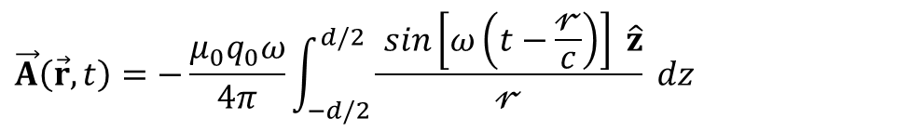
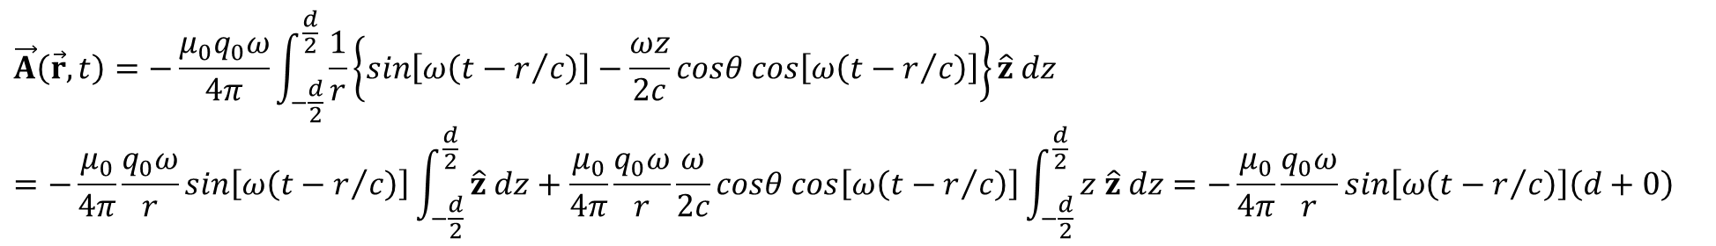
Integral in $\vec{A}\left(\vec{r},t\right)$
13
$$\vec{A}\left(\vec{r},t\right)=−\frac{μ_{0}q_{0}ω}{4π}\int_{−d/2}^{d/2}{\frac{ sin\left[ω\left(t−\frac{𝓇}{c}\right)\right] \hat{z}}{𝓇} dz}$$
$$Appr.1: \frac{1}{𝓇}≅\frac{1}{r}\left(1+\frac{z}{2r}cosθ\right)≅\frac{1}{r};𝓇≅r\left(1−\frac{z}{2r}cosθ\right)$$
$$sin\left[ω\left(t−\frac{𝓇}{c}\right)\right]=sin\left[ω\left(t−r/c\right)−\frac{ωz}{2}cosθ\right]=sin\left[ω\left(t−r/c\right)\right]cos\left[\frac{ωz}{2c}cosθ\right]−cos\left[ω\left(t−r/c\right)\right]sin\left[\frac{ωz}{2c}cosθ\right]$$
$$Appr.2: \frac{ωd}{c}≪1: cos\left[\frac{ωz}{2c}cosθ\right]≅1; sin\left[\frac{ωz}{2c}cosθ\right]≅\frac{ωz}{2c}cosθ$$
$$sin\left[ω\left(t−\frac{𝓇}{c}\right)\right]=sin\left[ω\left(t−r/c\right)\right]−\frac{ωz}{2c}cosθ cos\left[ω\left(t−r/c\right)\right]$$
$$\vec{A}\left(\vec{r},t\right)=−\frac{μ_{0}q_{0}ω}{4π}\int_{−\frac{d}{2}}^{\frac{d}{2}}{\frac{1}{r}\left\{sin\left[ω\left(t−r/c\right)\right]−\frac{ωz}{2c}cosθ cos\left[ω\left(t−r/c\right)\right]\right\}\hat{z} dz}=−\frac{μ_{0}}{4π}\frac{q_{0}ω}{r}sin\left[ω\left(t−r/c\right)\right]\int_{−\frac{d}{2}}^{\frac{d}{2}}{ \hat{z} dz}+\frac{μ_{0}}{4π}\frac{q_{0}ω}{r}\frac{ω}{2c}cosθ cos\left[ω\left(t−r/c\right)\right]\int_{−\frac{d}{2}}^{\frac{d}{2}}{ z \hat{z} dz}=−\frac{μ_{0}}{4π}\frac{q_{0}ω}{r}sin\left[ω\left(t−r/c\right)\right]\left(d+0\right)$$
Notes:
13

Slide 14



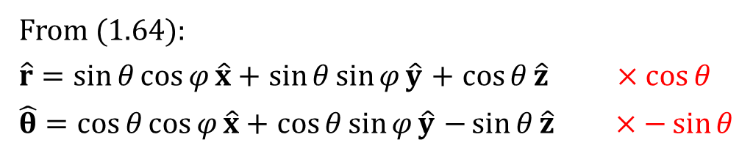
















Step 1b. Retarded potentials: $\vec{A}\left(\vec{r},t\right)$
14
$$z$$
$$\vec{A}\left(\vec{r},t\right)=−\frac{μ_{0}}{4π}\frac{p_{0}ω}{r}sin\left[ω\left(t−\frac{r}{c}\right)\right] \hat{z}$$
$$cosθ \hat{r}$$
$$\hat{φ}$$
$$sinθ \hat{θ}$$
Let’s convert $\vec{A}\left(\vec{r},t\right)$ to the spherical coordinates (Problem 1.36)
$$\hat{r}$$
$$\hat{z}$$
$$𝒫$$
$$\hat{θ}$$
From (1.64):
$\hat{r}=\sin{θ}\cos{φ}\hat{x}+$ $\sin{θ}\sin{φ}\hat{y}$ $+$ $\cos{θ}\hat{z}$ $×\cos{θ}$
$\hat{θ}=\cos{θ}\cos{φ}\hat{x}+$ $\cos{θ}\sin{φ}\hat{y}$ $−\sin{θ}\hat{z}$ $×−\sin{θ}$
$$θ$$
$$r$$
$$φ$$
$$y$$
$$x$$
$\cos{θ}\hat{r}= \cos{θ}\sin{θ}\cos{φ}\hat{x}+$ $\cos{θ}\sin{θ}\sin{φ}\hat{y}$ $+$ $\cos{θ}\cos{θ}\hat{z}$
$−\sin{θ}\hat{θ}=−\sin{θ}\cos{θ}\cos{φ}\hat{x}$ $−\sin{θ}\cos{θ}\sin{φ}\hat{y}$ $+\sin{θ} \sin{θ}\hat{z}$
$$cosθ \hat{θ}$$
$$\hat{z}=cosθ \hat{r}−sinθ \hat{θ}$$
$$\cos{θ}\hat{r}−\sin{θ}\hat{θ}=\left(\cos^{2}{θ}+\sin^{2}{θ}\right) \hat{z}=\hat{z}$$
Check: $\left|\hat{z}\right|=\sqrt{\cos^{2}θ+\sin^{2}θ}=1$
$$\vec{A}\left(\vec{r},t\right)=−\frac{μ_{0}}{4π}\frac{p_{0}ω}{r}sin\left[ω\left(t−r/c\right)\right]\left(cosθ \hat{r}−sinθ \hat{θ}\right)$$
Notes:
14

Slide 15




Step 2. Electric field $\vec{E}\left(\vec{r},t\right)$
15
$$\vec{E}=−∇V−\frac{∂\vec{A}}{∂t}$$
The part that concerns $∇V$
$$V=−\frac{p_{0}ω}{4πε_{0}c}\left(\frac{cosθ}{r}\right)sin\left[ω\left(t−r/c\right)\right]$$
$$∇V=\frac{∂V}{∂r}\hat{r}+\frac{1}{r}\frac{∂V}{∂θ}\hat{θ}$$
$$=−\frac{p_{0}ω}{4πε_{0}c}\left\{cosθ\left(−\frac{1}{r^{2}}sin\left[ω\left(t−r/c\right)\right]+\frac{1}{r}cos\left[ω\left(t−r/c\right)\right]\left[−\frac{ω}{c}\right]\right)\hat{r}−\frac{1}{r}\frac{sinθ}{r}sin\left[ω\left(t−r/c\right)\right] \hat{θ}\right\}$$
$$≅\frac{p_{0}ω}{4πε_{0}c}cosθ\frac{1}{r}\frac{ω}{c}cos\left[ω\left(t−r/c\right)\right] \hat{r}$$
$$Recalling that \frac{1}{c^{2}}=ε_{0}μ_{0}$$
$$∇V=\frac{μ_{0}p_{0}ω^{2}}{4π}\frac{cosθ}{r}cos\left[ω\left(t−r/c\right)\right] \hat{r}$$
Notes:
15
Derivation of cos – minus sine
1/(e_0 c^2)=mu_0

Slide 16








Step 2. Electric field $\vec{E}\left(\vec{r},t\right)$
16
$$\frac{∂\vec{A}}{∂t}$$
The part that concerns
$$\vec{A}\left(r,t\right)=−\frac{μ_{0}}{4π}\frac{p_{0}ω}{r}sin\left[ω\left(t−r/c\right)\right]\left(cosθ \hat{r}−sinθ \hat{θ}\right)$$
$$\frac{∂\vec{A}\left(r,t\right)}{∂t}=−\frac{μ_{0}p_{0}ω^{2}}{4πr}cos\left[ω\left(t−r/c\right)\right]\left(cosθ \hat{r}−sinθ \hat{θ}\right)$$
$$\vec{E}=−∇V−\frac{∂\vec{A}}{∂t}$$
Electric field
$$−\frac{∂\vec{A}}{∂t}$$
$$−∇V$$
$$\vec{E}=−\frac{μ_{0}p_{0}ω^{2}}{4π}\frac{cosθ}{r}cos\left[ω\left(t−r/c\right)\right] \hat{r}$$
$$+\frac{μ_{0}p_{0}ω^{2}}{4π}cos\left[ω\left(t−r/c\right)\right]\left(\frac{1}{r}cosθ \hat{r}−\frac{sinθ}{r}\hat{θ}\right)$$
$$=−\frac{μ_{0}p_{0}ω^{2}}{4π}cos\left[ω\left(t−r/c\right)\right]\left\{\left(\frac{cosθ}{r}−\frac{1}{r}cosθ\right)\hat{r}+\frac{sinθ}{r}\hat{θ}\right\}$$
$$\vec{E}=−\frac{μ_{0}p_{0}ω^{2}}{4π}\left(\frac{\sin{θ}}{r}\right)cos\left[ω\left(t−r/c\right)\right] \hat{θ}$$
Electric field has only the $\hat{θ}$-component!
Notes:
16
Derivative of cos – minus sine

Slide 17



Step 2. Magnetic field $\vec{B}\left(\vec{r},t\right)$
17
$$\vec{A}\left(r,t\right)=−\frac{μ_{0}}{4π}\frac{p_{0}ω}{r}sin\left[ω\left(t−\frac{r}{c}\right)\right]\left(cosθ \hat{r}−sinθ \hat{θ}\right) NB:A_{φ}=0$$
$$\vec{B}=∇×\vec{A}=\frac{1}{r sinθ}\left[\frac{∂}{∂θ}\left(sinθ A_{φ}\right)−\frac{∂A_{θ}}{∂φ}\right] \hat{r}+\frac{1}{r}\left[\frac{1}{sinθ}\frac{∂A_{r}}{∂φ}−\frac{∂}{∂r}\left(rA_{φ}\right)\right] \hat{θ}+\frac{1}{r}\left[\frac{∂}{∂r}\left(rA_{θ}\right)−\frac{∂A_{r}}{∂θ}\right]\hat{φ}$$
$$=\frac{1}{rsinθ}\left[0\right] \hat{r}+\frac{1}{r}\left[0\right] \hat{θ}+\frac{1}{r}\left[\frac{∂}{∂r}\left(rA_{θ}\right)−\frac{∂A_{r}}{∂θ}\right]\hat{φ}$$
Magnetic field has only the $\hat{φ}$-component!
$$\vec{B}=−\frac{μ_{0}p_{0}ω}{4π}\frac{1}{r}\left[\frac{∂}{∂r}\left(r\frac{1}{r}sin\left[ω\left(t−r/c\right)\right]\left[−sinθ\right]\right)−\frac{∂}{∂θ}\left(\frac{1}{r}sin\left[ω\left(t−r/c\right)\right]cosθ\right)\right]\hat{φ}$$
$$\vec{B}=−\frac{μ_{0}p_{0}ω}{4π}\frac{1}{r}\left[−\frac{ω}{c} cos\left[ω\left(t−r/c\right)\right]\left[−sinθ\right]+\frac{sin\left[ω\left(t−r/c\right)\right]}{r}sinθ\right]\hat{φ}$$
$$\vec{B}=−\frac{μ_{0}p_{0}ω^{2}}{4πc}\left(\frac{\sin{θ}}{r}\right)cos\left[ω\left(t−r/c\right)\right]\hat{φ}$$
Notes:
17
Sin’ = cos

Slide 18







Step 2. Electromagnetic field $\vec{E}\left(\vec{r},t\right)$ and $\vec{B}\left(\vec{r},t\right)$
18
$$\vec{E}=−\frac{μ_{0}p_{0}ω^{2}}{4π}\left(\frac{\sin{θ}}{r}\right)cos\left[ω\left(t−r/c\right)\right] \hat{θ}$$
$$\vec{B}=−\frac{μ_{0}p_{0}ω^{2}}{4πc}\left(\frac{\sin{θ}}{r}\right)cos\left[ω\left(t−r/c\right)\right]\hat{φ}$$
1. The dipole oscillating as $\vec{p}\left(t\right)=p_{0}cos\left(ωt\right) \hat{z}$ radiates а monochromatic wave at the same frequency $ω$
2. Waves travel in the radial direction at the speed of light
3. $\vec{E}$ and $\vec{B}$ are in phase
4. $\vec{E}$and $\vec{B}$ are mutually perpendicular and transverse
5. The ratio of the amplitudes is ${E_{0}}/{B_{0}}=c$
Electric field in zy-plane
$$\hat{z}$$
All of those is precisely what we expect for electromagnetic waves in free space
$$\hat{y}$$
6. The wave amplitude decreases like $1/r$
Such waves are called spherical waves
Notes:
18

Slide 19



Lecture 30. Radiation
What you should learn (Griffiths Chapter 11.1.1-11.1.2):
1. Properties of spherical waves
2. The radiated intensity
3. The radiated power
4. Why the sky is blue and polarized, and why the sunset is red
5. Larmor formula and synchrotron radiation
$$\left\langle \vec{S}\right\rangle =\frac{μ_{0}p_{0}^{2}ω^{4}}{32π^{2}c}\left(\frac{\sin^{2}θ}{r^{2}}\right)\hat{r}$$
$$\left\langle P\right\rangle =\frac{μ_{0}p_{0}^{2}ω^{4}}{12πc}$$
$$P=\frac{μ_{0}q^{2}a^{2}}{6πc}$$
Photo © Maxim Pchenitchnikov
Notes:
19

Slide 20



Question 1: PollEv.com/2023mp
20
Coulomb's law holds if
$$\vec{E}\left(\vec{r},t\right)=\frac{1}{4πε_{0}}\int{\frac{ρ\left({\vec{r}}^{′},t\right)}{𝓇^{2}}\hat{𝓻} dτ^{′}}$$
Answer
A. Currents are constant
B. Charge density changes in time slowly
C. Both of above
D. Neither of above: Coulomb's law always holds
Answer C
$$\vec{E}(\vec{r},t)=\frac{1}{4πε_{0}}\int{\left[\frac{ρ({\vec{r}}^{′},t_{r})}{𝓇^{2}}\hat{𝓻}+\frac{1}{c𝓇}\frac{∂ρ({\vec{r}}^{′},t_{r})}{∂t_{r}}\hat{𝓻}−\frac{1}{c^{2}𝓇}\frac{∂\vec{J}\left({\vec{r}}^{′},t_{r}\right)}{∂t_{r}}\right]}dτ^{′}$$
Currents are constant and charge density changes in time slowly
PollEv.com/2023mp, Lecture 31
Notes:
20

Slide 21




Question 1: PollEv.com/2023mp
21
“Point dipole approximation” means that we
$${q(t)=q}_{0} cos\left(ωt\right)$$
$$z$$
$$+q(t)$$
$$𝓇_{+}$$
Answer
A. Suppose that $𝓇_{+}=𝓇_{−}=r$
B. Dismiss all terms which scale faster than $d/r$
C. Dismiss all terms which scale faster than ${\left(d/r\right)}^{2}$
D. I use no approximation; I go numerical !
$$𝒫$$
$$\vec{r}$$
$$θ$$
$$𝓇_{−}$$
$$d$$
$$y$$
Answer B
We use approximation $d≪r$, or $d/r≪1$ which converts physical dipole into a perfect dipole
$$−q(t)$$
$$𝓇_{±}=r\sqrt{1∓\left(d/r\right)cosθ+{(d/2r)}^{2}}$$
PollEv.com/2023mp, Lecture 31
Notes:
21

Slide 22









Step 3. The radiated energy and intensity
22
$$\vec{E}=−\frac{μ_{0}p_{0}ω^{2}}{4π}\left(\frac{sinθ}{r}\right)cos\left[ω\left(t−r/c\right)\right] \hat{θ}; \vec{B}=−\frac{μ_{0}p_{0}ω^{2}}{4πc}\left(\frac{sinθ}{r}\right)cos\left[ω\left(t−r/c\right)\right]\hat{φ}$$
The energy radiated by an oscillating electric dipole
$$\vec{S}(r,t)=\frac{1}{μ_{0}}\left(\vec{E}×\vec{B}\right)=\frac{μ_{0}}{c}{\left\{\frac{p_{0}ω^{2}}{4π}\left(\frac{sinθ}{r}\right)cos\left[ω\left(t−r/c\right)\right]\right\}}^{2}\hat{r}$$
$$\hat{z}$$
The intensity is obtained by averaging over time:
$$\left\langle \vec{S}\right\rangle =\frac{μ_{0}p_{0}^{2}ω^{4}}{32π^{2}c}\left(\frac{\sin^{2}θ}{r^{2}}\right)\hat{r}$$
$$\vec{E}$$
1. The intensity profile takes the form of a donut
2. The maximum is in the equatorial plane
(where $\sin{θ}=1$)
3. No radiation along the axis of the dipole,
i.e. z-axis (where $\sin{θ}=0$)
4. Strong frequency dependence: $ω^{4}$ !
$$\hat{y}$$
$$\vec{S}$$
$$\vec{B}$$
$$\hat{x}$$
Notes:
22

Slide 23











Step 3. The radiated power
23
$$\left\langle \vec{S}\right\rangle =\frac{μ_{0}p_{0}^{2}ω^{4}}{32π^{2}c}\left(\frac{\sin^{2}θ}{r^{2}}\right)\hat{r}$$
$$\left\langle P\right\rangle =\int_{𝒮}{\left\langle \vec{S}\right\rangle ∙d\vec{a}}$$
$$=\frac{μ_{0}p_{0}^{2}ω^{4}}{32π^{2}c}\int{\frac{\sin^{2}θ}{r^{2}}r^{2}sinθ dθdφ}$$
$$=\frac{μ_{0}p_{0}^{2}ω^{4}}{32π^{2}c}\int_{0}^{2π}{dφ}\int_{0}^{π}{\sin^{3}θ dθ}$$
The total power radiated:
large surface
r-dependence cancels!
The radiated power does not depend on the distance ! (it should not, of course)
$$\int{\sin^{3}θ dθ}$$
$$=−\int{\sin^{2}θ d(cosθ)}$$
$$=−\int{\left(1−\cos^{2}θ\right)d(cosθ)}$$
$$=\frac{\cos^{3}θ}{3}−cosθ$$
$$\left\langle P\right\rangle =\frac{μ_{0}p_{0}^{2}ω^{4}}{32π^{2}c}2π\left.\left(\frac{\cos^{3}θ}{3}−cosθ\right)\right|\begin{matrix}\begin{aligned}π \\ \end{aligned} \\ 0\end{matrix}$$
$$=\frac{μ_{0}p_{0}^{2}ω^{4}}{16πc}\left(−\frac{1}{3}+1−\frac{1}{3}+1\right)$$
$$=\frac{μ_{0}p_{0}^{2}ω^{4}}{16πc}\frac{4}{3}=\frac{μ_{0}p_{0}^{2}ω^{4}}{12πc}$$
$$\left\langle P\right\rangle =\frac{μ_{0}p_{0}^{2}ω^{4}}{12πc}$$
The $ω^{4}$ dependence has few interesting consequences which link the abstract theory to daily life
Notes:
23
All done up to here

Slide 24


Step 4.1. Why is the sky blue?
24
$$\left\langle P\right\rangle =\frac{μ_{0}p_{0}^{2}ω^{4}}{12πc}$$
Blue light scattered more efficiently by the atmosphere
White light directly from the sun
The incident solar radiation covers a broad range of frequencies (white light)
Sunlight passing through the atmosphere stimulates atoms to oscillate as tiny dipoles. It is this re-radiated (scattered) light that you see when you look up in the sky
The energy absorbed and reradiated by the atmospheric dipoles is stronger at the higher frequencies because of the $\left\langle P\right\rangle ∝ω^{4}$dependence (400 nm vs. 750 nm)
Re-radiation is more intense in the blue than in the red
Notes:
24

Slide 25


Step 4.2. Why is the sunset red?
25
Blue colors are re-radiated into all directions
$$\left\langle P\right\rangle =\frac{μ_{0}p_{0}^{2}ω^{4}}{12πc}$$
Red colors are scattered less
In the sunset/sunrise, the sunlight travels through the most atmosphere
The blue light is efficiently removed from the sunrays by re-radiation into all directions
The red light is removed less efficiently from the sunrays by re-radiation
Red is the color to be seen!
Notes:
25

Slide 26

Sunset at other planets
26
https://www.youtube.com/watch?v=DwD3HD6t5Vs
Notes:
26

Slide 27


Step 4.3. What about the polarization?
27
$$\left\langle \vec{S}\right\rangle =\frac{μ_{0}p_{0}^{2}ω^{4}}{32π^{2}c}\left(\frac{\sin^{2}θ}{r^{2}}\right)\hat{r}$$
This dipole does not radiate to the observer
This dipole radiates to the observer
Because electromagnetic waves are transverse, the dipoles oscillate in a plane orthogonal to the sun's rays
In the celestial arc perpendicular to these rays, the dipoles oscillating along the line of sight send no radiation to the observer (because of the$\sin^{2}θ$ term)
Light received by the observer is therefore polarized perpendicular to the sun's rays
Notes:
27

Slide 28

Experimental setup
28
Observer
“Atmosphere”
Water in a jar
“Sun”
Tungsten lamp
“Scattering dipoles”
Magere melk
Notes:
28

Slide 29




Which milk to take?
29
We need scattering particles with sizes << $λ$
Cow’s milk is composed of 87% water, 3.5% protein, 3.7% fat, 4.9% lactose, and 0.7% salts
The proteins, referred to as casein particles, combine together calcium and phosphate to form aggregates with a well-defined structure. Their typical size is in the range of 100-200 nm
The fat globules in raw unhomogenized milk are between 1-10 µm
So the nonfat (skimmed) milk should work!
Particle size distribution in raw milk
Particle size distribution in nonfat milk
Raw milk
Median 3.1 µm
Mean 3.7 µm
Non-fat milk
Median 0.18 µm
Mean 0.2 µm
Occurrence (%)
Occurrence (%)
0.1 1.0 10.0 100.0
0.1 1.0 10.0 100.0
Diameter (µm)
Diameter (µm)
Notes:
29

Slide 30






Sunset in 11.0022
30
Different phases of the “sunset”
Horizontal polarization Vertical polarization
Notes:
30

Slide 31


Make Your Own Sunset
31
$$\left\langle \vec{S}\right\rangle =\frac{μ_{0}p_{0}^{2}ω^{4}}{32π^{2}c}\left(\frac{\sin^{2}θ}{r^{2}}\right)\hat{r}$$
Notes:
31

Slide 32



Question 3: PollEv.com/2023mp
32
Why does the sky appear blue and not violet?
Answer
A. Violet scatters less than blue
B. There is no violet color in Sun’s radiation
C. Our eyes are not very sensitive to violet
D. Maxwell was wrong!
Answer C
PollEv.com/2023mp, Lecture 31
Notes:
32

Slide 33


















Step 4.4. What about Brewster’s angle?
33
Electric field parallel to the plane of incidence
Dipoles at the interface do not re-emit at$θ=π/2$
$$θ_{B}+π/2+θ_{T}=π$$
$$E_{I}$$
$$θ_{B}$$
$$θ_{T}=π/2−θ_{B}$$
$$θ_{B}$$
$$E_{R}=0$$
$$\frac{\sin{θ_{B}}}{\sin{θ_{T}}}=\frac{n_{2}}{n_{1}};$$
$$\frac{\sin{θ_{B}}}{\sin\left(π/2−θ_{B}\right)}=\frac{n_{2}}{n_{1}}$$
$$n_{1}$$
$$\frac{\sin{θ_{B}}}{\cos{θ_{B}}}=\frac{n_{2}}{n_{1}};$$
$$\tan{θ_{B}}=\frac{n_{2}}{n_{1}}$$
$$∞$$
$$n_{2}$$
$$E_{T}$$
Exactly as we established earlier for Brewster’s angle
You can do it another way around: start with Snell’s law and show that the angle between the “reflected” and transmitted beams is $π/2$
$$θ_{T}$$
Of course, there is no Brewster angle for the s-polarization
Notes:
33

Slide 34












Larmor formula
34
The energy radiated by an oscillating electric dipole (before time-averaging)
$$\vec{S}(r,t)=\frac{1}{μ_{0}}\left(\vec{E}×\vec{B}\right)=\frac{μ_{0}}{c}{\left\{\frac{p_{0}ω^{2}}{4π}\left(\frac{sinθ}{r}\right)cos\left[ω\left(t−r/c\right)\right]\right\}}^{2}\hat{r}$$
The power passing through a surface of small radius r:
$$P\left(r,t\right)= \oint{\vec{S}\left(r,t\right)}∙d\vec{a}$$
$$≅\frac{μ_{0}}{16π^{2}c}ω^{4}p_{0}^{2}\cos^{2}\left(ωt\right)\int{\frac{\sin^{2}θ}{r^{2}}r^{2}sinθ dθdφ}$$
$$=\frac{μ_{0}}{16π^{2}c}ω^{4}p_{0}^{2}\cos^{2}\left(ωt\right)∙2π\frac{4}{3}$$
$$P\left(t\right)≈\frac{μ_{0}}{6πc}ω^{4}p_{0}^{2}\cos^{2}\left(ωt\right)$$
$$\frac{d^{2}p}{{dt}^{2}}≡\ddot{p}=−ω^{2}p_{0}cos\left(ωt\right);$$
$$P=\frac{μ_{0}}{6πc}{\left(\ddot{p}\right)}^{2}$$
The oscillating dipole moment:
$$\vec{p}\left(t\right)=p_{0}cos\left(ωt\right) \hat{z};$$
For a single point charge q at the position $\vec{d}\left(t\right)$:
$$\vec{p}\left(t\right)=q\vec{d}\left(t\right);$$
$$\ddot{\vec{p}}\left(t\right)=q\ddot{\vec{d}}\left(t\right)=q\vec{a}\left(t\right)$$
$$P=\frac{μ_{0}q^{2}a^{2}}{6πc}$$
acceleration
Accelerated a (non-relativistic) point charge radiates power as an EM wave
The power radiated is proportional to the square of acceleration
The “derivation” above is not exactly accurate but it provides the right result
(interested in more? see Chapter 10.3 on Liénard-Wiechert potentials & Chapter 11.2 on Point charges)
Notes:
34

Slide 35





Synchrotron radiation
35
$$P=\frac{μ_{0}q^{2}a^{2}}{6πc}$$
Accelerated charged particles emit electromagnetic radiation
Predicted by Iwanenko and Pomeranchuk, "On the maximal energy attainable in betatron", Physical Review vol.65, p. 343 (1944)
Observed by Elder, Gurewitsch, Langmuir, Pollock, "Radiation from Electrons in a Synchrotron" Physical Review 71, pp. 829-830 (1947)
A nuisance, causing undesired energy loss
A deliberately produced radiation source of wavelengths from 100 µm to 0.1 nm
Bunch of electrons
Bunch of electrons
“Wiggler”
Gap
undulators
x-rays
“Synchrotron radiation”
Notes:
35

Slide 36


Question 1: PollEv.com/2023mp
36
What in your opinion is depicted on this painting?
Answer
A. Eclectic Twilights
B. Flying with the Harp in Toscana
C. Electromagnetic Waves
D. Witches Going to Their Sabbath
Answer C
“Allegory of Electromagnetic Waves”
attributed to Vittorio Matteo Corcos (1859-1933)
PollEv.com/2023mp, Lecture 32
Notes:
36

Slide 37










Question 2: PollEv.com/2023mp
37
An ideal dipole oscillates along the $\hat{z}$-direction.
At which polar angle is the maximum of intensity radiated?
$$\hat{z}$$
Answer
A. $θ=0$
B. $θ=π/2$
C. $θ=π$
D. At all angles
$$\vec{E}$$
$$\hat{y}$$
$$\vec{S}$$
$$\vec{B}$$
$$\hat{x}$$
Answer B
$$\left\langle S\right\rangle =\frac{μ_{0}p_{0}^{2}ω^{4}}{32π^{2}c}\left(\frac{\sin^{2}θ}{r^{2}}\right)\hat{r}$$
The maximum is in the equatorial plane, i.e. $θ=π/2$
PollEv.com/2023mp, Lecture 32
Notes:
37

Slide 38


Soleil synchrotron (Paris)
38
Notes:
38

Slide 39

Synchrotron radiation
39
Notes:
39
SLAC = Stanford Linear Accelerator Center
LCLS = Linac Coherent Light Source

Slide 40


Synchrotron radiation
40
SLAC = Stanford Linear Accelerator Center
LCLS = Linac Coherent Light Source
SLAC = Stanford Linear Accelerator Center
LCLS = Linac Coherent Light Source
https://www.youtube.com/watch?v=zKbJMFFjnNU
Notes:
40
SLAC = Stanford Linear Accelerator Center
LCLS = Linac Coherent Light Source

Slide 41


Synchrotron radiation in astronomy
41
Synchrotron radiation is generated by astronomical objects, typically where relativistic electrons spiral (and hence change velocity) through magnetic fields.
Supermassive black holes have been suggested for producing synchrotron radiation, by ejection of jets ions through the polar areas of magnetic fields (Messier 87)
The pulsar wind nebulae (aka plerions)
The bluish glow from the central region of the Crab nebula is believed to be due to synchrotron radiation
Notes:
41
Supermassive black holes have been suggested for producing synchrotron radiation, by ejection of jets produced by gravitationally accelerating ions through the super contorted 'tubular' polar areas of magnetic fields. Such jets, the nearest being in Messier 87, have been confirmed by the Hubble telescope as apparently superluminal, travelling at 6 × c (six times the speed of light) from our planetary frame. This phenomenon is caused because the jets are travelling very near the speed of light and at a very small angle towards the observer. Because at every point of their path the high-velocity jets are emitting light, the light they emit does not approach the observer much more quickly than the jet itself. Light emitted over hundreds of years of travel thus arrives at the observer over a much smaller time period (ten or twenty years) giving the illusion of faster than light travel. There is no violation of special relativity.

Slide 42





Gravitational waves
42
Gravitational waves are the disturbance in the curvature of spacetime generated by accelerated masses and propagate as waves at the speed of light
$$\vec{F}=G\frac{m_{1}m_{2}}{𝓇^{2}}\hat{𝓻}$$
$$\vec{F}=\frac{1}{4πε_{o}}\frac{q_{1}q_{2}}{𝓇^{2}}\hat{𝓻}$$
Newton’s gravitation law
Coulomb's law
“Oscillating dipole”
First observation on 14 September 2015; The Nobel Prize in Physics was awarded in 2017 to Rainer Weiss, Kip Thorne and Barry Barish for their role in the detection of gravitational waves
https://youtu.be/szTHVJ9PJsk?t=47
Notes:
42
LIGO – the Laser Interferometer Gravitational Wave Observatory.
On 11 February 2016, the LIGO collaboration announced the first observation of gravitational waves, from a signal detected at 09:50:45 GMT on 14 September 2015^{[27]} of two black holes with masses of 29 and 36 solar masses merging about 1.3 billion light-years away.
16 October 2017, the LIGO and Virgo (Europe) collaborations announced the first-ever detection of gravitational waves originating from the coalescence of a binary neutron star system.
~90 events have been observed by now (june 2022)

Slide 43

Useful resources
43
Dipole radiation (mind $sinθ↔cosθ$):
https://www.youtube.com/watch?v=MGCHznSfCnQ
Demonstration of the sunset by Walter Lewin
https://youtu.be/sJG-rXBbmCc?t=2341
NASA sunset stimulator
https://www.youtube.com/watch?v=vrLfHv6sze0&feature=youtu.be
Notes:
43

Slide 44








Stability of the Rutherford atom
44
The accelerated charge emits radiation so that it loses its energy. What about a Rutherford atom?
$$P=\frac{μ_{0}e^{2}ω^{4}r^{2}}{6πc}$$
The electron has “centrifugal” acceleration $a=v^{2}/r=ω^{2}r$
so that it emits power (=loses)
$$P=\frac{dW}{dt}=\frac{μ_{0}q^{2}a^{2}}{6πc};a=ω^{2}r$$
$$E=\frac{μ_{0}e^{2}ω^{4}r^{2}}{6πc}t$$
The energy lost in time t:
The energy comes from the “initial” kinetic energy
$$E=\frac{m_{e}}{2}v^{2}=\frac{m_{e}}{2}ω^{2}r^{2}$$
$$\frac{μ_{0}e^{2}ω^{4}r^{2}}{6πc}τ=\frac{m_{e}}{2}ω^{2}r^{2};τ=\frac{3πcm_{e}}{μ_{0}e^{2}ω^{2}}$$
This energy will be spent in the time $τ$:
For an H-atom, $λ=122 nm→ ω={2πc}/λ=1.5∙{10}^{16} rad/s$
$$τ=\frac{3π∙3∙{10}^{8}∙9.11∙{10}^{−31}}{4π∙{10}^{−7}{\left(1.6∙{10}^{−19}∙1.5∙{10}^{16}\right)}^{2}}≈\frac{3∙{10}^{−21}}{20∙{{10}^{−7}∙10}^{−6}}≈\frac{3}{2}\frac{{10}^{−21}}{{10}^{−12}}={0.7∙10}^{−9} \text{s}$$
The Rutherford atom is inherently unstable! (in the framework of classical electrodynamics)
Notes:
44
Moved to tutorials!

