Slide 1


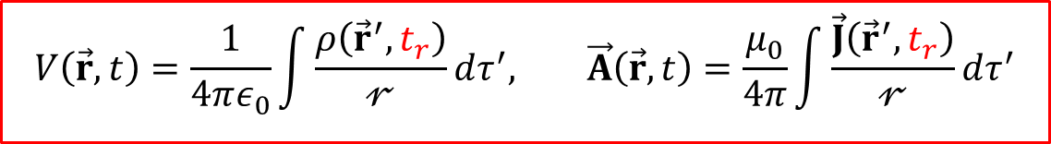
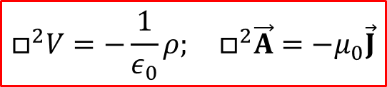
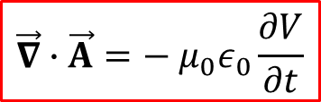



Chapter 10. Potentials and fields
1
What you should learn (Griffiths 10.1.2-10.1.3, 10.2):
1. Potentials in a new formulation
2. The Coulomb gauge and the Lorenz gauge
3. Inhomogeneous wave equations for V and $\vec{A}$
4. Retarded time
5. Retarded potentials
$$\vec{E}=−\vec{∇}V−\frac{∂\vec{A}}{∂t}$$
$$\vec{B}=\vec{∇}×\vec{A}$$
$$\vec{∇}∙\vec{A}=−{{ μ}_{0}ε}_{0}\frac{∂V}{∂t}$$
$$\vec{∇}∙\vec{A}=0$$
$$□^{2}V=−\frac{1}{ε_{0}}ρ; □^{2}\vec{A}=−μ_{0}\vec{J}$$
$$t_{r}≡t−\frac{𝓇}{c}$$
$$V\left(\vec{r},t\right)=\frac{1}{4πε_{0}}\int{\frac{ρ\left({\vec{r}}^{′},t_{r}\right)}{𝓇}}dτ^{′},{}^{}\vec{A}\left(\vec{r},t\right)=\frac{μ_{0}}{4π}\int{\frac{\vec{J}\left({\vec{r}}^{′},t_{r}\right)}{𝓇}}dτ^{′}$$
Notes:
1

Slide 2
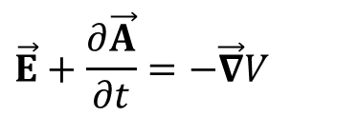
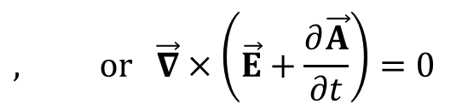

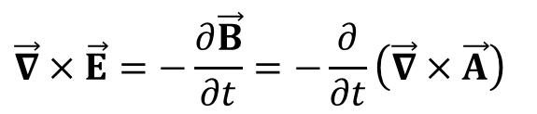
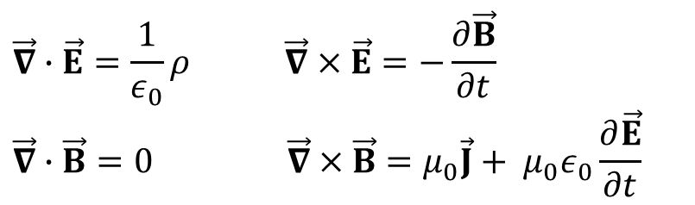


Chapter 10. Scalar and vector potentials
2
$$\vec{∇}∙\vec{E}=\frac{1}{ε_{0}}ρ \vec{∇}×\vec{E}=−\frac{∂\vec{B}}{∂t}$$
$$\vec{∇}∙\vec{B}=0 \vec{∇}×\vec{B}=μ_{0}\vec{J}+{{ μ}_{0}ε}_{0}\frac{∂\vec{E}}{∂t}$$
General problem to be solved in E&M: Given $ρ\text{(}\vec{\text{r}}\text{, }\text{t}\text{)}$ and $\vec{J} \text{(}\vec{\text{r}}\text{, }\text{t}\text{)}$, what are the fields $\vec{E}$($\vec{\text{r}}$, t) and $\vec{B}$($\vec{\text{r}}$, t)?
Аs $\vec{∇}∙\vec{B}=0$ still unchanged, we still define the vector potential $\vec{A}$ as earlier in magnetostatics:
$$\vec{B}=\vec{∇}×\vec{A}$$
However, we cannot keep the old definition of the scalar potential$\vec{E}=−\vec{∇}V$ because $\vec{∇}×\vec{E}≠0 any longer$
But we can play the following trick to redefine $V$:
$$\vec{∇}×\vec{E}=−\frac{∂\vec{B}}{∂t}=−\frac{∂}{∂t}\left(\vec{∇}×\vec{A}\right)$$
$$, or \vec{∇}×\left(\vec{E}+\frac{∂\vec{A}}{∂t}\right)=0$$
$$\vec{E}+\frac{∂\vec{A}}{∂t}=−\vec{∇}V$$
As $\vec{∇}×\left(…\right)$ vanishes, $\left(…\right)$ could be written as the gradient of a scalar
$$\vec{E}=−\vec{∇}V−\frac{∂\vec{A}}{∂t}$$
where V is the new scalar potential
$$\frac{∂\vec{A}}{∂t}=0$$
NB: if , back to electrostatics $\vec{E}=−\vec{∇}V$
Notes:
2

Slide 3


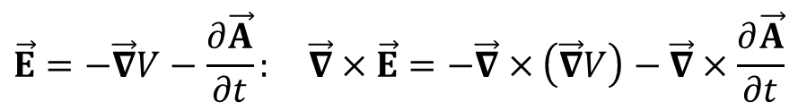
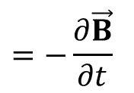

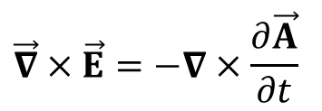
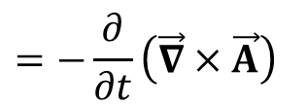
Scalar and vector potentials
3
$$\vec{∇}∙\vec{E}=\frac{1}{ε_{0}}ρ \vec{∇}×\vec{E}=−\frac{∂\vec{B}}{∂t}$$
$$\vec{∇}∙\vec{B}=0 \vec{∇}×\vec{B}=μ_{0}\vec{J}+{{ μ}_{0}ε}_{0}\frac{∂\vec{E}}{∂t}$$
$$\vec{E}=−\vec{∇}V−\frac{∂\vec{A}}{∂t}$$
$$\vec{B}=\vec{∇}×\vec{A}$$
Note that the definitions of the potentials automatically take care of noname’s and Faraday’s equations In fact, the potentials are defined on basis of these equations:
√
Applying div to $\vec{B}=\vec{∇}×\vec{A}$: $\vec{∇}∙\vec{B}=\vec{∇}∙\left(∇×\vec{A}\right)≡0$ (Identity #9)
$$\vec{E}=−\vec{∇}V−\frac{∂\vec{A}}{∂t}: \vec{∇}×\vec{E}=−\vec{∇}×\left(\vec{∇}V\right)−\vec{∇}×\frac{∂\vec{A}}{∂t}$$
Applying curl to
$\vec{∇}×\left(\vec{∇}V\right)≡0$ (Identity #10)
$$\vec{∇}×\vec{E}=−∇×\frac{∂\vec{A}}{∂t}$$
$$=−\frac{∂}{∂t}\left(\vec{∇}×\vec{A}\right)$$
$$=−\frac{∂\vec{B}}{∂t}$$
√
Why bother with the potentials? They become more useful than the fields when charges and currents move around!
Notes:
3

Slide 4
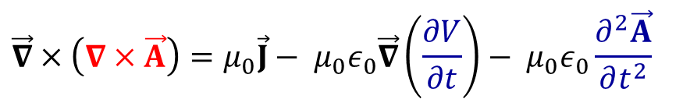
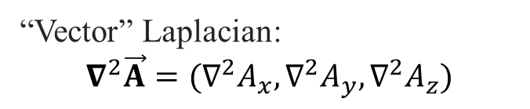
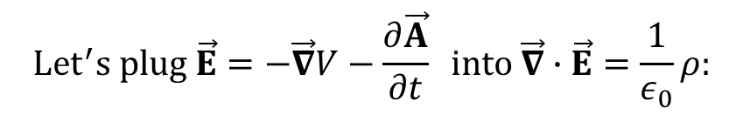
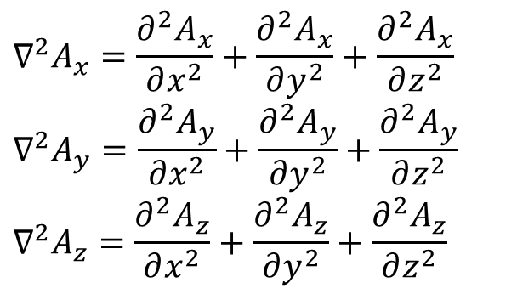
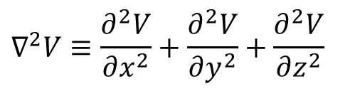
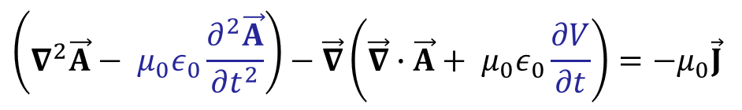
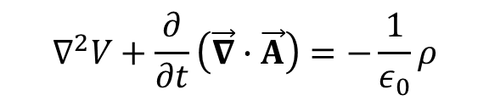
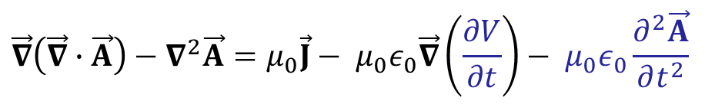
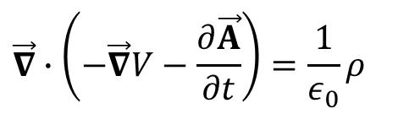

What about the other two Maxwell’s equations?
4
$${Let}^{′}s plug \vec{E}=−\vec{∇}V−\frac{∂\vec{A}}{∂t} into \vec{∇}∙\vec{E}=\frac{1}{ε_{0}}ρ:$$
$$\vec{∇}∙\left(−\vec{∇}V−\frac{∂\vec{A}}{∂t}\right)=\frac{1}{ε_{0}}ρ$$
New Poisson’s equation:
“Scalar” Laplacian:
$$∇^{2}V+\frac{∂}{∂t}\left(\vec{∇}∙\vec{A}\right)=−\frac{1}{ε_{0}}ρ$$
$$∇^{2}V≡\frac{∂^{2}V}{∂x^{2}}+\frac{∂^{2}V}{∂y^{2}}+\frac{∂^{2}V}{∂z^{2}}$$
$$Putting \vec{B}=\vec{∇}×\vec{A} and \vec{E}=−\vec{∇}V−\frac{∂\vec{A}}{∂t} into \vec{∇}×\vec{B}=μ_{0}\vec{J}+{{ μ}_{0}ε}_{0}\frac{∂\vec{E}}{∂t}:$$
$$\vec{∇}×\left(∇×\vec{A}\right)=μ_{0}\vec{J}−{{ μ}_{0}ε}_{0}\vec{∇}\left(\frac{∂V}{∂t}\right)−{{ μ}_{0}ε}_{0}\frac{∂^{2}\vec{A}}{∂t^{2}}$$
“Vector” Laplacian:
$$∇^{2}\vec{A}=(∇^{2}A_{x},∇^{2}A_{y},∇^{2}A_{z})$$
(Identity 11)
$$\vec{∇}×\left(\vec{∇}×\vec{A}\right)=\vec{∇}\left(\vec{∇}∙\vec{A}\right)−∇^{2}\vec{A}$$
$$∇^{2}A_{x}=\frac{∂^{2}A_{x}}{∂x^{2}}+\frac{∂^{2}A_{x}}{∂y^{2}}+\frac{∂^{2}A_{x}}{∂z^{2}}$$
$$∇^{2}A_{y}=\frac{∂^{2}A_{y}}{∂x^{2}}+\frac{∂^{2}A_{y}}{∂y^{2}}+\frac{∂^{2}A_{y}}{∂z^{2}}$$
$$∇^{2}A_{z}=\frac{∂^{2}A_{z}}{∂x^{2}}+\frac{∂^{2}A_{z}}{∂y^{2}}+\frac{∂^{2}A_{z}}{∂z^{2}}$$
$$\vec{∇}\left(\vec{∇}∙\vec{A}\right)−∇^{2}\vec{A}=μ_{0}\vec{J}−{{ μ}_{0}ε}_{0}\vec{∇}\left(\frac{∂V}{∂t}\right)−{{ μ}_{0}ε}_{0}\frac{∂^{2}\vec{A}}{∂t^{2}}$$
$$\left(∇^{2}\vec{A}−{{ μ}_{0}ε}_{0}\frac{∂^{2}\vec{A}}{∂t^{2}}\right)−\vec{∇}\left(\vec{∇}∙\vec{A}+{{ μ}_{0}ε}_{0}\frac{∂V}{∂t}\right)=−μ_{0}\vec{J}$$
Notes:
4

Slide 5
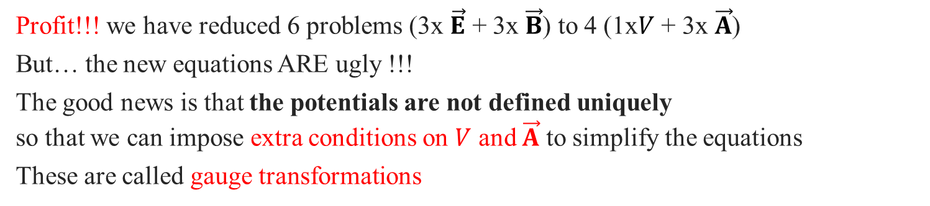
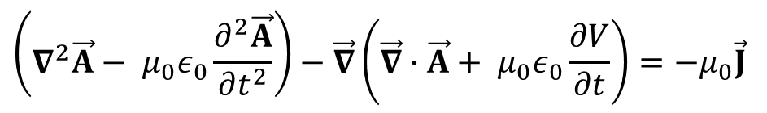
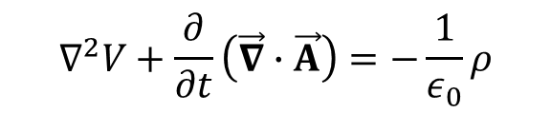
Scalar and vector potentials: self-reflection
5
$$∇^{2}V+\frac{∂}{∂t}\left(\vec{∇}∙\vec{A}\right)=−\frac{1}{ε_{0}}ρ$$
$$\left(∇^{2}\vec{A}−{{ μ}_{0}ε}_{0}\frac{∂^{2}\vec{A}}{∂t^{2}}\right)−\vec{∇}\left(\vec{∇}∙\vec{A}+{{ μ}_{0}ε}_{0}\frac{∂V}{∂t}\right)=−μ_{0}\vec{J}$$
Two new equations contain all the information in Maxwell’s equations:
• The potentials are defined on basis of noname and Faraday’s equations so these two are automatically taken care of
• The other two Maxwell’s equations (Gauss’ and Ampère-Maxwell’s laws) recast into the two equations above
Profit!!! we have reduced 6 problems (3x $\vec{E}$ + 3x $\vec{B}$) to 4 (1x$V$ + 3x $\vec{A}$)
But… the new equations ARE ugly !!!
The good news is that the potentials are not defined uniquely
so that we can impose extra conditions on $V$ and $\vec{A}$ to simplify the equations
These are called gauge transformations
Notes:
5

Slide 6


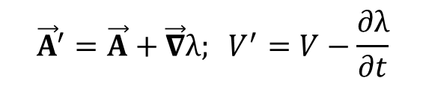


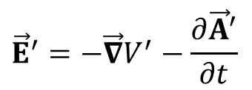
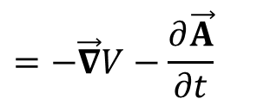

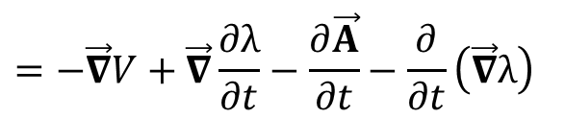
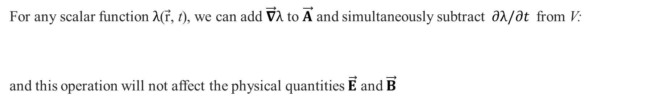

Gauge transformations theorem
6
Potentials are not defined uniquely!
Gauge transformations theorem:
For any scalar function $λ\text{(}\vec{\text{r}}\text{, }\text{t}\text{)}$, we can add $\vec{∇}λ$ to $\vec{A}$ and simultaneously subtract$∂λ/∂t$ from V:
and this operation will not affect the physical quantities $\vec{E}$ and $\vec{B}$
$${\vec{A}}^{′}=\vec{A}+\vec{∇}λ; V^{′}=V−\frac{∂λ}{∂t}$$
Proof:
$${\vec{B}}^{′}=\vec{∇}×{\vec{A}}^{′}$$
$$=\vec{∇}×\vec{A}+\vec{∇}×\vec{∇}λ$$
$$=\left[rule \#10:\vec{∇}×\vec{∇}λ=0\right]$$
$$=\vec{∇}×\vec{A}$$
$$=\vec{B}$$
$${\vec{E}}^{′}=−\vec{∇}V^{′}−\frac{∂{\vec{A}}^{′}}{∂t}$$
$$=−\vec{∇}V+\vec{∇}\frac{∂λ}{∂t}−\frac{∂\vec{A}}{∂t}−\frac{∂}{∂t}\left(\vec{∇}λ\right)$$
$$=−\vec{∇}V−\frac{∂\vec{A}}{∂t}$$
$$=\vec{E}$$
General proof: Section 10.1.2
Notes:
6

Slide 7
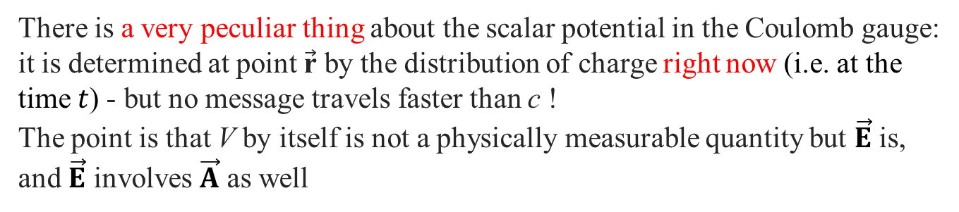



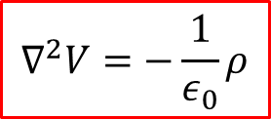


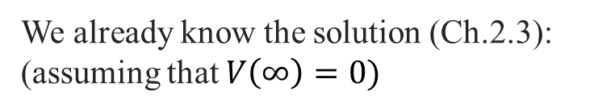

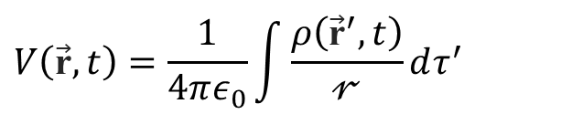


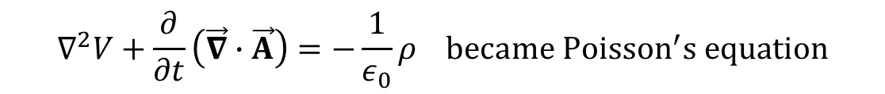
The Coulomb gauge
7
$$\vec{∇}∙\vec{A}=0$$
In magnetostatics, we picked (aka the Coulomb gauge)
$$∇^{2}V+\frac{∂}{∂t}\left(\vec{∇}∙\vec{A}\right)=−\frac{1}{ε_{0}}ρ became {Poisson}^{′}s equation$$
$$∇^{2}V=−\frac{1}{ε_{0}}ρ$$
$$𝒫$$
$$V\left(\vec{\text{r}},t\right)=\frac{1}{4πε_{0}}\int{\frac{ρ\left({\vec{\text{r}}}^{′},t\right)}{𝓇}}dτ^{′}$$
We already know the solution (Ch.2.3):
(assuming that $V\left(∞\right)=0)$
$$\vec{𝓻}$$
There is a very peculiar thing about the scalar potential in the Coulomb gauge:
it is determined at point $\vec{\text{r}}$ by the distribution of charge right now (i.e. at the time $t$) - but no message travels faster than c !
The point is that V by itself is not a physically measurable quantity but $\vec{E}$ is, and $\vec{E}$ involves $\vec{A}$ as well
$$dτ^{′}$$
$$\vec{r}$$
$${\vec{\text{r}}}^{′}$$
$$\vec{E}=−\vec{∇}V−\frac{∂\vec{A}}{∂t} with\left(∇^{2}\vec{A}−{{ μ}_{0}ε}_{0}\frac{∂^{2}\vec{A}}{∂t^{2}}\right)−\vec{∇}\left({{ μ}_{0}ε}_{0}\frac{∂V}{∂t}\right)=−μ_{0}\vec{J}$$
$$𝒪$$
$$\vec{𝓻}=\vec{r}−{\vec{\text{r}}}^{′}$$
Whereas V instantaneously reflects all changes in $ρ$, the combination $−\vec{∇}V−∂\vec{A}/∂t$ does not
$\vec{E}$ will change only after sufficient time has elapsed for the "news" to arrive
Notes:
7
$\vec{𝓻}$ is separation vector

Slide 8

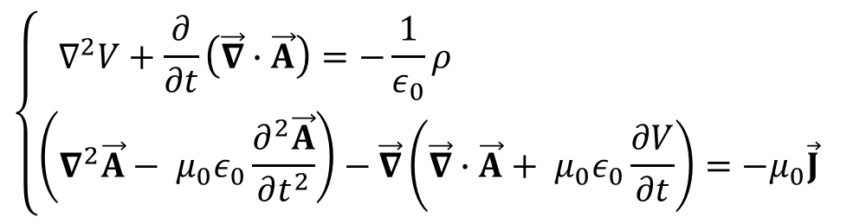
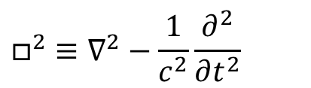

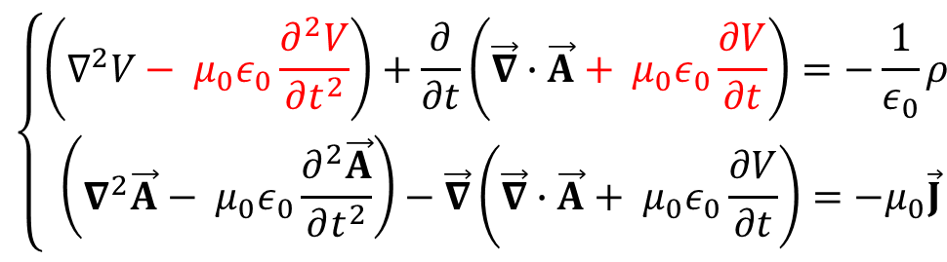
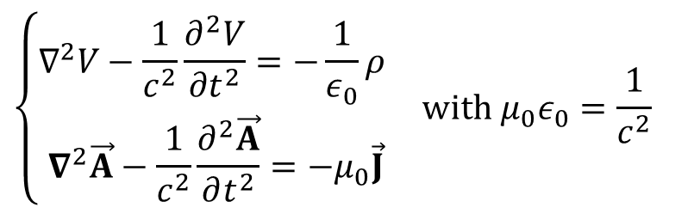
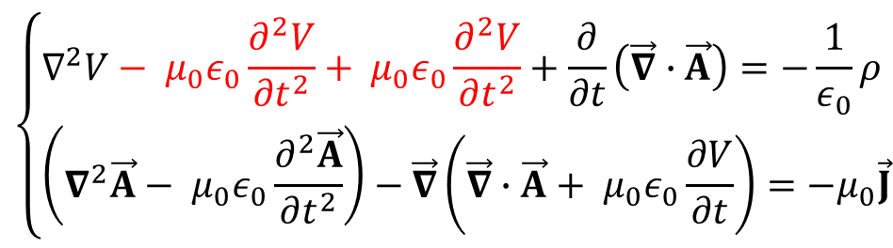
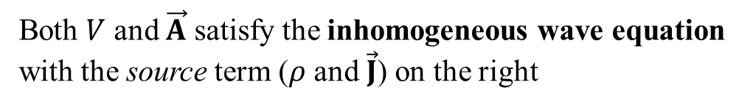
The Lorenz gauge
8
Let’s do a bit of transformations over the equations for potentials
$$\vec{∇}∙\vec{A}=−{{ μ}_{0}ε}_{0}\frac{∂V}{∂t}$$
Now we pick
$$\left\{\begin{aligned}∇^{2}V+\frac{∂}{∂t}\left(\vec{∇}∙\vec{A}\right)=−\frac{1}{ε_{0}}ρ \\ \left(∇^{2}\vec{A}−{{ μ}_{0}ε}_{0}\frac{∂^{2}\vec{A}}{∂t^{2}}\right)−\vec{∇}\left(\vec{∇}∙\vec{A}+{{ μ}_{0}ε}_{0}\frac{∂V}{∂t}\right)=−μ_{0}\vec{J} \end{aligned}\right.$$
It’s called the Lorenz gauge
NB1: Not Dutch H.A. Lorentz, but Danish L.V. Lorenz
NB2: In case of the static scalar potential, Coulomb and Lorenz gauges become identical
$$\left\{\begin{aligned}∇^{2}V−\frac{1}{c^{2}}\frac{∂^{2}V}{∂t^{2}}=−\frac{1}{ε_{0}}ρ \\ ∇^{2}\vec{A}−\frac{1}{c^{2}}\frac{∂^{2}\vec{A}}{∂t^{2}}=−μ_{0}\vec{J}\end{aligned}\right. with{{ μ}_{0}ε}_{0}=\frac{1}{c^{2}}$$
$$\left\{\begin{aligned}∇^{2}V−{{ μ}_{0}ε}_{0}\frac{∂^{2}V}{∂t^{2}}+{{ μ}_{0}ε}_{0}\frac{∂^{2}V}{∂t^{2}}+\frac{∂}{∂t}\left(\vec{∇}∙\vec{A}\right)=−\frac{1}{ε_{0}}ρ \\ \left(∇^{2}\vec{A}−{{ μ}_{0}ε}_{0}\frac{∂^{2}\vec{A}}{∂t^{2}}\right)−\vec{∇}\left(\vec{∇}∙\vec{A}+{{ μ}_{0}ε}_{0}\frac{∂V}{∂t}\right)=−μ_{0}\vec{J}\end{aligned}\right.$$
Both $V$ and $\vec{A}$ satisfy the inhomogeneous wave equation with the source term ($ρ$ and $\vec{J}$) on the right
$$□^{2}≡∇^{2}−\frac{1}{c^{2}}\frac{∂^{2}}{∂t^{2}}$$
$$\left\{\begin{aligned}\left(∇^{2}V−{{ μ}_{0}ε}_{0}\frac{∂^{2}V}{∂t^{2}}\right)+\frac{∂}{∂t}\left(\vec{∇}∙\vec{A}+{{ μ}_{0}ε}_{0}\frac{∂V}{∂t}\right)=−\frac{1}{ε_{0}}ρ \\ \left(∇^{2}\vec{A}−{{ μ}_{0}ε}_{0}\frac{∂^{2}\vec{A}}{∂t^{2}}\right)−\vec{∇}\left(\vec{∇}∙\vec{A}+{{ μ}_{0}ε}_{0}\frac{∂V}{∂t}\right)=−μ_{0}\vec{J}\end{aligned}\right.$$
d'Alembertian operator:
$$□^{2}V=−\frac{1}{ε_{0}}ρ; □^{2}\vec{A}=−μ_{0}\vec{J}$$
So electrodynamics is reduced to solving these equations
Notes:
8
Coulomb gauge $∇∙\vec{A}=0$ so that for static fields both gauges become identical

Slide 9
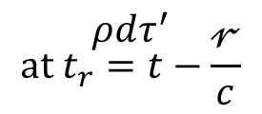


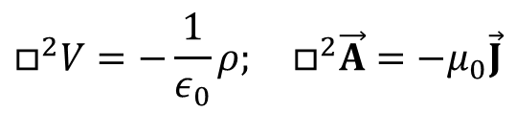
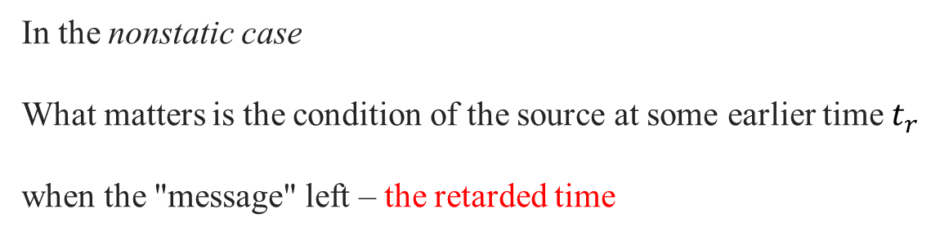

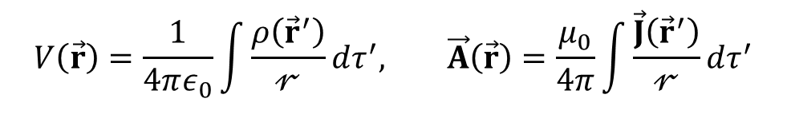

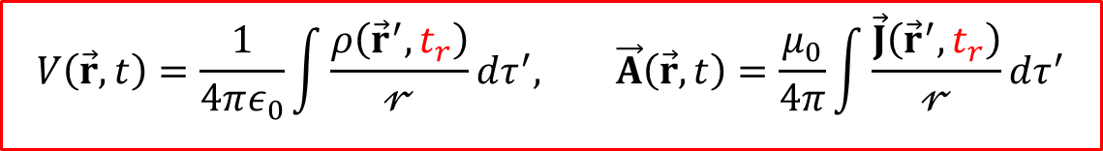
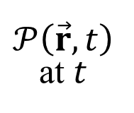
Retarded potentials
9
$$∇^{2}V=−\frac{1}{ε_{0}}ρ; ∇^{2}\vec{A}=−μ_{0}\vec{J}$$
In the static case
$$V\left(\vec{r}\right)=\frac{1}{4πε_{0}}\int{\frac{ρ\left({\vec{r}}^{′}\right)}{𝓇}}dτ^{′}, {}^{}\vec{A}\left(\vec{r}\right)=\frac{μ_{0}}{4π}\int{\frac{\vec{J}\left({\vec{r}}^{′}\right)}{𝓇}}dτ^{′}$$
$$𝒫\left(\vec{r},t\right)$$
at $t$
with the familiar solutions
$$□^{2}V=−\frac{1}{ε_{0}}ρ; □^{2}\vec{A}=−μ_{0}\vec{J}$$
In the nonstatic case
What matters is the condition of the source at some earlier time $t_{r}$
when the "message" left – the retarded time
$$\vec{𝓻}$$
$$t_{r}≡t−\frac{𝓇}{c}$$
$$\vec{r}$$
$${\vec{r}}^{′}$$
The generalized solutions are called retarded potentials
$$ρdτ^{′}$$
$$at t_{r}=t−\frac{𝓇}{c}$$
$$V\left(\vec{r},t\right)=\frac{1}{4πε_{0}}\int{\frac{ρ\left({\vec{r}}^{′},t_{r}\right)}{𝓇}}dτ^{′},{}^{}\vec{A}\left(\vec{r},t\right)=\frac{μ_{0}}{4π}\int{\frac{\vec{J}\left({\vec{r}}^{′},t_{r}\right)}{𝓇}}dτ^{′}$$
$$𝒪$$
$$\vec{𝓻}=\vec{r}−{\vec{\text{r}}}^{′}$$
All sounds reasonable - but surprisingly simple. Are we sure it's right?
We didn't actually derive the formulas for V and $\vec{A}$; we invoked a heuristic argument ("electromagnetic news travels at the speed of light") to make them seem plausible. Homework: prove the retarded potentials
Notes:
9
where $𝓇$ is the distance from the source point $\vec{r}$' to the field point $\vec{r}$

Slide 10
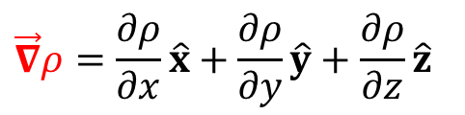




















Prove for the retarded potential $V\left(r,t\right)$
10
$$V\left(\vec{r},t\right)=\frac{1}{4πε_{0}}\int{\frac{ρ\left({\vec{r}}^{′},t_{r}\right)}{𝓇}}dτ^{′}$$
$$\left(∇^{2}−{{ μ}_{0}ε}_{0}\frac{∂^{2}}{∂t^{2}}\right)V=−\frac{1}{ε_{0}}ρ$$
satisfies the inhomogeneous wave equation
Important! In calculating the Laplacian, the crucial point to notice is that the integrand depends on $\vec{r}$ in two places: explicitly, in the denominator ($𝓇=\left|\vec{r}−{\vec{r}}^{′}\right|$), and implicitly, through $t_{r}=t−\frac{𝓇}{c}$, in the numerator. Thus
$$\vec{∇}V\left(\vec{r},t\right)=\frac{1}{4πε_{0}}\int{\left[\left(\vec{∇}ρ\right)\frac{1}{𝓇}+ρ\vec{∇}\left(\frac{1}{𝓇}\right)\right]}dτ^{′}$$
$$t_{r}≡t−\frac{𝓇}{c}$$
$$\vec{∇}ρ=\frac{∂ρ}{∂x}\hat{x}+\frac{∂ρ}{∂y}\hat{y}+\frac{∂ρ}{∂z}\hat{z}$$
$$=\frac{∂ρ}{∂t_{r}}\frac{∂t_{r}}{∂x}\hat{x}+\frac{∂ρ}{∂t_{r}}\frac{∂t_{r}}{∂y}\hat{y}+\frac{∂ρ}{∂t_{r}}\frac{∂t_{r}}{∂z}\hat{z}$$
$$=\frac{∂ρ}{∂t_{r}}\vec{∇}t_{r}$$
$$=\dot{ρ}\vec{∇}\left(t−\frac{𝓇}{c}\right)$$
$$=−\frac{1}{c}\dot{ρ} \vec{∇}𝓇$$
$$=\frac{∂}{∂x}{\left(x^{2}+y^{2}+z^{2}\right)}^{1/2} \hat{x}+\frac{∂}{∂y}\left(\right) \hat{y}+\frac{∂}{∂z}\left(\right) \hat{z}$$
$$=\frac{x \hat{x}+y \hat{y}+z \hat{z}}{{\left(x^{2}+y^{2}+z^{2}\right)}^{1/2}}$$
$$=\frac{\vec{𝓻}}{𝓻}$$
Note that $∂t_{r}=∂t$ as $𝓇$ is independent of $t$
$$\vec{∇}𝓇$$
$$=\hat{𝓻}$$
$$\vec{∇}\left(\frac{1}{𝓇}\right)$$
$$=\frac{∂}{∂x}{\left(x^{2}+y^{2}+z^{2}\right)}^{−1/2}\hat{ x}+\frac{∂}{∂y}\left(\right) \hat{y}+\frac{∂}{∂z}\left(\right) \hat{z}$$
$$=−\frac{x \hat{x}+y \hat{y}+z \hat{z}}{{\left(x^{2}+y^{2}+z^{2}\right)}^{3/2}}$$
$$=−\frac{\vec{𝓻}}{𝓇^{3}}$$
$$=−\frac{\hat{𝓻}}{𝓇^{2}}$$
$$\vec{∇} V\left(\vec{r},t\right)=\frac{1}{4πε_{0}}\int{\left[−\frac{\dot{ρ}}{c}\frac{\hat{𝓻}}{𝓇}−ρ\frac{\hat{𝓻}}{𝓇^{2}}\right]}dτ^{′}$$
Next calculate the divergence of $∇V\left(r,t\right)$
Notes:
10

Slide 11






















Prove for the retarded potential $V\left(r,t\right)$
11
$$=\frac{1}{4πε_{0}}\int{\left[−\frac{1}{c}\frac{\hat{𝓻}}{𝓇}∙\left(\vec{∇}\dot{ρ}\right)−\frac{\dot{ρ}}{c}\vec{∇}∙\left(\frac{\hat{𝓻}}{𝓇}\right)−\frac{\hat{𝓻}}{𝓇^{2}}∙\left(\vec{∇}ρ\right)−ρ\vec{∇}∙\left(\frac{\hat{𝓻}}{𝓇^{2}}\right)\right]}dτ^{′}$$
$$\vec{∇}V\left(\vec{r},t\right)=\frac{1}{4πε_{0}}\int{\left[−\frac{\dot{ρ}}{c}\frac{\hat{𝓻}}{𝓇}−ρ\frac{\hat{𝓻}}{𝓇^{2}}\right]}dτ^{′}$$
$$∇^{2}V\left(\vec{r},t\right)$$
$$\vec{∇}\dot{ρ}=−\frac{1}{c}\ddot{ρ} \vec{∇}𝓇=−\frac{1}{c}\ddot{ρ} \hat{𝓻};$$
$$−\frac{1}{c}\frac{\hat{𝓻}}{𝓇}∙\left(\vec{∇}\dot{ρ}\right)$$
$$=\frac{1}{c^{2}}\frac{\hat{𝓻}∙\hat{𝓻}}{𝓇}\ddot{ρ}$$
$$=\frac{1}{c^{2}}\frac{\ddot{ρ}}{𝓇}$$
(As $\vec{∇}ρ$ before)
$$(\vec{∇}ρ=−\frac{\dot{ρ}}{c}\hat{𝓻} before)$$
(Prob. 1.63)
$$−\frac{\dot{ρ}}{c}\vec{∇}∙\left(\frac{\hat{𝓻}}{𝓇}\right)=\left\langle \text{Prob}\text{. 1.63}\right\rangle =−\frac{\dot{ρ}}{c}\left(\frac{1}{𝓇^{2}}\right)=−\frac{\dot{ρ}}{c𝓇^{2}};$$
$$−\frac{\hat{𝓻}}{𝓇^{2}}∙\left(\vec{∇}ρ\right)$$
$$=−\frac{\hat{𝓻}}{𝓇^{2}}∙\left(−\frac{\dot{ρ}}{c}\hat{𝓻}\right)$$
$$=\frac{\hat{𝓻}∙\hat{𝓻}}{𝓇^{2}}\frac{\dot{ρ}}{c}$$
$$=\frac{\dot{ρ}}{c𝓇^{2}}$$
$$\vec{∇}∙\left(\frac{\hat{𝓻}}{𝓇^{2}}\right)=4πδ^{3}\left(\vec{𝓻}\right) \left(Eq.1.100\right);$$
$$−ρ\vec{∇}∙\left(\frac{\hat{𝓻}}{𝓇^{2}}\right)=−4πρδ^{3}\left(\vec{𝓻}\right)$$
Cancel
$$∇^{2}V\left(\vec{r},t\right)=\frac{1}{4πε_{0}}\int{\left[\frac{1}{c^{2}}\frac{\ddot{ρ}}{𝓇}−4πρδ^{3}\left(\vec{𝓻}\right)\right]}dτ^{′}$$
$$=\frac{1}{c^{2}}\frac{1}{4πε_{0}}\int{\frac{\ddot{ρ}}{𝓇}}dτ^{′}−\frac{1}{ε_{0}}ρ$$
$$\frac{∂^{2}V}{∂t^{2}}=\frac{1}{4πε_{0}}\int{\frac{\ddot{ρ}}{𝓇}}dτ^{′}$$
$$\left(∇^{2}−{{ μ}_{0}ε}_{0}\frac{∂^{2}}{∂t^{2}}\right)V$$
$$=\frac{1}{c^{2}}\frac{1}{4πε_{0}}\int{\frac{\ddot{ρ}}{𝓇}}dτ^{′}−\frac{1}{ε_{0}}ρ −\frac{1}{c^{2}}\frac{1}{4πε_{0}}\int{\frac{\ddot{ρ}}{𝓇}}dτ^{′}$$
$$=−\frac{1}{ε_{0}}ρ$$
q.e.d.
Homework: check that the retarded potentials obey the Lorenz gauge (Problem 10.10)
Notes:
11
quod erat demonstrandum

Slide 12








Why is it possible to define the Lorenz gauge as $∇∙\vec{A}=−{{ μ}_{0}ε}_{0}\frac{∂V}{∂t}$ ?
12
$$\text{Suppose} \text{that} \vec{∇}∙\vec{A}≠−{{ μ}_{0}ε}_{0}\frac{∂V}{∂t} so that \vec{∇}∙\vec{A}+{{ μ}_{0}ε}_{0}\frac{∂V}{∂t}=Φ$$
$${\vec{A}}^{′}=\vec{A}+\vec{∇}λ; V^{′}=V−\frac{∂λ}{∂t}$$
We want to pick $λ$ such that ${\vec{A}}^{′}$ and $V^{′}$ in
$$\vec{∇}∙{\vec{A}}^{′}+{{ μ}_{0}ε}_{0}\frac{∂V^{′}}{∂t}=0$$
do obey
How to pick?
$$\vec{∇}∙{\vec{A}}^{′}+{{ μ}_{0}ε}_{0}\frac{∂V^{′}}{∂t}$$
$$=\vec{∇}∙\vec{A}+∇^{2}λ+{{ μ}_{0}ε}_{0}\frac{∂V}{∂t}−{{ μ}_{0}ε}_{0}\frac{∂^{2}λ}{∂t^{2}}$$
$$=\vec{∇}∙\vec{A}+{{ μ}_{0}ε}_{0}\frac{∂V}{∂t}+∇^{2}λ−{{ μ}_{0}ε}_{0}\frac{∂^{2}λ}{∂t^{2}}$$
$$Φ$$
$$+ □^{2}λ$$
So that if we pick for $λ$ the solution to $□^{2}λ=−Φ$ (which we know how to solve!), $Φ+□^{2}λ=0$ and
$$\vec{∇}∙{\vec{A}}^{′}+{{ μ}_{0}ε}_{0}\frac{∂V^{′}}{∂t}=0$$
See Problem 10.6
Notes:
12

Slide 13





Lecture 30. Potentials and fields (1/2). Radiation (1/2)
13
What you should learn (Griffiths 10.2):
1. Retarded potentials
2. Efimenko’s equations
3. How slow is “slowly enough”?
$$V\left(\vec{r},t\right)=\frac{1}{4πε_{0}}\int{\frac{ρ\left({\vec{r}}^{′},t_{r}\right)}{𝓇}}dτ^{′},{}^{}\vec{A}\left(\vec{r},t\right)=\frac{μ_{0}}{4π}\int{\frac{\vec{J}\left({\vec{r}}^{′},t_{r}\right)}{𝓇}}dτ^{′}$$
$$t_{r}≡t−\frac{𝓇}{c}$$
$$\vec{E}(\vec{r},t)=\frac{1}{4πε_{0}}\int{\left[\frac{ρ({\vec{r}}^{′},t_{r})}{𝓇^{2}}\hat{𝓻}+\frac{1}{c𝓇}\frac{∂ρ({\vec{r}}^{′},t_{r})}{∂t}\hat{𝓻}−\frac{1}{c^{2}𝓇}\frac{∂\vec{J}\left({\vec{r}}^{′},t_{r}\right)}{∂t}\right]}dτ^{′}$$
$$\vec{B}(\vec{r},t)=\frac{μ_{0}}{4π}\int{\left[\frac{\vec{J}\left({\vec{r}}^{′},t_{r}\right)}{𝓇^{2}}+\frac{1}{c𝓇}\frac{∂\vec{J}\left({\vec{r}}^{′},t_{r}\right)}{∂t}\right]×}\hat{𝓻} dτ^{′}$$
$$𝓇≪\frac{c}{ω}$$
Notes:
13

Slide 14




Jefimenko’s equation for $\vec{E}(\vec{r}$,t) and $\vec{B}(\vec{r},t)$
14
If you apply the logic of retarded time to the fields, you'll get the entirely wrong answer:
$$\vec{E}\left(\vec{r},t\right)≠\frac{1}{4πε_{0}}\int{\frac{ρ\left({\vec{r}}^{′},t_{r}\right)}{𝓇^{2}}}\hat{𝓻} dτ^{′},{}^{}\vec{B}\left(\vec{r},t\right)≠\frac{μ_{0}}{4π}\int{\frac{\vec{J}\left({\vec{r}}^{′},t_{r}\right)×\hat{𝓻}}{𝓇^{2}}}dτ^{′}$$
$$t_{r}≡t−\frac{𝓇}{c}$$
BTW, this is why in electrodynamics we prefer to deal with the potentials rather then with the fields
$$\text{But} \text{you} \text{can} \text{find} \text{the} \text{fields} \vec{E} \text{and} \vec{B} \text{from} \text{the} \text{retarded} \text{potentials} \text{as} \vec{E}=−\vec{∇}V−\frac{∂\vec{A}}{∂t} and \vec{B}=∇×\vec{A}$$
$$\vec{E}(\vec{r},t)=\frac{1}{4πε_{0}}\int{\left[\frac{ρ({\vec{r}}^{′},t_{r})}{𝓇^{2}}\hat{𝓻}+\frac{1}{c𝓇}\frac{∂ρ({\vec{r}}^{′},t_{r})}{∂t}\hat{𝓻}−\frac{1}{c^{2}𝓇}\frac{∂\vec{J}\left({\vec{r}}^{′},t_{r}\right)}{∂t}\right]}dτ^{′}$$
Time-dependent generalization of
Coulomb's law
$$\vec{B}(\vec{r},t)=\frac{μ_{0}}{4π}\int{\left[\frac{\vec{J}\left({\vec{r}}^{′},t_{r}\right)}{𝓇^{2}}+\frac{1}{c𝓇}\frac{∂\vec{J}\left({\vec{r}}^{′},t_{r}\right)}{∂t}\right]×}\hat{𝓻} dτ^{′}$$
Time-dependent generalization of the Bio-Savart law
The equations were first obtained by Oleg Jefimenko in 1966
(Homework: Chapter 10.2.2 and two slides at the end)
Notes:
14

Slide 15










How slow is slowly enough?
15
$$\vec{B}(\vec{r},t)=\frac{μ_{0}}{4π}\int{\left[\frac{\vec{J}\left({\vec{r}}^{′},t_{r}\right)}{𝓇^{2}}+\frac{1}{c𝓇}\frac{∂\vec{J}\left({\vec{r}}^{′},t_{r}\right)}{∂t}\right]×}\hat{𝓻} dτ^{′}$$
Let’s request the time-dependent term be much smaller than the previous one:
$$\left|\frac{1}{c𝓇}\frac{∂\vec{J}}{∂t}\right|≪\left|\frac{\vec{J}}{𝓇^{2}}\right|$$
This is the quasistatic approximation
$$\left|\frac{1}{J}\frac{∂J}{∂t}\right|≪\frac{c}{𝓇}$$
The rate of the relative change of the current is much smaller than the time it takes to get to the observation point
$$Suppose J=J_{0}e^{iωt}: \left|\frac{1}{J_{0}e^{iωt}}\left(iω\right)J_{0}e^{iωt}\right|≪\frac{c}{𝓇}$$
$$, or ω≪\frac{c}{𝓇}$$
$$, or 𝓇≪\frac{c}{ω}$$
(It is called the near zone)
$$=\frac{3∙{10}^{8}}{2π∙50}$$
$$For ν=50 Hz,𝓇≪\frac{c}{2πν}$$
$$≈{10}^{6} m$$
$$For ν=5 GHz,𝓇≪\frac{3∙{10}^{8}}{2π∙{5∙10}^{9}}≈1 cm$$
-- quasistatic approximation doesn’t work in a computer
We just answered a long-standing question in the course of E&M:
The quasistatic approximation can be safely used for many problems which do not involve either long distances or high frequencies – as we did many times before
Notes:
15
384,400 km

Slide 16
YouTube resources
16
Youtube lectures by Jonathan Gardner: https://www.youtube.com/playlist?list=PLDDEED00333C1C30E
Scalar and vector potentials: https://www.youtube.com/watch?v=gc8NvnlMawY
Gauge transformations: https://www.youtube.com/watch?v=7du0vyQ99mQ
The Coulomb gauge: https://www.youtube.com/watch?v=saX9EVKx82E
Lorentz gauge: https://www.youtube.com/watch?v=MAz1eo-Zwjk
Retarded potentials:
Part 1/3 https://www.youtube.com/watch?v=G4MdRbV-bgU
Part 3/3 https://www.youtube.com/watch?v=z9lC1rGLqDo&t=0s
Part 3/3 https://www.youtube.com/watch?v=0TXS9A6tjK4&t=49s
Notes:
16

Slide 17







Derivation of Jefimenko’s equation for $\vec{E}(\vec{r}$,t)
$$\text{Extra}$$
17
$$\text{Let}\text{’}\text{s} \text{find} \text{the} \text{field} \vec{E}=−\vec{∇}V−\frac{∂\vec{A}}{∂t} from V\left(\vec{r},t\right)=\frac{1}{4πε_{0}}\int{\frac{ρ\left({\vec{r}}^{′},t_{r}\right)}{𝓇}}dτ^{′},{}^{}\vec{A}\left(\vec{r},t\right)=\frac{μ_{0}}{4π}\int{\frac{\vec{J}\left(r^{′},t_{r}\right)}{𝓇}}dτ^{′}$$
$$\vec{∇}V\left(\vec{r},t\right)=\frac{1}{4πε_{0}}\int{\left[−\frac{\dot{ρ}}{c}\frac{\hat{𝓻}}{𝓇}−ρ\frac{\hat{𝓻}}{𝓇^{2}}\right]}dτ^{′}$$
(was already calculated a few slides earlier)
$$\frac{∂\vec{A}\left(\vec{r},t\right)}{∂t}$$
$$=\frac{μ_{0}}{4π}\int{\frac{1}{𝓇}\frac{∂\vec{J}\left({\vec{r}}^{′},t_{r}\right)}{∂t_{r}}\frac{∂t_{r}}{∂t}}dτ^{′}$$
$$=\frac{ε_{0}μ_{0}}{4πε_{0}}\int{\frac{\dot{\vec{J}}\left({\vec{r}}^{′},t_{r}\right)}{𝓇}}dτ^{′}$$
$$=\frac{1}{4πε_{0}c^{2}}\int{\frac{\dot{\vec{J}}\left({\vec{r}}^{′},t_{r}\right)}{𝓇}}dτ^{′}, where \dot{\vec{J}}≡\frac{∂\vec{J}}{∂t_{r}}$$
$$\vec{E}(\vec{r},t)=\frac{1}{4πε_{0}}\int{\left[\frac{ρ({\vec{r}}^{′},t_{r})}{𝓇^{2}}\hat{𝓻}+\frac{\dot{ρ} ({\vec{r}}^{′},t_{r})}{c𝓇}\hat{𝓻}−\frac{\dot{\vec{J}}\left({\vec{r}}^{′},t_{r}\right)}{c^{2}𝓇}\right]}dτ^{′}$$
Notes:
17

Slide 18













Derivation of Jefimenko’s equation for $\vec{B}(\vec{r}$,t)
$$\text{Extra}$$
18
$$\vec{A}\left(\vec{r},t\right)=\frac{μ_{0}}{4π}\int{\frac{\vec{J}\left({\vec{r}}^{′},t_{r}\right)}{𝓇}}dτ^{′}$$
$$t_{r}≡t−\frac{𝓇}{c}$$
$$\vec{B}=\vec{∇}×\vec{A}$$
$$\left|\begin{matrix}\hat{x} & \hat{y} & \hat{z} \\ {\dot{J}}_{x} & {\dot{J}}_{y} & {\dot{J}}_{z} \\ \frac{1}{c}\frac{∂𝓇}{∂x} & \frac{1}{c}\frac{∂𝓇}{∂y} & \frac{1}{c}\frac{∂𝓇}{∂z}\end{matrix}\right|$$
Let’s find the field
Rule #7
$$\vec{B}=\frac{μ_{0}}{4π}\int{\left[\frac{1}{𝓇}\left(\vec{∇}×\vec{J}\right)−\vec{J}×\vec{∇}\left(\frac{1}{𝓇}\right)\right]}dτ^{′}$$
$${\left(\vec{∇}×\vec{J}\right)}_{x}=\frac{∂J_{z}}{∂y}−\frac{∂J_{y}}{∂z}$$
$$=\frac{∂J_{z}}{∂t_{r}}\frac{∂t_{r}}{∂y}−\frac{∂J_{y}}{∂t_{r}}\frac{∂t_{r}}{∂z}$$
$$={\dot{J}}_{z}\left(−\frac{1}{c}\frac{∂𝓇}{∂y}\right)−{\dot{J}}_{y}\left(−\frac{1}{c}\frac{∂𝓇}{∂z}\right)$$
$$=\frac{1}{c}{\left[\dot{\vec{J}}×\left(\vec{∇}𝓇\right)\right]}_{x}$$
$$=\frac{1}{c}{\left[\dot{\vec{J}}×\hat{𝓻}\right]}_{x}$$
$$\vec{∇}×\vec{J}=\frac{1}{c}\dot{\vec{J}}×\hat{𝓻};$$
$$\vec{∇}\left(\frac{1}{𝓇}\right)=−\frac{\hat{𝓻}}{𝓇^{2}}$$
$$\vec{B}(\vec{r},t)=\frac{μ_{0}}{4π}\int{\left[\frac{\vec{J}\left({\vec{r}}^{′},t_{r}\right)}{𝓇^{2}}+\frac{\dot{\vec{J}}\left({\vec{r}}^{′},t_{r}\right)}{c𝓇}\right]×}\hat{𝓻} dτ^{′}$$
This is the time-dependent generalization of the Bio-Savart law
Notes:
18

Slide 19







From Jefimenko’s to Coulomb’s for $\vec{E}(\vec{r}$,t)
$$\text{Extra}$$
19
$$\vec{E}(\vec{r},t)=\frac{1}{4πε_{0}}\int{\left[\frac{ρ({\vec{r}}^{′},t_{r})}{𝓇^{2}}\hat{𝓻}+\frac{1}{c𝓇}\frac{∂ρ({\vec{r}}^{′},t_{r})}{∂t}\hat{𝓻}−\frac{1}{c^{2}𝓇}\frac{∂\vec{J}\left({\vec{r}}^{′},t_{r}\right)}{∂t}\right]}dτ^{′}$$
Let’s suppose $\vec{J}=const$ in time (magnetostatics approximation), so that $\dot{\vec{J}}=0$ and the 3rd term $=0$
Let’s expand $ρ\left({\vec{r}}^{′},t_{r}\right)$ into Taylor’s series around $t_{r}=0$ $(∂t_{r}=∂t$ as $𝓇$ is independent of $t$):
$$≅ρ\left({\vec{r}}^{′},0\right)+\frac{∂ρ\left({\vec{r}}^{′}, 0\right)}{∂t_{r}}t_{r}$$
$$ρ\left({\vec{r}}^{′},t_{r}\right)=ρ\left({\vec{r}}^{′},t_{r}=0\right)+\frac{∂ρ\left({\vec{r}}^{′},t_{r}=0\right)}{∂t_{r}}t_{r}+…$$
$$\frac{∂ρ({\vec{r}}^{′},t_{r})}{∂t_{r}}=\frac{∂ρ({\vec{r}}^{′},0)}{∂t_{r}}$$
$$t_{r}≡t−\frac{𝓇}{c}$$
$$\vec{E}\left(\vec{r},t\right)=\frac{1}{4πε_{0}}\int{\left[\frac{ρ\left({\vec{r}}^{′},0\right)}{𝓇^{2}}+\frac{1}{𝓇^{2}}\frac{∂ρ\left({\vec{r}}^{′}, 0\right)}{∂t_{r}}t_{r}+\frac{1}{c𝓇}\frac{∂ρ({\vec{r}}^{′},0)}{∂t_{r}}\right]}\hat{𝓻} dτ^{′}$$
$$≅ρ\left({\vec{r}}^{′},t\right)$$
$$=\frac{1}{4πε_{0}}\int{\left[\frac{1}{𝓇^{2}}\left(ρ\left({\vec{r}}^{′},0\right)+\frac{∂ρ\left({\vec{r}}^{′}, 0\right)}{∂t}t\right)−\frac{1}{𝓇^{2}}\frac{∂ρ\left({\vec{r}}^{′}, 0\right)}{∂t_{r}}\frac{𝓇}{c}+\frac{1}{c𝓇}\frac{∂ρ({\vec{r}}^{′},0)}{∂t_{r}}\right]\hat{𝓻}}dτ^{′}$$
$$=\frac{1}{4πε_{0}}\int{\frac{ρ\left({\vec{r}}^{′},t\right)}{𝓇^{2}}\hat{𝓻} dτ^{′}}$$
This is Coulomb's law with $\vec{J}=const$ and the charge density evaluated at the non-retarded time
The static approximation works much better than we had any right to expect:
the two errors involved (neglecting retardation and the time-dependent term $\frac{∂ρ({\vec{r}}^{′},t_{r})}{∂t_{r}}$) cancel one another
Notes:
19

Slide 20










From Jefimenko’s to Bio-Savart’s for $\vec{B}(\vec{r},t)$
$$\text{Extra}$$
20
$$\vec{B}(\vec{r},t)=\frac{μ_{0}}{4π}\int{\left[\frac{\vec{J}\left({\vec{r}}^{′},t_{r}\right)}{𝓇^{2}}+\frac{1}{c𝓇}\frac{∂\vec{J}\left({\vec{r}}^{′},t_{r}\right)}{∂t}\right]×}\hat{𝓻} dτ^{′}$$
$$\vec{J}\left({\vec{r}}^{′},t_{r}\right)=\vec{J}\left({\vec{r}}^{′},t\right)+\frac{∂\vec{J}\left({\vec{r}}^{′},t\right)}{∂t_{r}}\left(t_{r}−t\right)+…$$
Let’s expand $\vec{J}\left({\vec{r}}^{′},t_{r}\right)$ into the Taylor series around $t_{r}=t$:
Suppose the current density changes slowly enough that we can ignore all higher derivatives
$$\vec{J}\left({\vec{r}}^{′},t_{r}\right)≅\vec{J}\left({\vec{r}}^{′},t\right)+\frac{∂\vec{J}\left({\vec{r}}^{′},t\right)}{∂t_{r}}\left(t_{r}−t\right)$$
$$=\vec{J}\left({\vec{r}}^{′},t\right)−\frac{∂\vec{J}\left({\vec{r}}^{′},t\right)}{∂t_{r}}\frac{𝓇}{c}$$
$$t_{r}−t≡−\frac{𝓇}{c}$$
$$t_{r}≡t−\frac{𝓇}{c}$$
$$\frac{∂\vec{J}\left({\vec{r}}^{′},t_{r}\right)}{∂t_{r}}=\frac{∂\vec{J}\left({\vec{r}}^{′},t\right)}{∂t_{r}}$$
$$\vec{B}(\vec{r},t)=\frac{μ_{0}}{4π}\int{\left[\frac{\vec{J}\left({\vec{r}}^{′},t\right)}{𝓇^{2}}−\frac{1}{𝓇^{2}}\frac{∂\vec{J}\left({\vec{r}}^{′},t\right)}{∂t_{r}}\frac{𝓇}{c}+\frac{1}{c𝓇}\frac{∂\vec{J}\left({\vec{r}}^{′},t\right)}{∂t_{r}}\right]×}\hat{𝓻} dτ^{′}$$
$$=\frac{μ_{0}}{4π}\int{\frac{\vec{J}\left({\vec{r}}^{′},t\right)×\hat{𝓻}}{𝓇^{2}}} dτ^{′}$$
This is the Bio-Savart law with the current density evaluated at the non-retarded time
The quasistatic approximation is actually much better than we had any right to expect:
the two errors involved (neglecting retardation and the time-dependent term $\frac{∂\vec{J}\left({\vec{r}}^{′},t_{r}\right)}{∂t_{r}}$) cancel one another
This lends strong support to the quasistatic approximation used by us earlier
Notes:
20

Slide 21







How slow is slowly enough? Another approach
$$\text{Extra}$$
21
$$\vec{J}\left({\vec{r}}^{′},t_{r}\right)=\vec{J}\left({\vec{r}}^{′},t\right)+\frac{∂\vec{J}\left({\vec{r}}^{′},t\right)}{∂t_{r}}\left(t_{r}−t\right)+…$$
For the Taylor series to converge, we need to request the next term be smaller than the previous one:
$$\left|\frac{∂\vec{J}\left({\vec{r}}^{′},t\right)}{∂t_{r}}\left(t_{r}−t\right)\right|≪\left|\vec{J}\left({\vec{r}}^{′},t\right)\right|$$
This is the quasistatic approximation
$$\left|\frac{∂J}{∂t}\frac{𝓇}{c}\right|≪\left|J\right|;$$
$$\left|\frac{1}{J}\frac{∂J}{∂t}\right|≪\frac{c}{𝓇}$$
The rate of the change of the relative change is much smaller than the time it takes to get to the observation point
$$Suppose J=J_{0}e^{iωt}: \left|\frac{1}{J_{0}e^{iωt}}\left(iω\right)J_{0}e^{iωt}\right|≪\frac{c}{𝓇}$$
$$, or ω≪\frac{c}{𝓇}$$
$$, or 𝓇≪\frac{c}{ω}$$
(It is called the near zone)
$$=\frac{3∙{10}^{8}}{2π∙50}$$
$$For ν=50 Hz,𝓇≪\frac{c}{2πν}$$
$$≈{10}^{6} m$$
$$For ν=5 GHz,𝓇≪\frac{3∙{10}^{8}}{2π∙{5∙10}^{9}}≈1 cm$$
-- quasistatic approximation doesn’t work in a computer
We just answered a long-standing question in the course of E&M:
The quasistatic approximation can be safely used for many problems which do not involve either long distances or high frequencies – as we did many times before
Notes:
21
384,400 km

